Slide 1
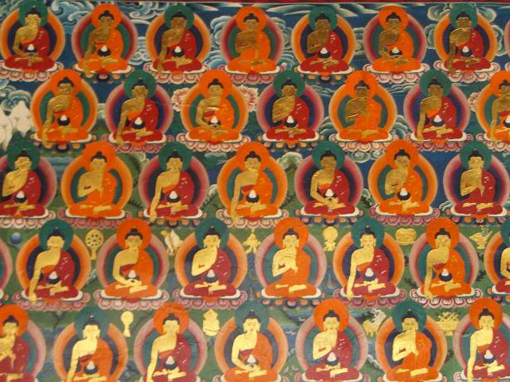
The Three Marks of Existence
Focus.
What are Buddhist beliefs about the nature of life?
To start...
Quiz.
https://play.kahoot.it/#/?quizId=95c4f3e5-4fd3-49ae-9916-f562408c6ed4

Slide 2
The Three Marks of Existence
Explain….
Explain, with examples why material things are impermanent.
Explain with examples why human beings/life are/is impermanent.

Slide 3
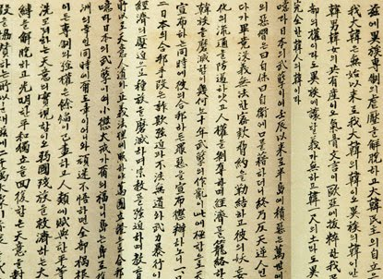
The Three Marks of Existence
Read about Anicca and explain…
Explain with examples, how material things are impermanent.
2. Explain with examples, how humans are impermanent.
3. How can acceptance of anicca help to reduce
suffering. Use examples to aid your explanation.
4. Explain clearly why anicca links to dukkha.

Slide 4
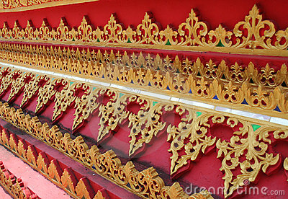
The Three Marks of Existence
Explain...
1. How can acceptance of anicca help to reduce suffering.
Use examples to aid your explanation.
2. Explain clearly why anicca links to dukkha.
Discussion and notes…
Does there seem to be anything at all that is permanent?
Do you agree with the Buddhist teaching that it is positive to understand and accept impermanence?

Slide 5
The Three Marks of Existence
Explain...
Explain the Buddhist idea of ‘no-self’.
How does the idea of anatta link to the idea of anicca?
How do the Three Marks of Existence link to each other?
Exam Questions…
Explore the Buddhist teaching of the Three Marks of Existence. (8 marks)
Assess the importance of the Three Marks of Existence. (9 marks)

