Slide 1
Buddhist Scriptures in More Detail
Focus;
How is the Pali Canon used and understood?
To start – recap quiz… Buddhist Scriptures
https://play.kahoot.it/#/?quizId=9b98df1a-651b-4304-be8e-cb4d01c7a945

Slide 2
Buddhist Scriptures in More Detail
The Vinaya Pitaka;
Read the information from your booklet and summarise the main points of each part of the Vinaya Pitaka. Do this on the table provided.
The Sutta Pitaka:
Read the information and summarise the main points of each the Sutta Pitaka.
http://en.dhammadana.org/sangha/vinaya/227.htm

Slide 3
Buddhist Scriptures in More Detail
Explain…
1. What does Abidharma Pitaka mean?
2. How is it different to the other parts of the Tipitaka?
3. When did it come about and why?
Note down some of the main works within the
Abidharma Pitaka.

Slide 4
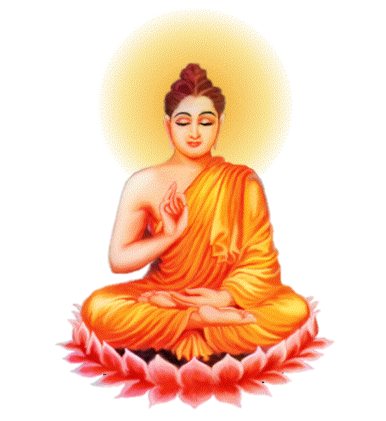
Buddhist Scriptures in More Detail
Explain…
How is the Tipitaka used by different groups of Buddhists?
How were the different collections of discourses brought together as the Tipitaka?
Could it be said that the Abidharma Pitaka is not the work of Buddha himself.

Slide 5
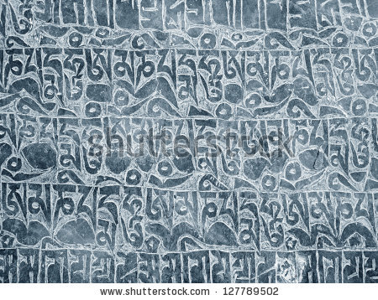
Buddhist Scriptures in More Detail
Exam Questions;
Assess the significance of the Tipitaka as the source of the Buddha’s teachings. [9 marks]
2. Assess the importance of the Buddhist scriptures
to the monastic sangha (community). [9 marks]

