Slide 1
Buddha’s Enlightenment
Focus.
What was significant about Buddha’s Enlightenment?
DLOs
To use pictures to show re-tell about the life of Siddhartha Gautama and how he became Buddha.
To understand the importance of the Four Sights and Buddha’s Enlightenment.
To combine knowledge learnt in both lessons to make connections between the Life of Siddartha Gautama and Buddha’s enlightenment.

Slide 2
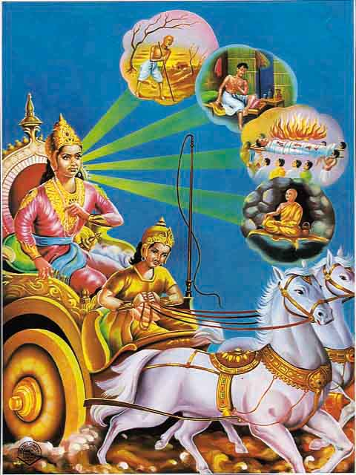
Buddha’s Enlightenment
Quick Task.
What were the Four Sights?
Why were the Four
Sights so significant
in the development of
Buddhism?

Slide 3
Buddha’s Enlightenment
Next...
Watch the video clip and read about Buddha’s enlightenment and complete the tasks on the sheet.
and then....
Draw up a table outlining causes of suffering and happiness according to Buddha.
Explain…
Why some of the examples on your table
can cause suffering and happiness.

Slide 4
Buddha’s Enlightenment
Happiness | Suffering
Awareness
 | Status

Slide 5
Buddha’s Enlightenment
… and finally – connecting ideas.
Note down at least 5 things you learnt last lesson and 5 things you learnt this lesson and make connections between your points.
Previous lesson’s learning
This lesson’s learning
Connecting learning

