Slide 1
Crime & Punishment

Slide 2
Crime, Christianity & Human Nature
Key Question: What does Christianity teach about crime & punishment?

Slide 3
Contents of this amazing PowerPoint
Human nature
Wrong-doing
Forgiveness

Slide 4
Christianity
1 John 1:8-9
If we say we have no sin, we deceive ourselves, and the truth is not in us. If we confess our sins, he is faithful and just to forgive us our sins and to cleanse us from all unrighteousness.

Slide 5
Christianity
Biblical Law
613 laws written in Genesis, Exodus, Leviticus, Numbers and Deuteronomy
Exodus 21:24 ‘An eye for an eye, a tooth for a tooth…’
Exodus 22
https://www.biblegateway.com/passage/?search=Exodus%2022&version=NIVUK

Slide 6
Christianity
Romans 1-3
http://www.biblegateway.com/passage/?search=Romans+1-3&version=NIVUK

Slide 7
Psalm 51
Written by King David after committing adultery with Bathsheba and arranging the death of her husband.
Miserere mei, Deus. ‘God be merciful to me.’
http://www.youtube.com/watch?v=36Y_ztEW1NE
https://www.biblegateway.com/passage/?search=ps+51&version=ESVUK
Notes:
The link is to Allegri’s Miserere based on this Psalm. I use it for background atmosphere and give the story of David & Bathsheba in some detail to fill in the context of the Psalm.

Slide 8
Psalm 51
God be Merciful to Me by Jars of Clay
1. Describe David’s feelings
in this song.
2. What is his attitude
towards his crime?
3. What does he want from
God?
Notes:
Pupils put subheading and copy down the questions.

Slide 9
Psalm 51
Vocab
grace – undeserved kindness
transgression – sin
just - fair
wrath – anger
steadfast – immovable, determined
contrite – sorry
http://www.youtube.com/watch?v=Mu6R8fh4Llo
Notes:
To save lesson time, this slide could be printed and stuck in.

Slide 10
Psalm 51
God be merciful to me,
On Thy grace I rest my plea.
Plenteous in compassion Thou,
Blot out my transgressions now.
Wash me, make me pure within,
Cleanse, oh cleanse me from my sin.

Slide 11
Psalm 51
My transgressions I confess,
Grief and guilt my soul oppress.
I have sinned against Thy grace,
And provoked Thee to Thy face.
I confess Thy judgement just,
Speechless, I Thy mercy trust.

Slide 12
Psalm 51
I am evil born in sin,
Thou desirest truth within.
Thou alone my Savior art,
Teach Thy wisdom to my heart.
Make me pure, Thy grace bestow,
Wash me whiter than the snow.

Slide 13
Psalm 51
Gracious God, my heart renew.
Make my spirit right and true.
Thy salvation’s joy impart,
Steadfast make my willing heart.
Steadfast make my willing heart.

Slide 14
Psalm 51
Broken, humbled to the dust,
By Thy wrath and judgement just.
Let my contrite heart rejoice,
And in gladness hear Thy voice.
From my sins, oh hide Thy face,
Blot them out in boundless grace.

Slide 15
Christianity
Romans 6:23a ‘The wages of sin is death…’

Slide 16
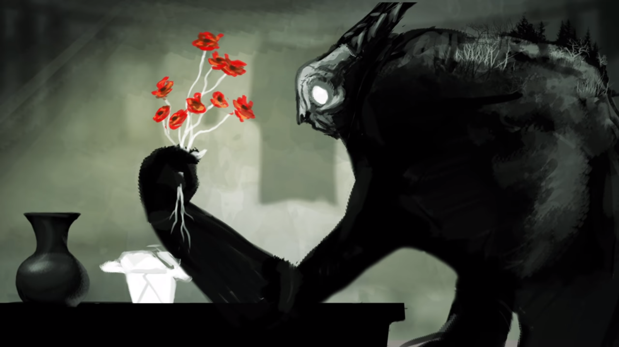
Born Again by Josh Garrels
https://www.youtube.com/watch?v=iBWeRK-j0Hw

Slide 17
The Humility of Christ by Timothy Brindle
1. According to Timothy Brindle, who is Jesus?
2. What is the purpose of his coming to earth?
3. What are the two ways in which God deals with human crime?
http://www.youtube.com/watch?v=nf6EUKPHQMU

Slide 18
The Parable of the Unmerciful Servant
Matthew chapter 18
Summarise what happens in the story.
What is Jesus saying about forgiveness in this parable?
https://www.biblegateway.com/passage/?search=mat+18&version=ESVUK

Slide 19
‘Forgiveness’ by Matthew West
Describe the story that inspired Matthew West to write his song called ‘Forgiveness’.
https://www.youtube.com/watch?v=wz3tkHv5sbg

Slide 20
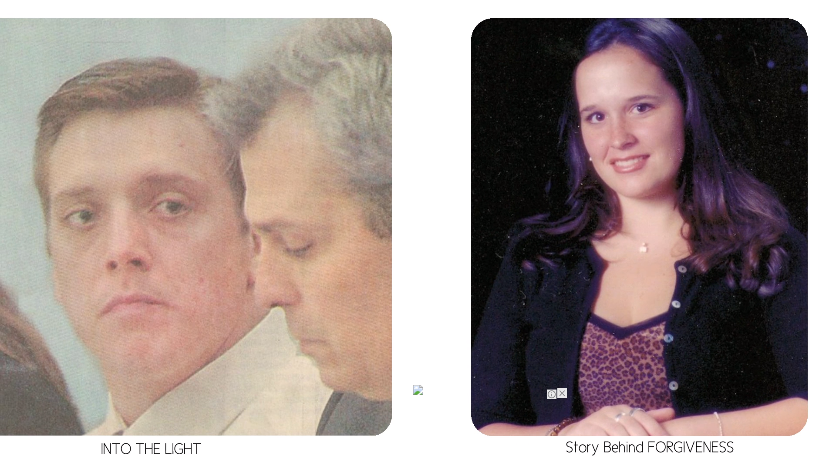
‘Forgiveness’ by Matthew West
Describe the story that inspired Matthew West to write his song called ‘Forgiveness’.
https://www.youtube.com/watch?v=wz3tkHv5sbg
11th May 2002
Eric Smallridge
Meagan Napier
Renee Napier

Slide 21
http://www.youtube.com/watch?v=xfkhqpl81NA
Give at least two teachings about forgiveness from the song.

Slide 22
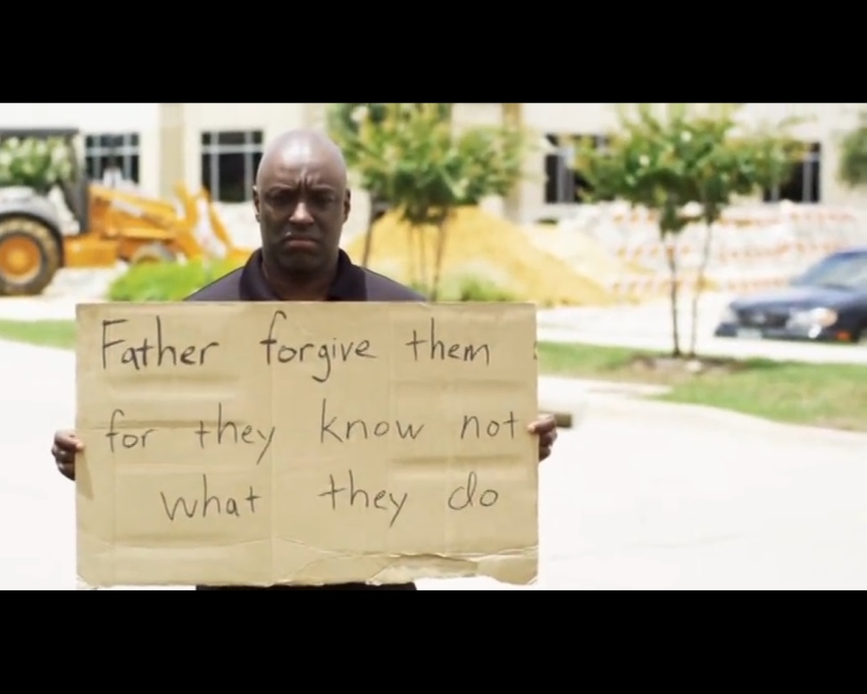
Signs of forgiveness
What does this video say about forgiveness?
http://www.youtube.com/watch?v=FxoMbPWuk0I

Slide 23
Christianity
Romans 6:23a ‘The wages of sin is death…’
Romans 6:23b ‘… but the gift of God is eternal life in Jesus Christ, our Lord.’

Slide 24
Christianity
Acts 2:38
And Peter said to them, “Repent and be baptized every one of you in the name of Jesus Christ for the forgiveness of your sins …”

Slide 25
Application
Christians believe criminals deserve to be punished.
However, Christians believe they themselves deserve to be punished as well.
They are no better than criminals in God’s sight.
They need to show forgiveness to criminals too if they want God to forgive them for their sins.
This does not mean that criminals should not be punished with jail etc.

Slide 26
Homework
Find a news story about crime and bring it in for next RS lesson.
This could be a printout from the internet or it could be from a newspaper or other source.

Slide 27
Conscience
What is a conscience? Talk to the person next to you and try to write a definition.

