Slide 1
Crime & Punishment

Slide 2
Crime, Christianity & Human Nature
Key Question: What does Christianity teach about crime & punishment?

Slide 3
Contents of this amazing PowerPoint
Human nature
Wrong-doing
Forgiveness & grace

Slide 4
Christianity
1 John 1:8-9
If we say we have no sin, we deceive ourselves, and the truth is not in us. If we confess our sins, he is faithful and just to forgive us our sins and to cleanse us from all unrighteousness.
Notes:
This is printed on the handout.

Slide 5
Christianity
Biblical Law
613 laws written in Genesis, Exodus, Leviticus, Numbers and Deuteronomy
Exodus 21:24 ‘An eye for an eye, a tooth for a tooth…’
Exodus 22
https://www.biblegateway.com/passage/?search=Exodus%2022&version=NIVUK
Notes:
Example laws from the Bible

Slide 6
Christianity
Romans 1-3
http://www.biblegateway.com/passage/?search=Romans+1-3&version=NIVUK
Notes:
If you have a lot of time or a very motivated class you can read through these three chapters that explain the NT view of the human condition as corrupt and fallen but capable of being redeemed and forgiven.

Slide 7
Christianity
Romans 6:23a ‘The wages of sin is death…’

Slide 8

Psalm 51
  Written by King David after committing adultery with Bathsheba and arranging the death of her husband.
  Miserere mei, Deus. ‘God be merciful to me.’
http://www.youtube.com/watch?v=36Y_ztEW1NE
https://www.biblegateway.com/passage/?search=ps+51&version=ESVUK
The full story of David’s life is described in the Bible in 1 Samuel chapters 16-31; the whole of 2 Samuel and 1 Kings 1-2. The Jewish Star of David is named after him.
Notes:
The link is to Allegri’s Miserere based on this Psalm. I use it for background atmosphere and give the story of David & Bathsheba in some detail to fill in the context of the Psalm. This is told in 2 Samuel 11 – 12 https://www.blueletterbible.org/nasb95/2sa/11/1-31/s_278001 https://www.blueletterbible.org/nasb95/2sa/12/1/s_279001

Slide 9

Psalm 51
  God be Merciful to Me by Jars of Clay
  1. Describe David’s feelings
  in this song.
  2. What is his attitude
  towards his crime?
  3. What does he want from
  God?
Notes:
Pupils put subheading and copy down the questions.

Slide 10

Psalm 51
Vocab
grace – undeserved kindness
transgression – sin
just - fair
wrath – anger
steadfast – immovable, determined
contrite – sorry
thee/thou – you (singular)
thine/thy – your (singular)
http://www.youtube.com/watch?v=Mu6R8fh4Llo
Notes:
To save lesson time, this slide could be printed and stuck in.

Slide 11
Psalm 51
God be merciful to me,
On Thy grace I rest my plea.
Plenteous in compassion Thou,
Blot out my transgressions now.
Wash me, make me pure within,
Cleanse, oh cleanse me from my sin.

Slide 12
Psalm 51
My transgressions I confess,
Grief and guilt my soul oppress.
I have sinned against Thy grace,
And provoked Thee to Thy face.
I confess Thy judgement just,
Speechless, I Thy mercy trust.

Slide 13
Psalm 51
I am evil born in sin,
Thou desirest truth within.
Thou alone my Savior art,
Teach Thy wisdom to my heart.
Make me pure, Thy grace bestow,
Wash me whiter than the snow.

Slide 14
Psalm 51
Gracious God, my heart renew.
Make my spirit right and true.
Thy salvation’s joy impart,
Steadfast make my willing heart.
Steadfast make my willing heart.

Slide 15
Psalm 51
Broken, humbled to the dust,
By Thy wrath and judgement just.
Let my contrite heart rejoice,
And in gladness hear Thy voice.
From my sins, oh hide Thy face,
Blot them out in boundless grace.

Slide 16
Christianity
David’s sins carried a death penalty under biblical law.
However, he is forgiven by God.
Nevertheless, he is still punished by God and dethroned as well as seeing two of his sons die in family feuds.
Christians believe that criminals should be forgiven but this is not the same as saying they should not be punished.
Notes:
The consequences of David’s sin are described at length in 2 Sam 12-18 https://www.blueletterbible.org/nasb95/2sa/12/1/s_279001

Slide 17
Law & Grace
Les Misérables by Victor Hugo
The novel is set in 19th century France. Jean Valjean steals a loaf of bread to feed his starving sister’s children. He spends 19 years of hard labour in prison before being released. He has been turned away from towns because he is carrying yellow identity papers that mark him out as a convict.
Put the subheading ‘Les Misérables’.
Watch the opening scene. (7 min)
Write a sentence or two to explain what happens.
https://www.youtube.com/watch?v=BQKQ5xTbYZU

Slide 18
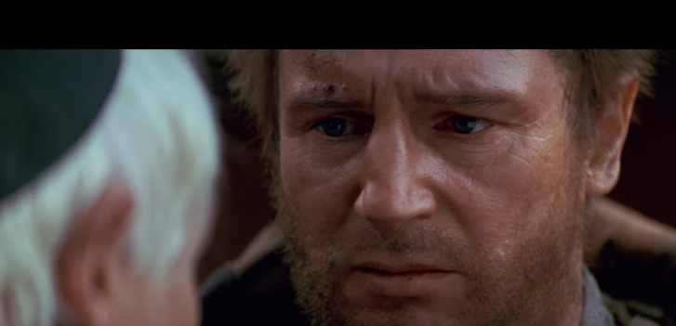
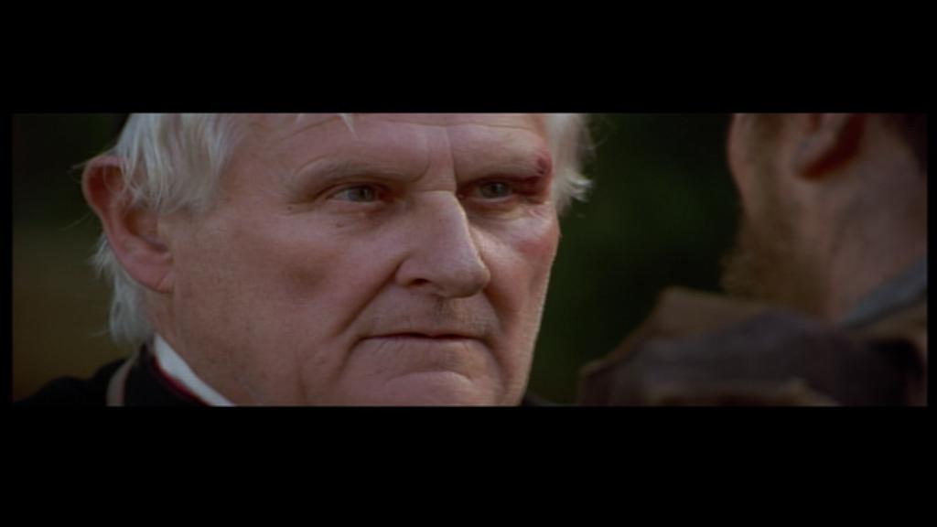
Redemption
“Jean Valjean, my brother, you no longer belong to evil. With this silver I’ve bought your soul. I’ve ransomed you from fear and hatred and now I give you back to God.”
The bishop’s forgiveness and gift of silver help Jean Valjean to start a new life in a new town where people don’t know about his past and won’t judge him.

Slide 19
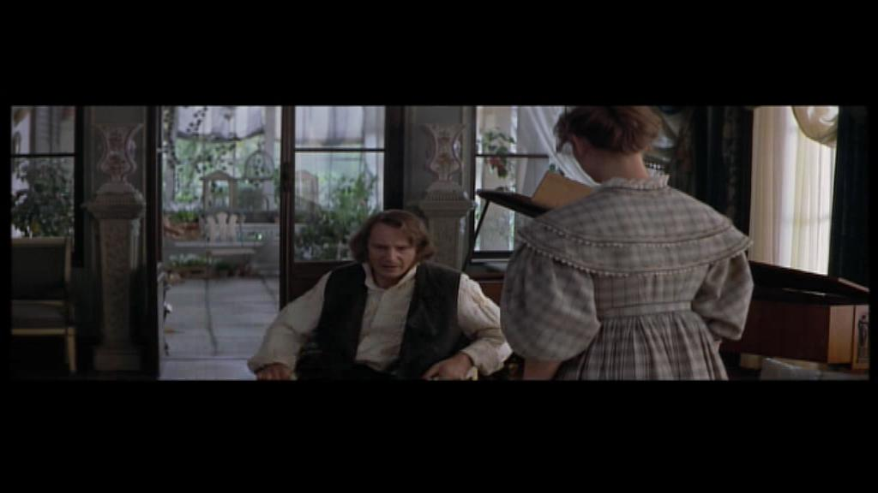
The Character of the Convict
“I did things there in jail, terrible things. I became an animal.”
Notes:
Jean Valjean moves to a town where nobody knows him and decides to go straight. He becomes a respectable member of society. He runs a business where he shows compassion to his workers and he later is elected mayor of his town. Nobody knows his shameful past until Inspector Javert is appointed chief of the local police. Javert was previously Jean Valjean’s jailor.

Slide 20
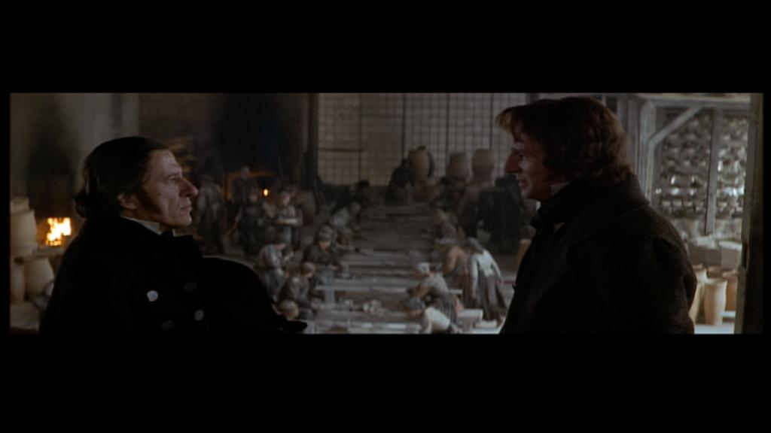
Inspector Javert’s View of Crriminals
“Reform is a discredited fantasy … a wolf can wear sheep’s clothing but he’s still a wolf.”
Is Javert right or can a criminal change for the better? Discuss with people next to you.
Notes:
Javert can’t forgive Jean Valjean or accept that he’s a changed person.

Slide 21
Law & Grace
“… but the gift of God is eternal life in Christ Jesus our lord.” Romans 6:23b
Parable of the Pharisee & the Tax Collector (Luke 18:9-14)
https://www.blueletterbible.org/nasb95/luk/18/9-14/s_991009

Slide 22
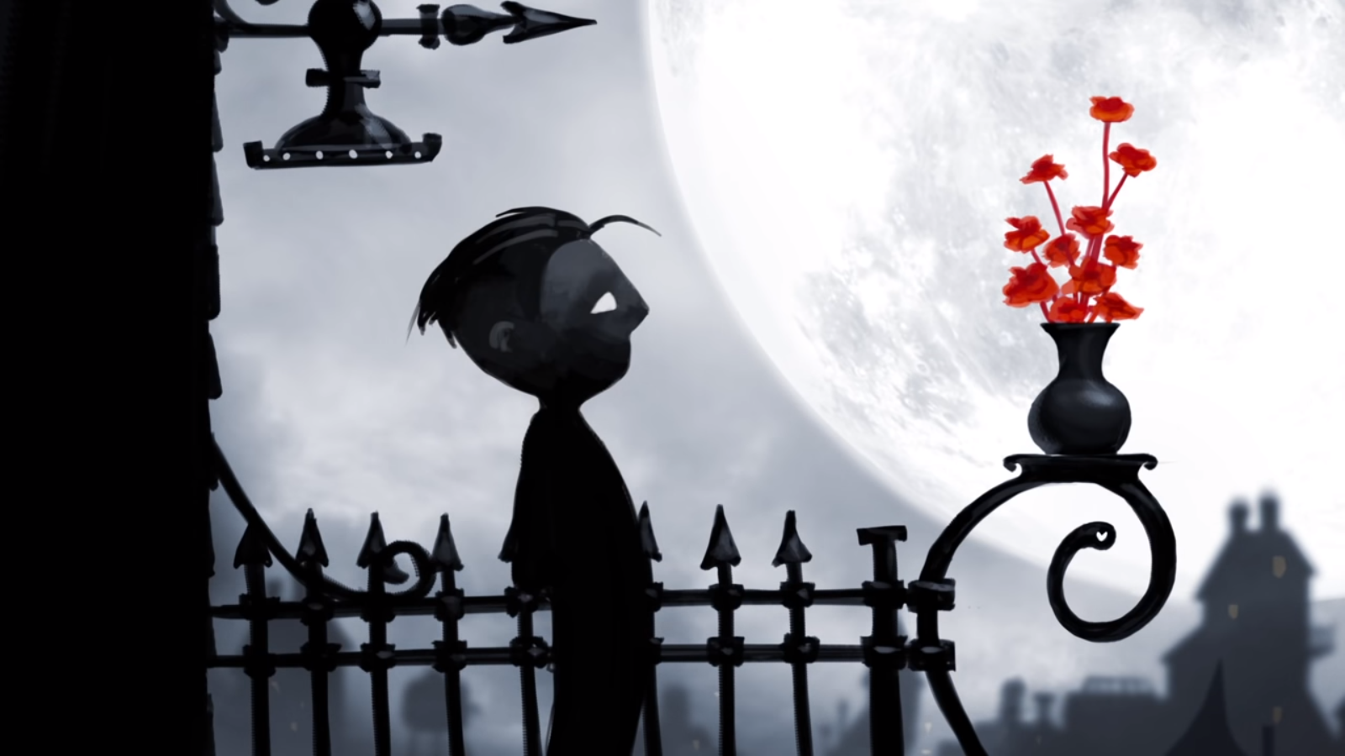
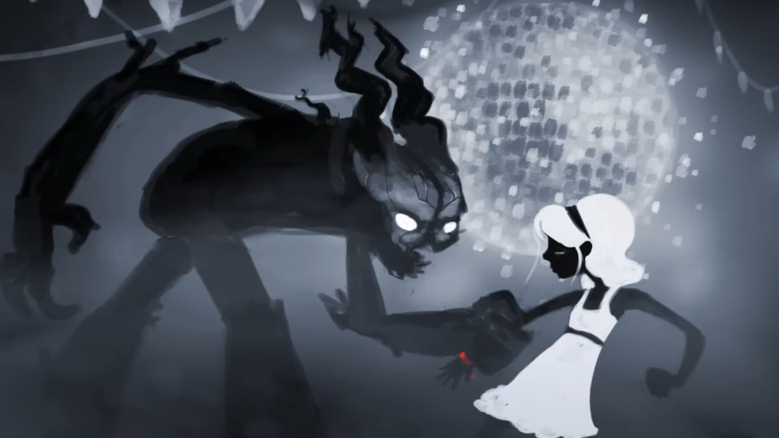
Born Again by Josh Garrels
Look at your sheet and read the questions.
Watch the video and give short answers.
https://www.youtube.com/watch?v=iBWeRK-j0Hw (4:35)

Slide 23
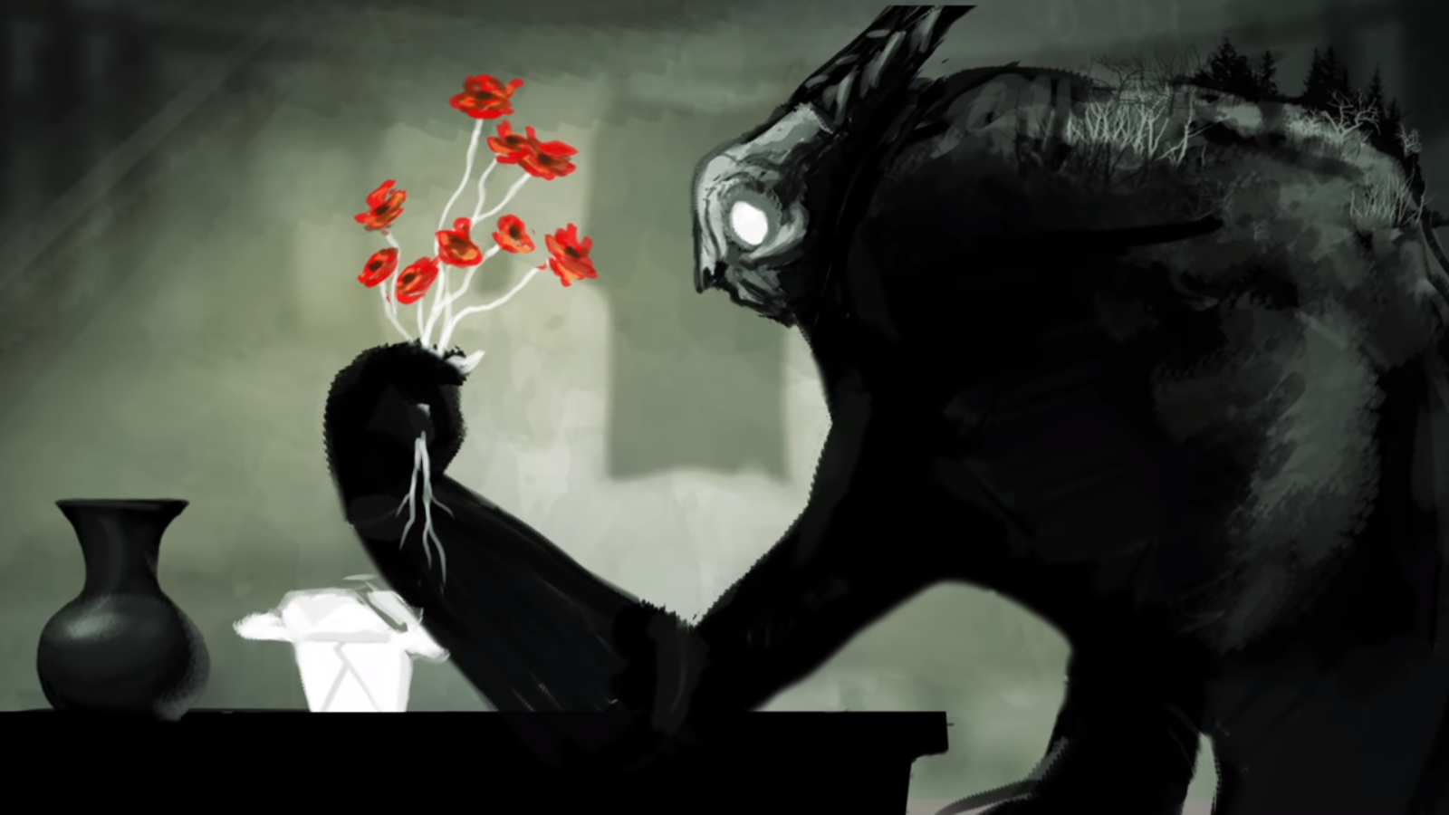
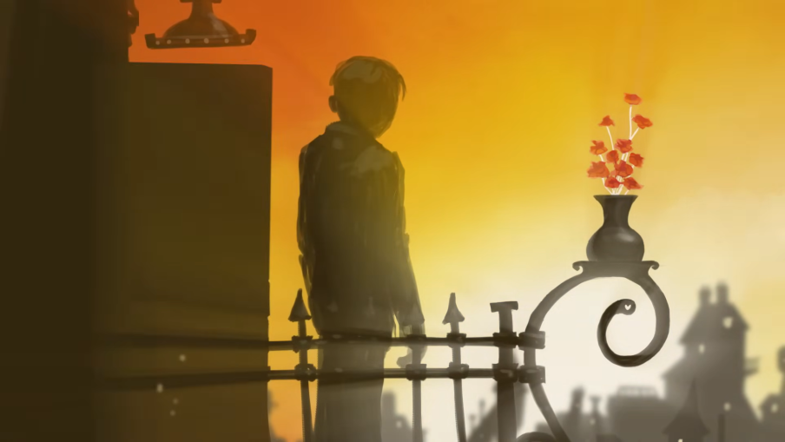
Born Again by Josh Garrels
The song shows the writer’s own story of loss of innocence, criminal life and then redemption.
Josh Garrels turned to drugs and crime in his teenage years but after his conversion to Christ he abandoned his previous life and got cleaned up.

Slide 24
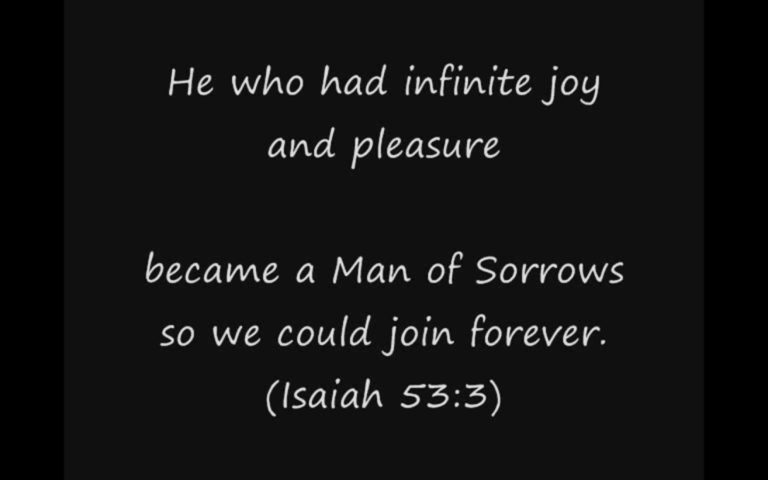
The Humility of Christ by Timothy Brindle
1. According to Timothy Brindle, who is Jesus?
2. What is the purpose of his coming to earth?
3. What are the two ways in which God deals with human crime?
http://www.youtube.com/watch?v=nf6EUKPHQMU

Slide 25
The Parable of the Unmerciful Servant
Matthew chapter 18
Summarise what happens in the story.
What is Jesus saying about forgiveness in this parable?
https://www.biblegateway.com/passage/?search=mat+18&version=ESVUK

Slide 26
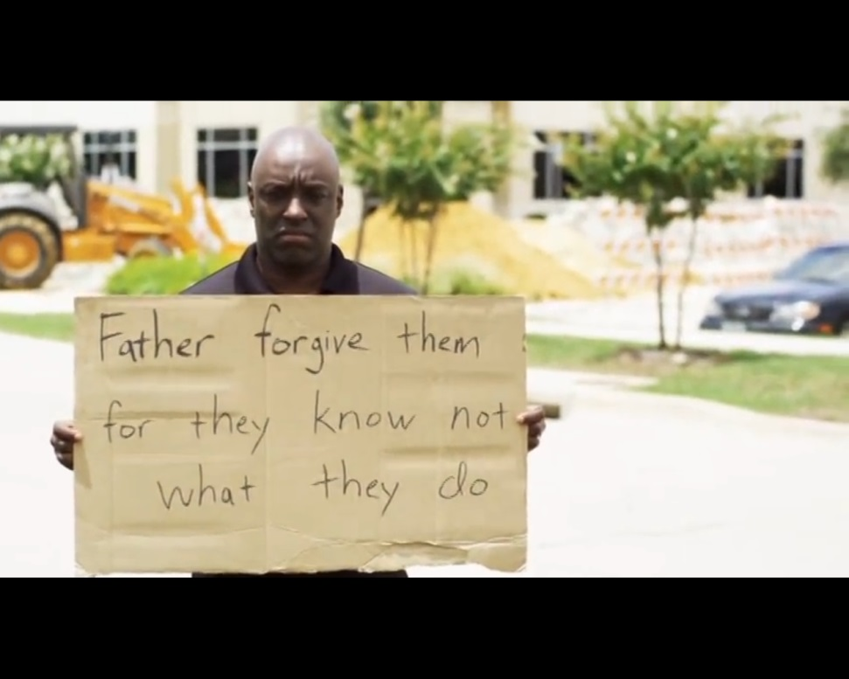
Signs of forgiveness
What does this video say about forgiveness? Write at least one quotation that you don’t already have. The video can be replayed and paused if necessary.
http://www.youtube.com/watch?v=FxoMbPWuk0I

Slide 27
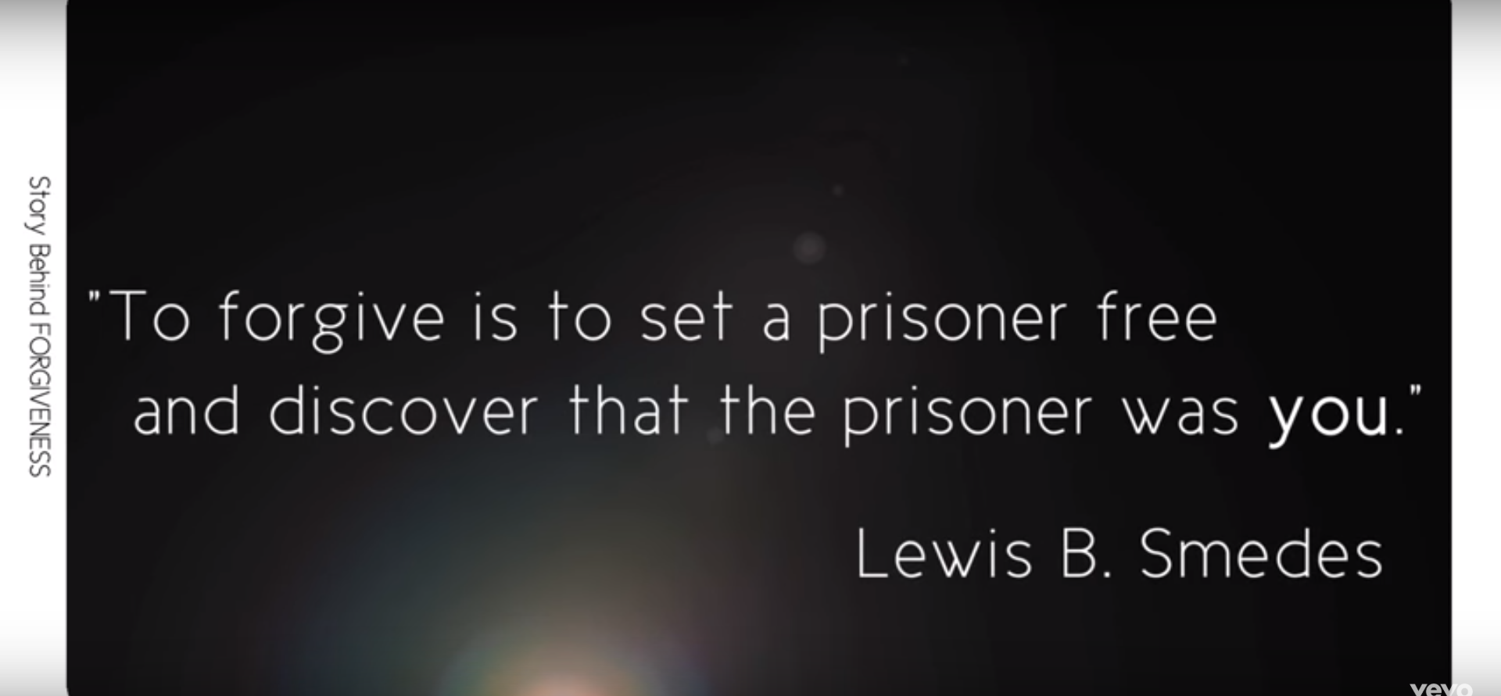
A modern true story of crime & redemption
‘Forgiveness’ by Matthew West
Describe the story that inspired Matthew West to write his song called ‘Forgiveness’.
https://www.youtube.com/watch?v=wz3tkHv5sbg

Slide 28
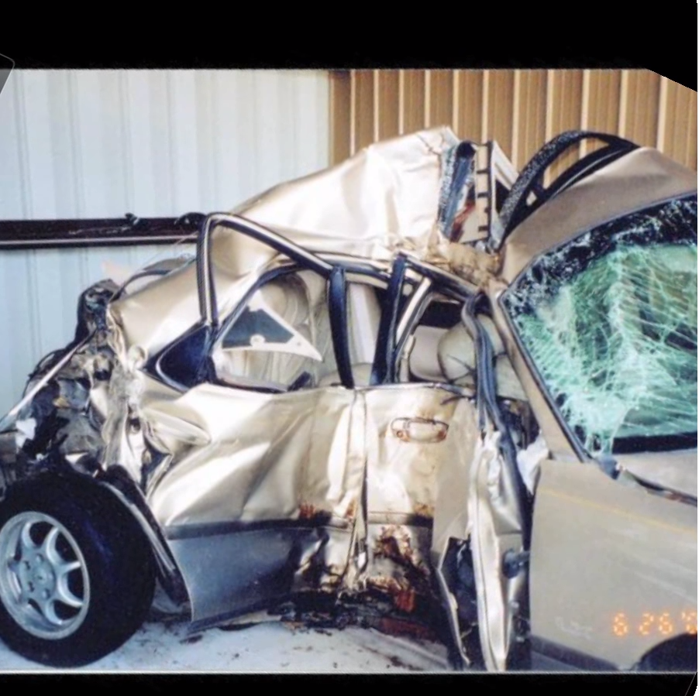
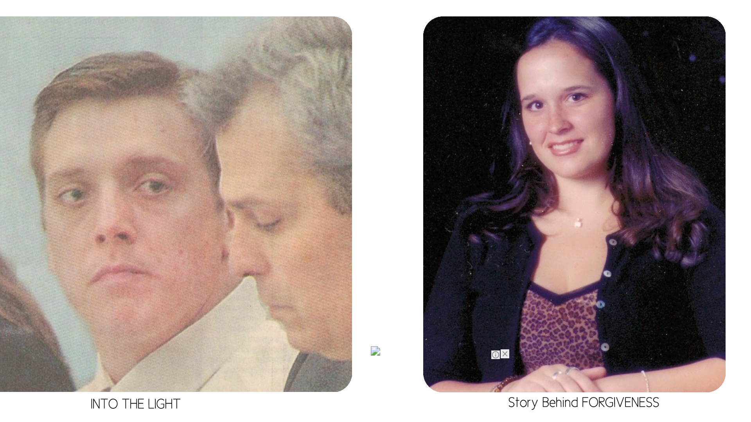
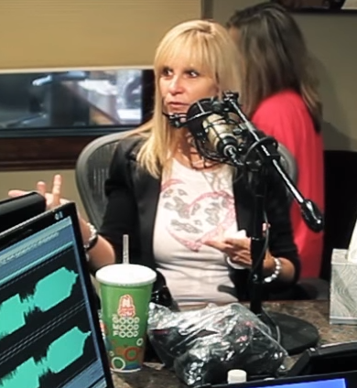
‘Forgiveness’ by Matthew West
Describe the story that inspired Matthew West to write his song called ‘Forgiveness’.
https://www.youtube.com/watch?v=wz3tkHv5sbg
11th May 2002
Eric Smallridge
Meagan Napier
Renee Napier

Slide 29

http://www.youtube.com/watch?v=xfkhqpl81NA
Give at least two teachings about forgiveness from the song.

Slide 30
Christianity
Romans 6:23a ‘The wages of sin is death…’
Romans 6:23b ‘… but the gift of God is eternal life in Jesus Christ, our Lord.’

Slide 31
Christianity
Acts 2:38
And Peter said to them, “Repent and be baptized every one of you in the name of Jesus Christ for the forgiveness of your sins …”

Slide 32
Application
Christians believe criminals deserve to be punished.
Christians themselves deserve punishment.
They are no better than criminals in God’s sight.
They need to forgive criminals if they want to be forgiven.
This does not mean that criminals should not be punished with jail, etc.

Slide 33
Homework
Find a news story about crime and bring it in for next RS lesson.
  This could be a printout from the internet or it could be from a newspaper or other source.

Slide 34
Conscience
What is a conscience? Talk to the person next to you and try to write a definition.

