Slide 1
Christian Persecution
Key Question;
How do Christian Churches respond to persecution?
To begin…

Slide 2
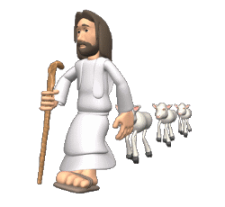
Christian Persecution
Questions (page 59);
How many Christians are persecuted across the world?
In what ways are they persecuted?
Where does the worst persecution of Christian take place?
What did St. Paul say about persecution in 2 Timothy 3:12?
What did Jesus say about persecution in John 15:18-19?

Slide 3
Christian Persecution
Questions (page 59/60);
Give an example of how the World Council of Churches tries to bring about reconciliation.
Note down the most important part of Matthew 5:10-12. What does this suggest about possible rewards for those who are persecuted?
Explain why some Christian thinkers believe persecution can be a positive thing.

Slide 4
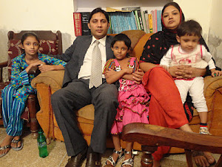
Christian Persecution
Questions (page 60/1);
Who is Pastor Baber George and under what circumstances did he become a Christian?
How and why was Pastor George persecuted?
Where did he flee to and how was he helped?
Explain the work of the Barnabus Fund.

Slide 5
Christian Persecution
Questions (page 61);
Not down Romans 12:21. What does this suggest about how Christians should react to those that persecute them?
Explain a reason (including a religious teaching) why Christians should help those that are persecuted. Give an example.
Give four examples of the strategies used by Christian Solidarity Worldwide in their campaign for religious freedom.

Slide 6
Christian Persecution
Exam style question.
Explain two ways that Christians help fellow believers who are being persecuted. (5 marks)
Use the sentences starters below to help;
One way Christians will help those who are persecuted is…
Another way would be to…
An example of this would be…

