Slide 1
The Importance of the Worldwide Church
Key Question;
How does the Church show its importance across the world?
To begin…

Slide 2
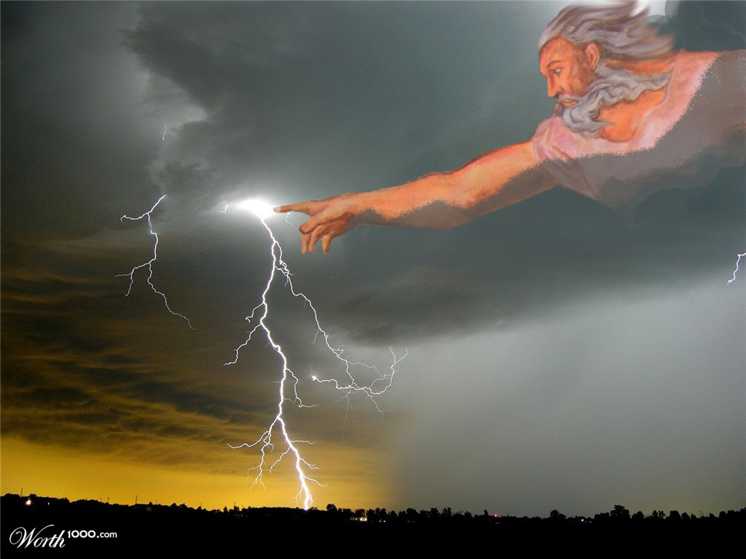
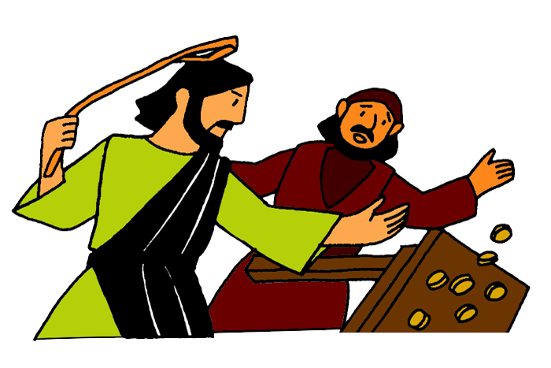
The Importance of the
Worldwide Church
Questions (page 58);
What is the main mission of the Church?
Why do Christians believe the relationship between God and the people has broken?
How might the relationship be restored? (Refer to Romans 5:10).
Give some examples of why the relationship between God and Humans has broken down.

Slide 3
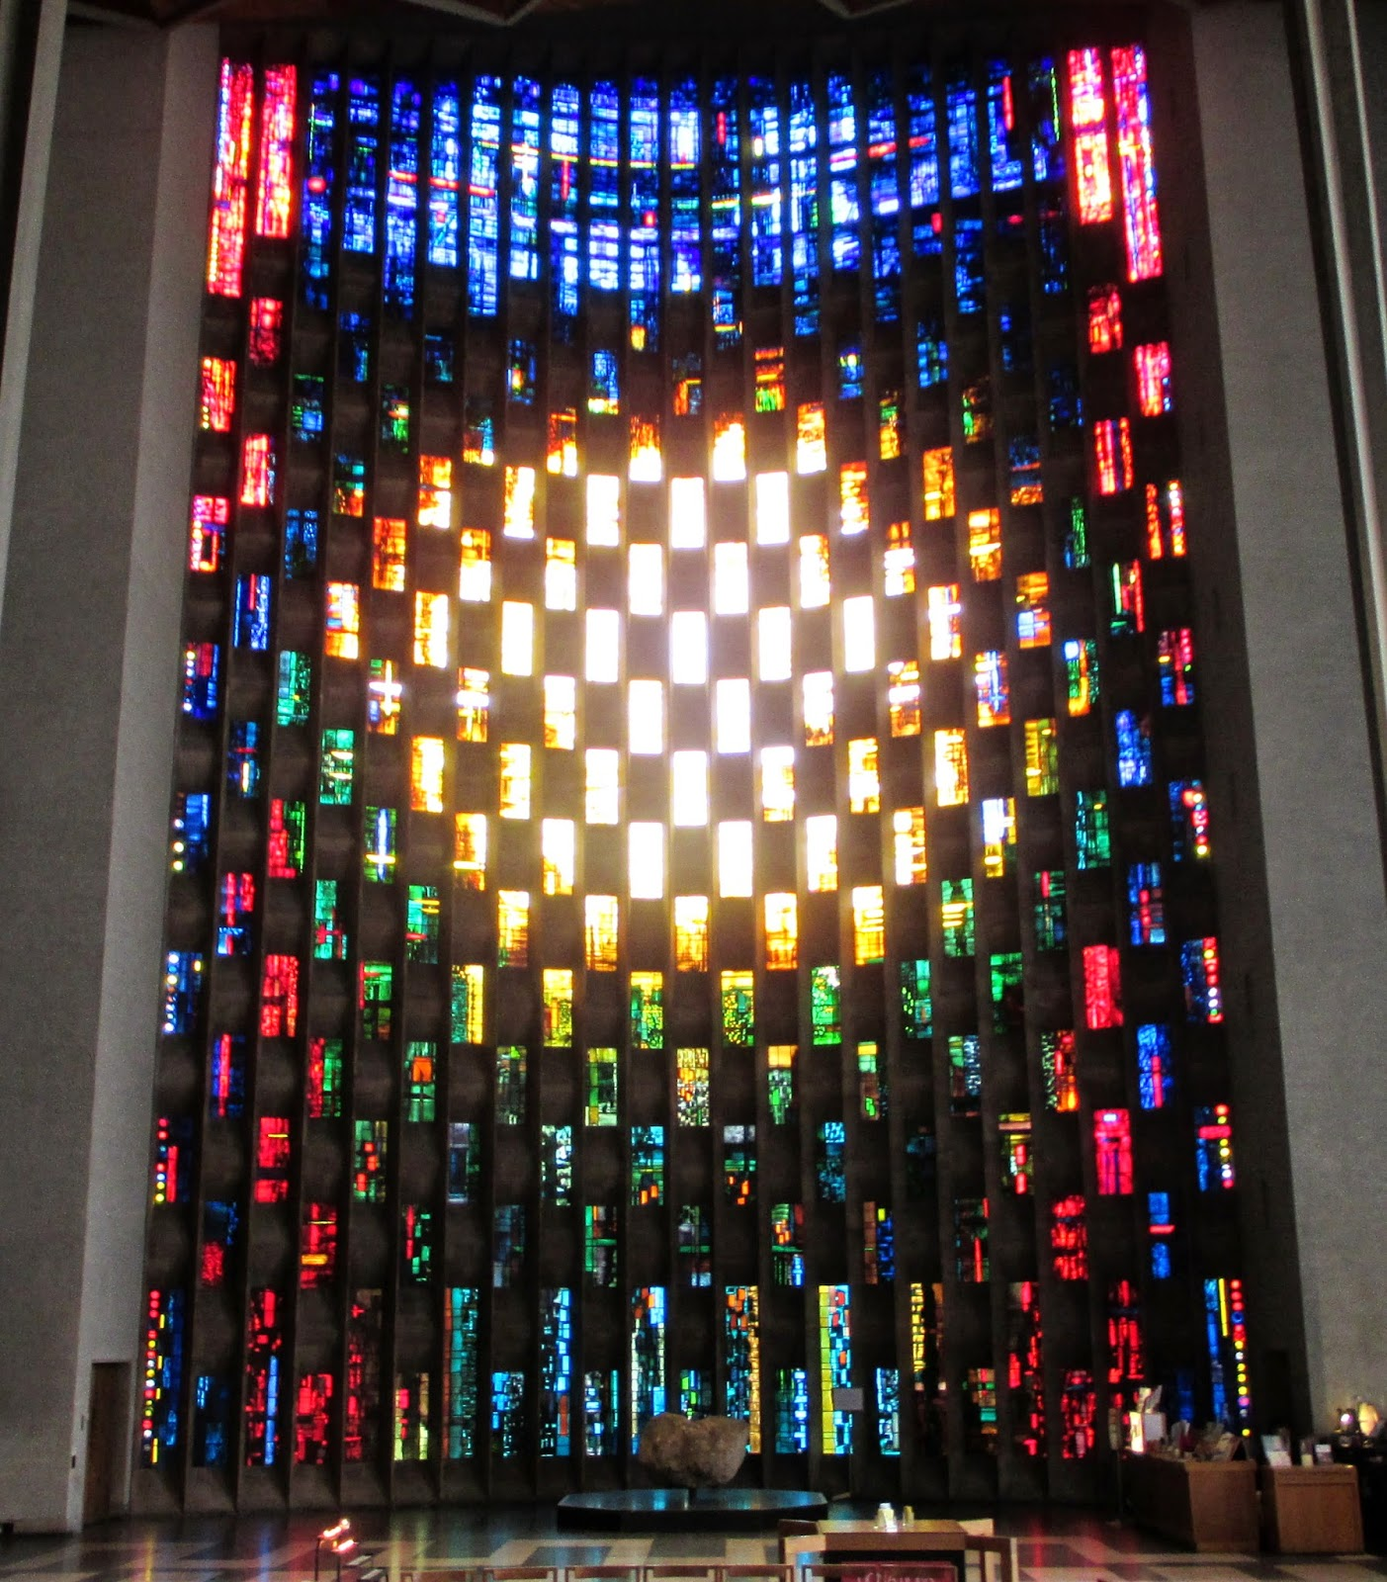
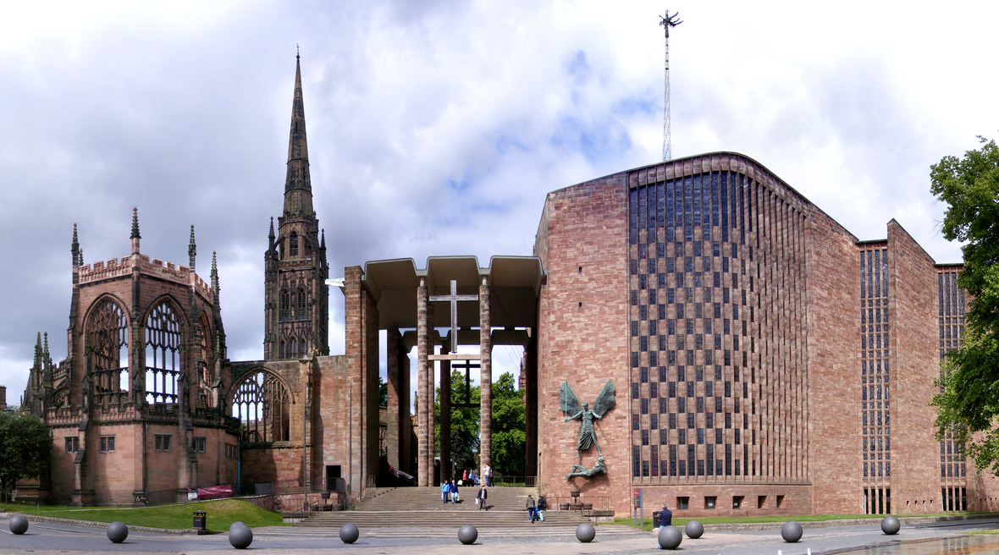
The Importance of the
Worldwide Church
Questions (page 58/9);
Why is Coventry Cathedral a centre of reconciliation?
What are the aims of the Community of the Cross based at Coventry Cathedral?

Slide 4
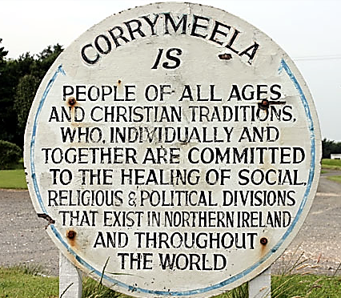
The Importance of the
Worldwide Church
Questions (page 59);
Explain the aims of the Corrymeela Community and how it attempts to achieve these aims.
Where has their work particularly important? Why was this?
Why is and how it?

