Slide 1
Church Growth
Key Question;
How is the Church promoting worldwide growth?
To begin…

Slide 2
Church Growth
Questions (page 56);
Approximately how many Christians are the in the world? Who does this figure include?
Where is the Church growing the most? Why do you think this might be?
Where in the world is the Church not growing so quickly? Why might this be?
Which is the biggest Christian denomination? How many members does this denomination have?
What is the estimated growth of Church membership in Africa?

Slide 3
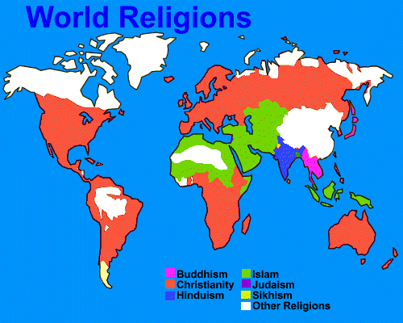

Slide 4
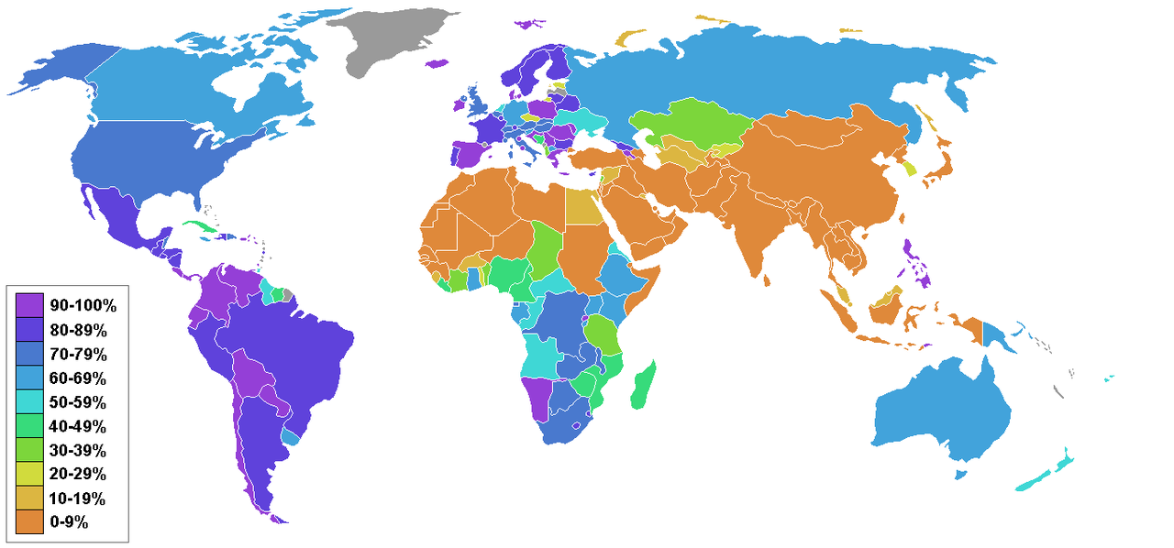
Percentage of Population who are Christian

Slide 5
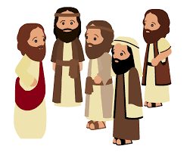
Church Growth
Questions (page 57);
What is the difference between being a convert to Christianity and a disciple of Christianity?
Give some examples of how the Church gets its message across to people.
https://www.youtube.com/watch?v=HSsKTPhTGw4

Slide 6
Church Growth –
Christ for all Nations (CfaN)
Questions (page 57);
When was this organisation set up and by whom?
Why did he set CfaN up?
Where do CfaN aim to gain the most converts? Why is this?
How many people have pledged to follow Jesus after attending meetings?
https://www.youtube.com/watch?v=HSsKTPhTGw4

Slide 7
Church Growth
Research – I.L.
Find out about the God Channel and explain how this channel is evangelical and helps the spread of Christianity. Find out about the following;
Their Mission
Their Vision
What they believe
https://www.god.tv/about

