Slide 1
The Place of Mission and Evangelism
Key Question;
What are some of the other responsibilities of Christians?
To begin…

Slide 2
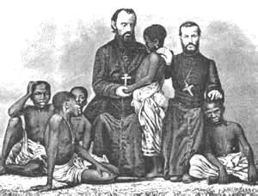
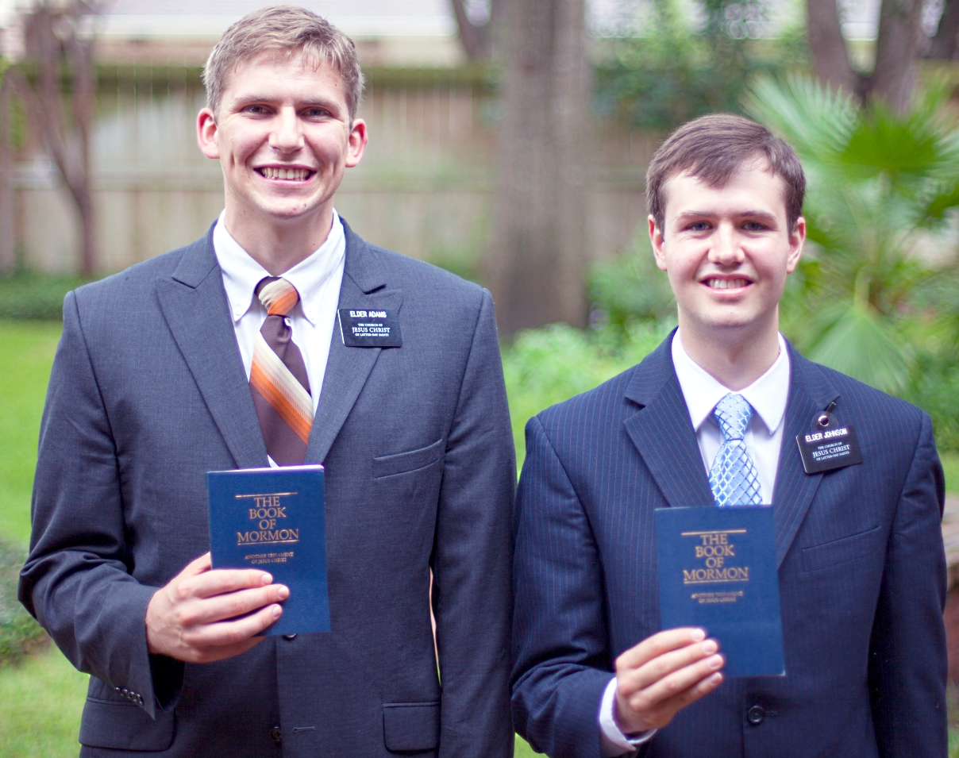
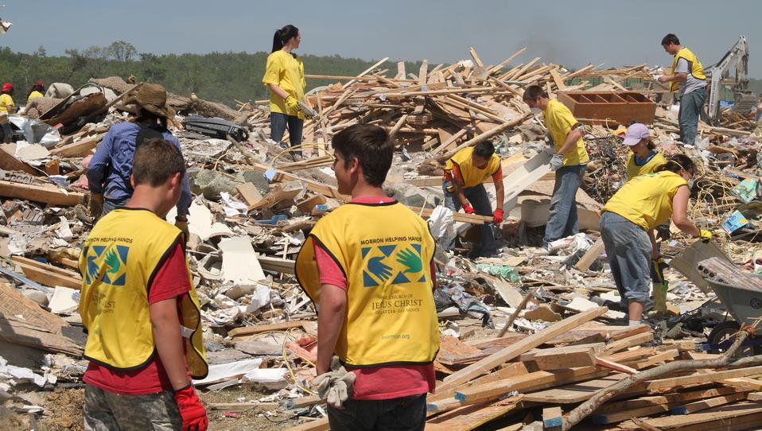
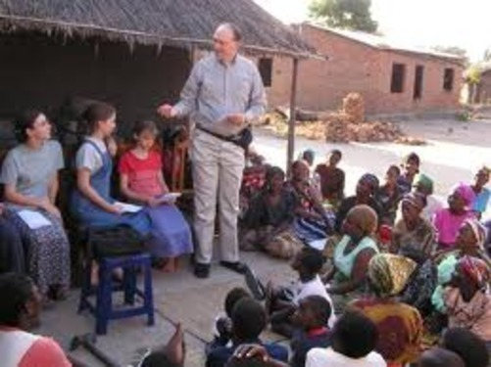
The Place of Mission and Evangelism
Questions (page 54);
1. Write down the Bible quotation –
Matthew 28:19.
2. Explain what this quotation
suggests about what Jesus expects
his followers to do.
3. Explain some ways in which
Christians carry out their duties of
mission and evangelism.

Slide 3
The Place of Mission and Evangelism
Questions (page 55);
When was the Alpha Course was set up?
What were the original aims of the course?
What does the course aim to do today?
How do the organisers of this course describe it?
Where can Alpha courses take place?

Slide 4
I.L. – What are missionaries?
Research the work of missionaries in one Christian denomination.
You could look at Mormon missionaries (both evangelist and humanitarian) and note down what they do, when, for how long and why.
The Place of Mission and Evangelism

