Slide 1
The role of the Church
in the local community
Key Questions;
What is ‘the Church’?
What help does the Church provide for local communities?
To begin…

Slide 2
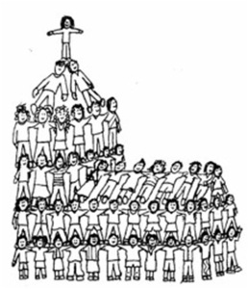
The role of the Church
Questions;
What do these images suggest about what ‘the Church’ really is?

Slide 3
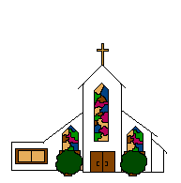
The role of the Church
Questions (page 50);
1. What is the church?
2. Other activities that take place in a church may
include…
3. Give examples of areas the Church has helped
people in history.

Slide 4
The role of the Church - Foodbanks
Questions (page 51);
1. What is the Trussell Trust and who do they help?
2. Give four causes of poverty that may mean
people have to use food banks.
3. Who donates to food banks?
4. Who decides who needs help from a
food bank and how is this decision made?
5. Explain why Christians would donate to, or
volunteer to help in a food bank. Refer to two
Christian teachings in your answer.

Slide 5
The role of the Church – Street Pastors
Questions – Street Pastors (page 52);
What is the term ‘agape’ mean and how might
Christians put this into action (include examples)?
2. When, where and with how many volunteers did the
network of street pastors begin?
3. Why was the network set up and what do they do?
4. Who do the Street Pastors work with and
how does this help local communities?
5. How many Street Pastors are there now?
6. What do School Pastors do and what are their aims?

Slide 6
The role of the Church – Street Pastors
Questions – Street Pastors (page 52);
Why would a Christian become a Street Pastor? Refer to religious teachings in your answer.
Give examples of other organisations Christians may be involved with in the local community.
I.L. – Research;
What is the YMCA? Why were they set up? By whom, what are their aims and how do they try to achieve these aims?
https://www.youtube.com/watch?v=CS9OO0S5w2k

