Slide 1
Christian Practice - Festivals
Key Question;
Why are Christian festivals important?
To begin;
Quiz…

Slide 2
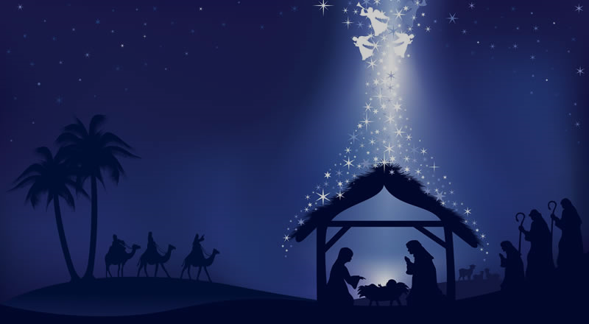
Christian Festivals - Christmas
Things to do (page 48);
Explain why Christian festivals are important.
On an outline of the Christian calendar note down the
main Christian festivals.
Explain what the festival of Christmas commemorates.
Note down 6 ways in which Christians celebrate Christmas.
Note down 2 reasons why Christmas can be valuable to non-Christians and 2 reasons why it is more important to Christians.

Slide 3
Christian Festivals - Easter
Things to do (page 48);
1. Explain what the festival of Easter is about.
Note down 6 ways in which Christians celebrate Easter.
Explain two reasons why it is more important to Christians Communities to celebrate festivals..

Slide 4
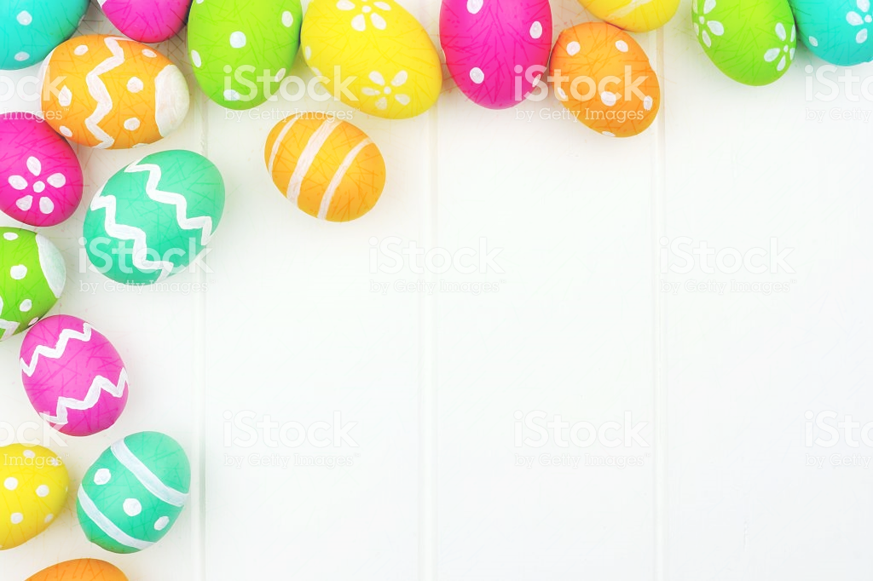
Christian Festivals - Easter
Review – Exam Question.
‘The most important religious festival for
Christians is Christmas’. Evaluate this statement.
In your answer you should:
• Refer to Christian teaching
• Give developed arguments to support this statement
• Give developed arguments to support a
different point of view
• Reach a justified conclusion.
[12 marks, SPaG 3 marks]

