Slide 1
Christian Practices - Pilgrimage.
Key Question;
Why do Christians go on pilgrimage?
To begin;
Quiz…

Slide 2
Christian Practices - Pilgrimage.
Things to do (page 46);
Explain what a pilgrimage is.
Give examples of where Christians might go on pilgrimage.
Why might Christians go to Jerusalem on pilgrimage?
Give five reasons why Christians may go on a pilgrimage.
Give three possible results of going on a pilgrimage.

Slide 3
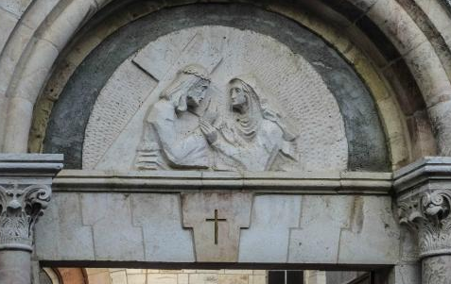
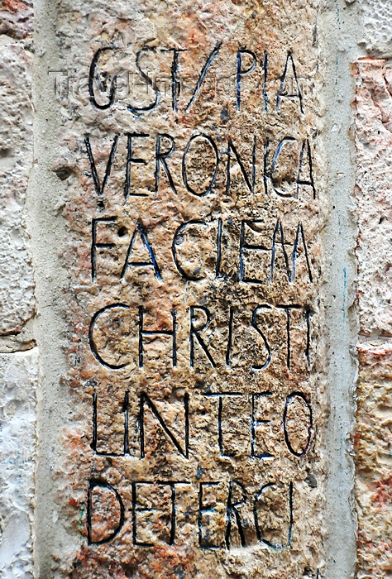
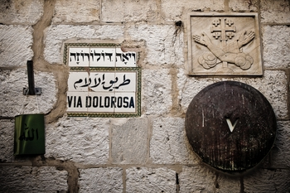
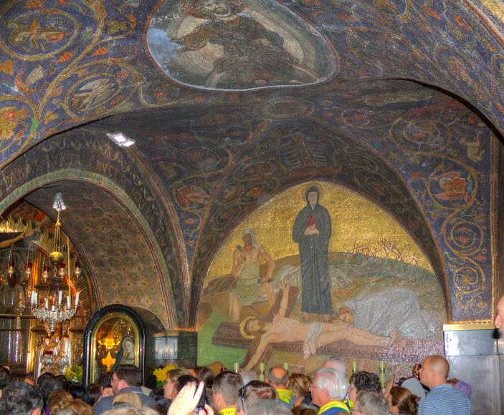
1
2
3
4
5
6
7
8
9
7
9
10
11
12
13
14

Slide 4
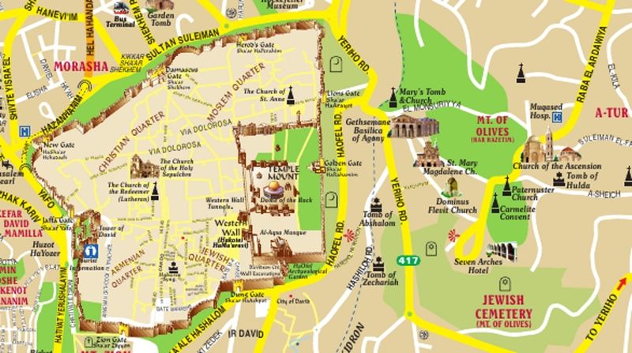
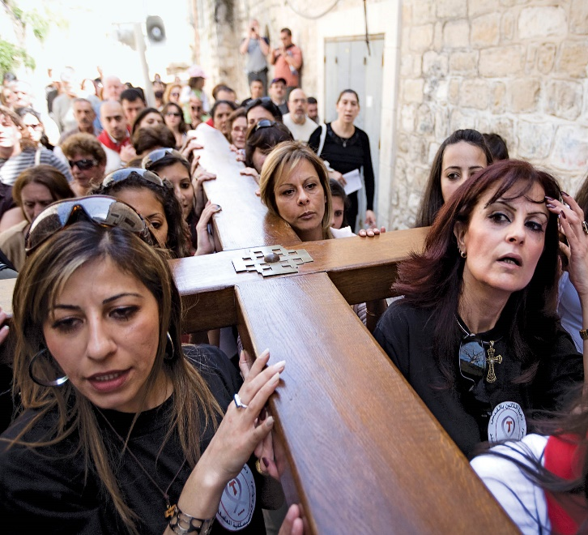
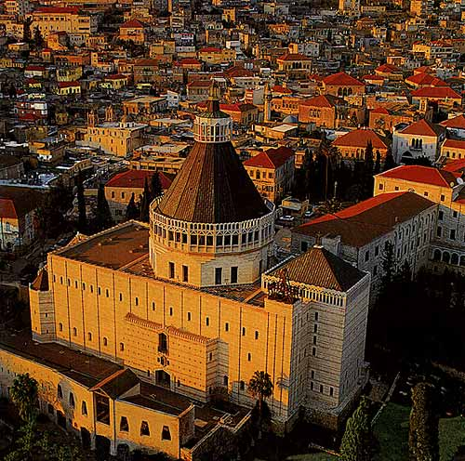
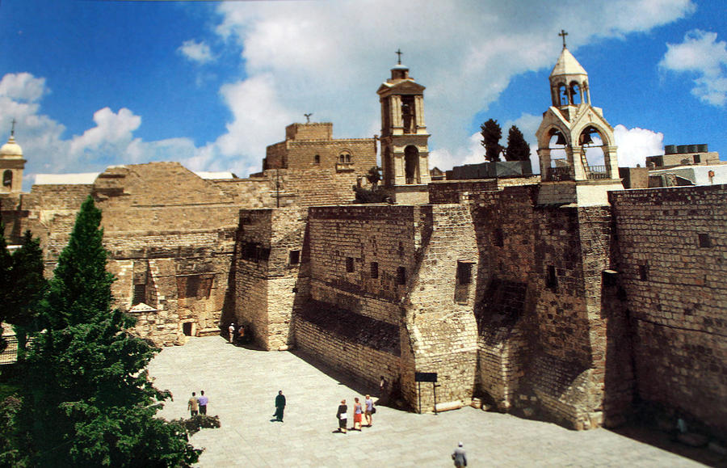
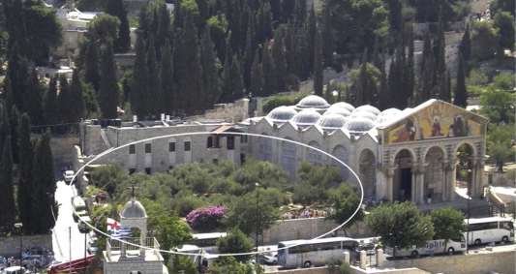
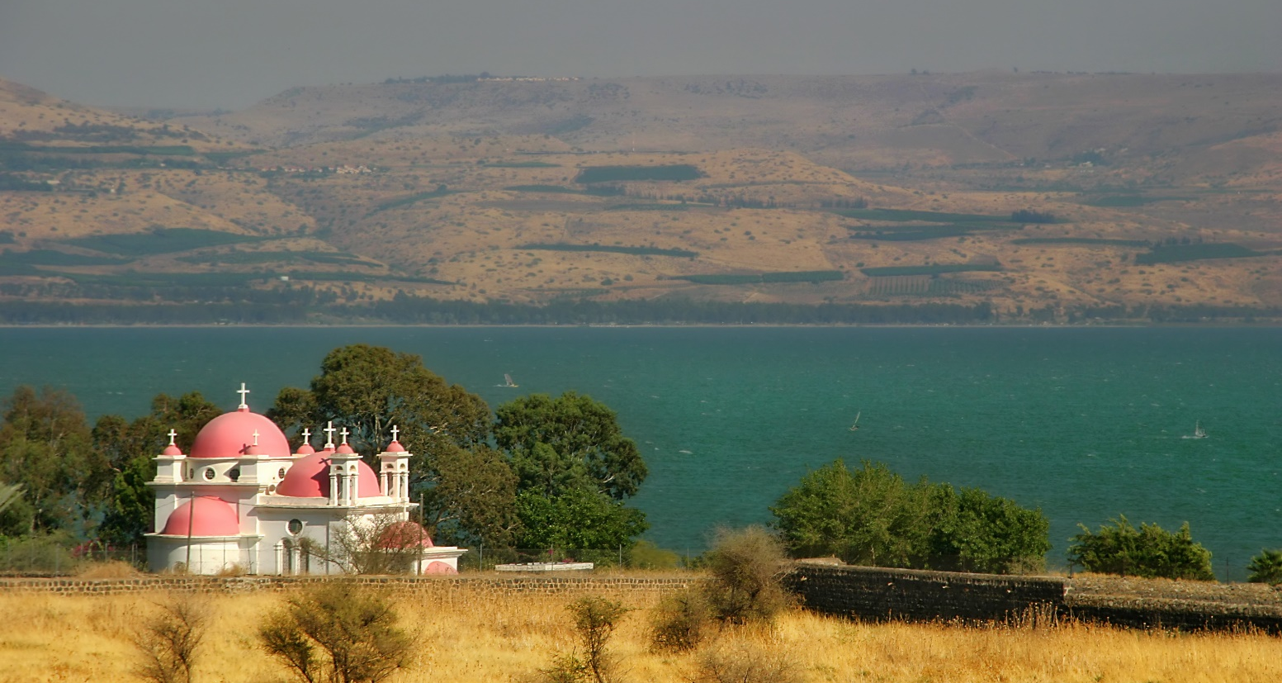

Slide 5
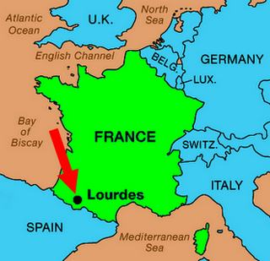
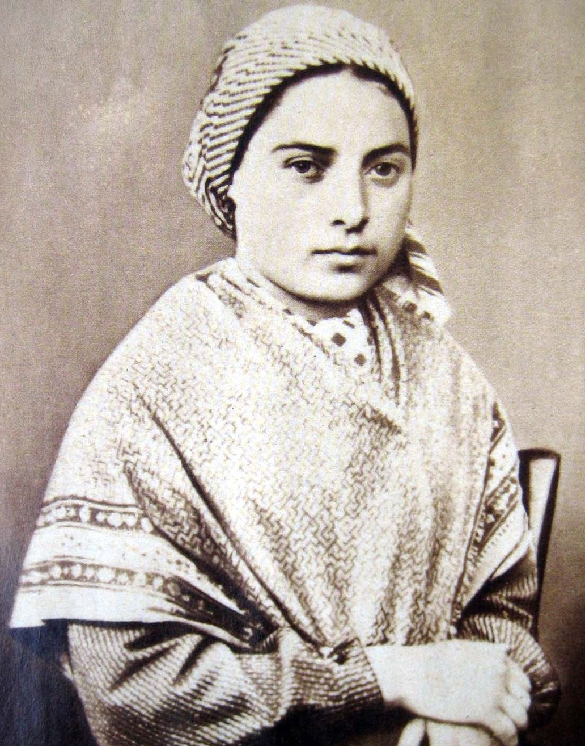
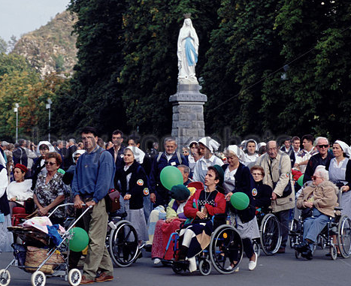
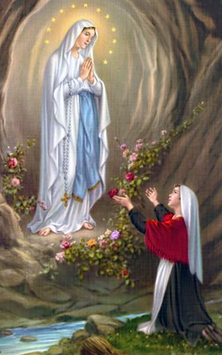
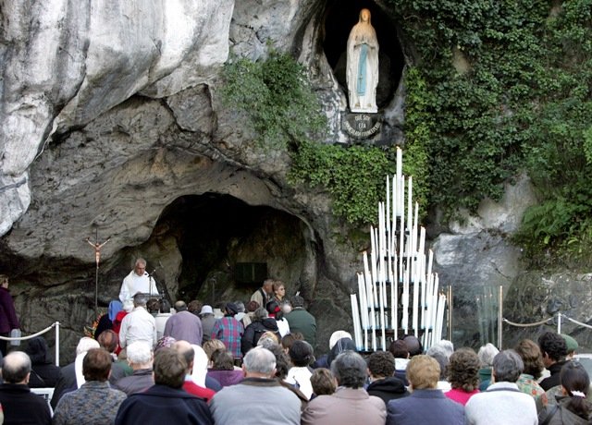

Slide 6
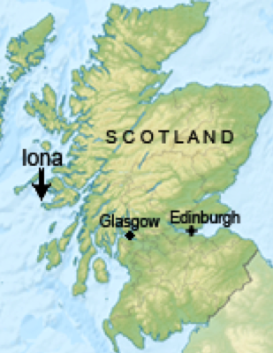
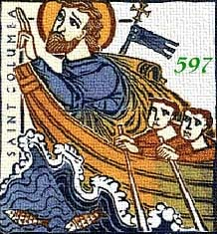
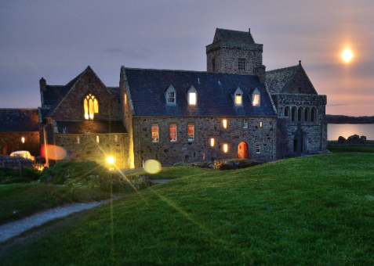
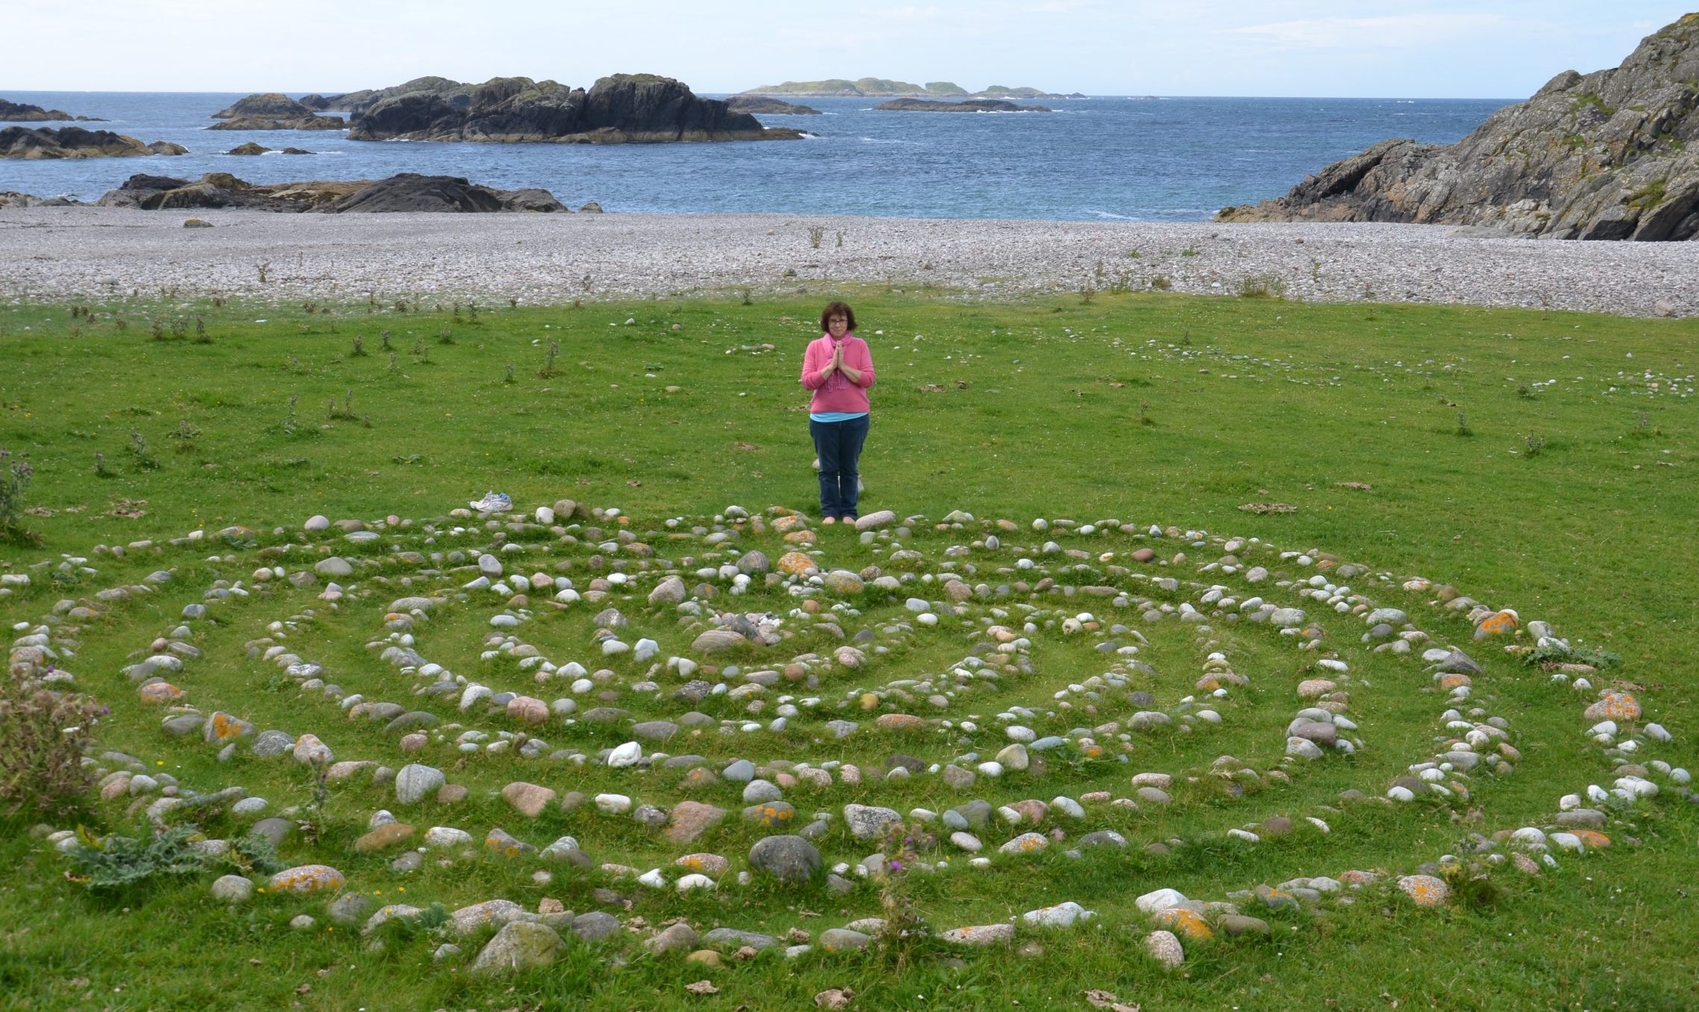

Slide 7
Christian Practices - Pilgrimage.
Things to do (page 47);
Explain why Lourdes became a place of pilgrimage.
Explain reasons why pilgrims go to Lourdes today.
Explain why Iona became a place of pilgrimage.
Explain what pilgrims do whilst on pilgrimage on Iona.

Slide 8
Christian Practices - Pilgrimage.
I.L. – Research two testimonies (experiences) of
Christians on different pilgrimages.
Note down the name of the pilgrim and the place of pilgrimage (this can be any place of Christian pilgrimage) and explain what the pilgrims did, how they felt on their pilgrimage and any long term affects of their pilgrimage.

