Slide 1
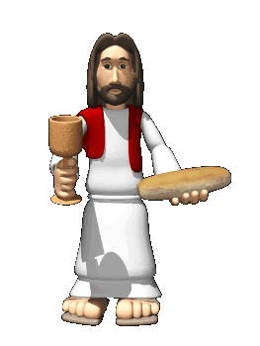
Christian Sacraments
Holy Communion.
Key Question;
Why is Holy Communion important to Christians?
To begin;
Quiz…

Slide 2
Christian Sacraments
Holy Communion.
Things to do (page 42);
1. What is Holy Communion?
2. Note down different names for Holy Communion.
3. Summarise the most important parts of the Bible
quotation 1 Corinthians 11:23-26.
4. Explain the meaning of Holy Communion.
5. Explain different beliefs about Holy Communion in
(a) the Catholic Church and (b) Protestant Churches.

Slide 3
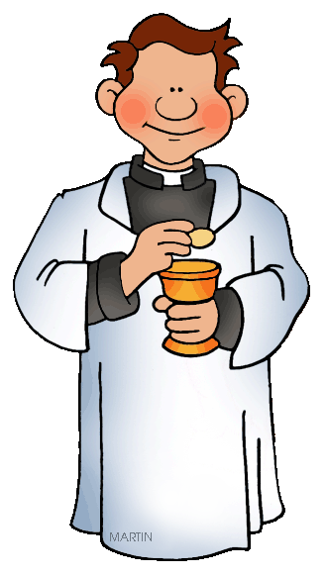
Christian Sacraments
Holy Communion.
Things to do;
Why is Holy Communion important to individual
Christians, Christian communities and wider society?
2. The ministry of the Word is…
3. The ministry of Holy Communion is…
4. Note down the most important parts of the different
Holy Communion services. Highlight any similarities.

Slide 4
Christian Sacraments - Holy Communion
Review – exam questions;
Explain two contrasting ways in which Christians worship (4 marks)
This question is asking for brief explanation of two different ways in which Christians worship(e.g. prayer and Holy Communion).
Explain two ways in which the Eucharist (Holy Communion) is celebrated in Christianity. (5 marks)
This question could be answered by looking at Holy Communion in different Christian Churches (e.g. Catholic and Orthodox). Remember to explain, do not give a bullet point list of what happens.

