Slide 1
Christian Sacraments - Baptism
Key Question;
What do we need to know about Christian prayer?
To begin;
Quiz…

Slide 2
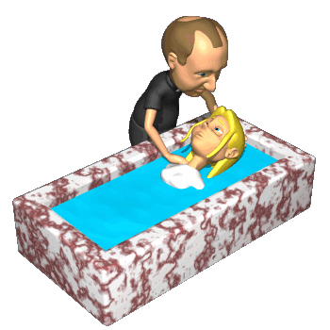
Christian Sacraments - Baptism
Things to do (page 40);
Briefly explain what sacraments are.
What are the seven sacraments in the Catholic Church?
Why are sacraments important to some churches but not others?
Explain clearly what baptism is.
What are the origins of Baptism in the Christian faith?

Slide 3
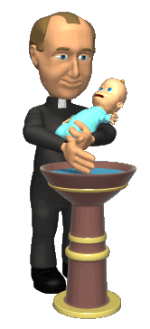
Christian Sacraments - Baptism
Things to do (page 41);
Explain clearly why Catholics believe it is important to baptise babies.
Note down three things that happen at an infant baptism ceremony.
Explain clearly why Baptists do not baptise babies.
Note down three things involved in a believers baptism.

Slide 4
Christian Sacraments - Baptism
Review.
Explain, using a diagram, the symbolism of believers’ baptism.

