Slide 1
Christian Prayer
Key Question;
What do we need to know about Christian prayer?
To begin;
Quiz…

Slide 2
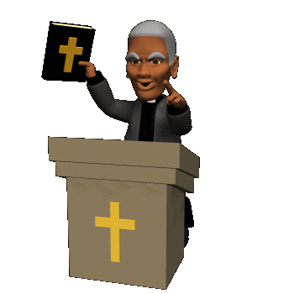
Christian Prayer
Things to do (page 38).
Why do Christians (or any theist) pray? Note down some ideas – either a list or spider diagram.
What is prayer? Explain with some examples of how and why Christians pray.
Explain why prayer is important for Christians.

Slide 3
Christian Prayer
There are different types of prayer;
• Adoration - offering praise to God thanking him for his creation,
greatness and power.
• Confession – confessing sins and asking God for forgiveness.
• Intercession - praying to God in behalf of someone else. Through prayer
Christians become more aware of the needs of others so they pray for
the sick, homeless, hungry, poor etc.
• Petition - asking God for something.
• Thanksgiving – offering thanks to God.
The Lord’s Prayer
Highlight the different types of prayer included in this prayer that Jesus taught.

Slide 4
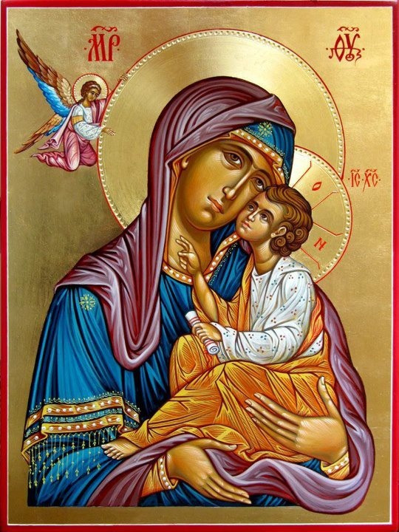
Christian Prayer
Things to do (page 39).
Why is the Lord’s Prayer important to Christians? Explain with examples of when and where it is said.
Research (I.L.):
How do Orthodox Christians use icons to worship? Include a picture of an icon is your explanation.
How do Catholic Christians use rosary beads to worship? In your answer explain what the Rosary actually is.

