Slide 1
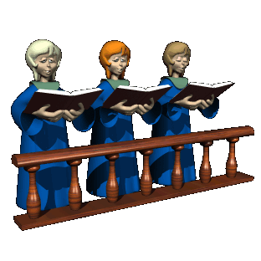
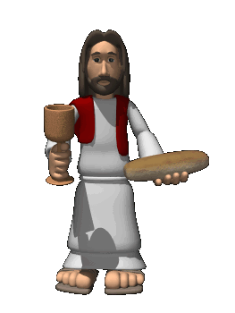
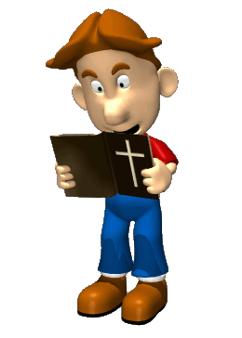
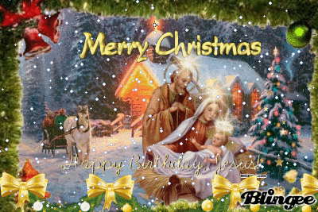
Christian Worship
Key Question;
What do we need to know about Christian worship?
To begin;
How do Christians worship? Complete a list or spider diagram with examples.

Slide 2
Worship and festivals
• liturgical, non-liturgical and informal, including the use of the Bible
• private prayer, prayer and its significance, including the Lord’s Prayer, set prayers
and informal prayer.
• the meaning of sacrament: the sacrament of baptism and its significance, the
sacrament of eucharist (Holy Communion) and its significance for Christians, including
different ways in which it is celebrated and different interpretations of its meaning.
• two contrasting examples of Christian pilgrimage: Lourdes and Iona
• the celebrations of Christmas and Easter, including their importance for Christians in
Great Britain today.
The role of the church in the local and worldwide community
• The place of mission, evangelism and Church growth.
• The importance of the worldwide Church including: food banks; working
For reconciliation; how Christian churches respond to persecution
• The work of one of the following: CAFOD, Christian Aid, or Tearfund.

Slide 3
Christian Worship
Things to do (page 36).
What is worship?
Why do Christians worship?
What is the difference between liturgical worship and non-liturgical worship? Explain your answer with examples.
Explain what private worship is, with examples.

Slide 4
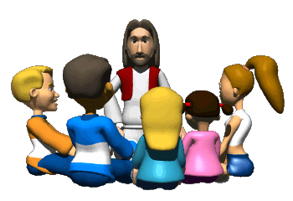
Christian Worship
Characteristics and importance of worship.
Note down 1 characteristic of liturgical worship and 2 reasons why liturgical worship is important.
Do the same for non-liturgical/informal worship
…and finally… - Quiz!
https://create.kahoot.it/details/christian-beliefs-and-practices-1/d916ffaf-a33f-43b8-9998-49b71ecaf24d

