Slide 1
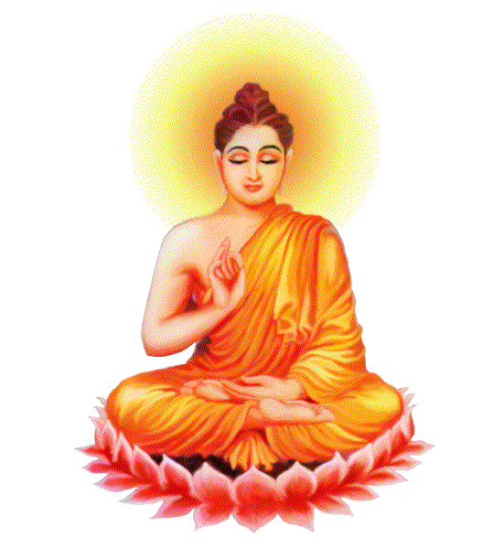
Buddhist Beliefs
Focus.
What do we need to know about Buddhist beliefs?
To begin...
Complete the sheet on Buddha’s life.

Slide 2
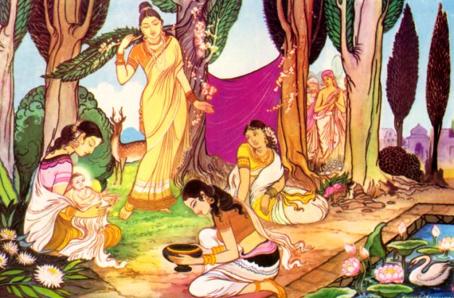
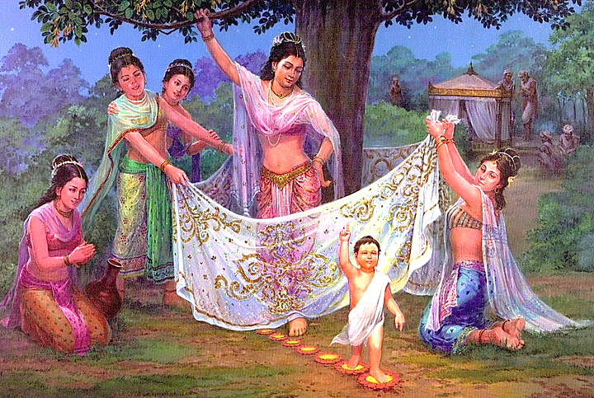
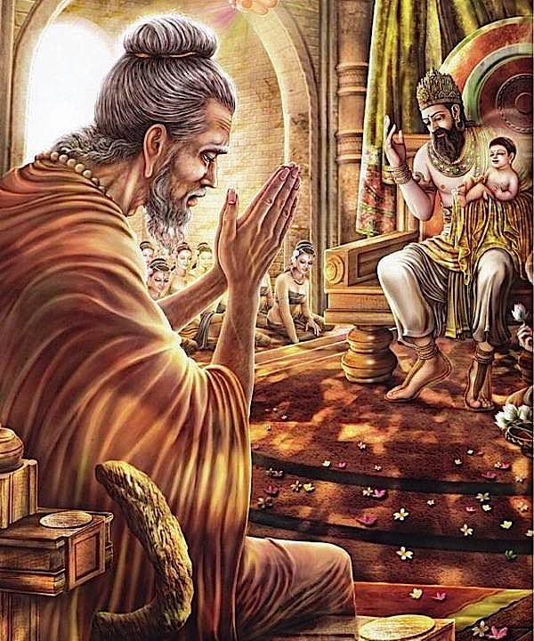
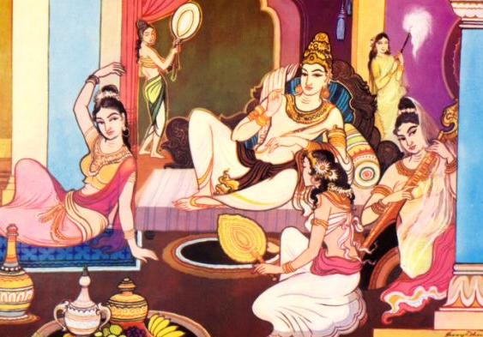
The Life of
Siddhartha Gautama
The Buddha
Siddhartha was born a Prince about 2,500 years ago.
It is said that when he was born, he walked and lotus flowers grew in his footsteps.
A prophecy was made that Siddhartha would become a Holy man or a king.
He lived a very rich lifestyle, wanting for nothing. All evidence of suffering was kept away from him.
However he became curious and he took a trip outside the palace and saw suffering for the first time. Old age, sickness & death.

Slide 3
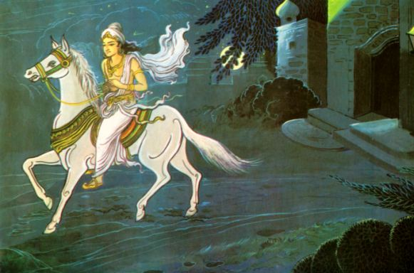
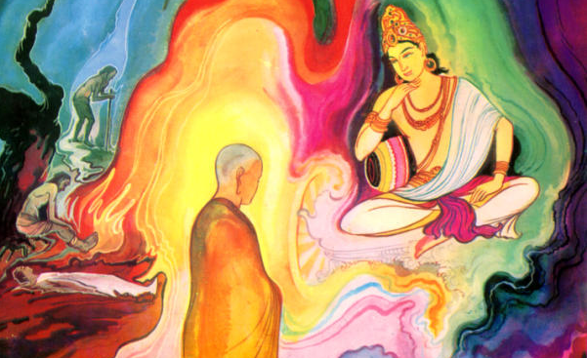
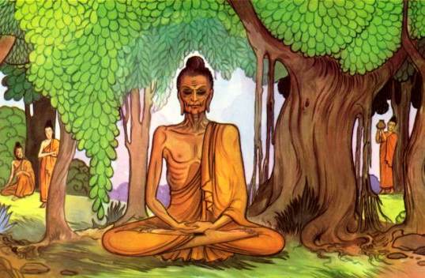
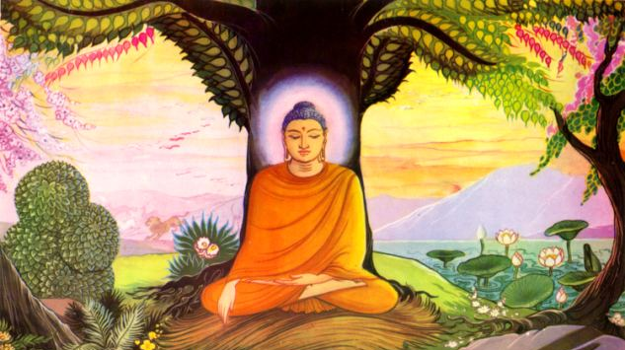
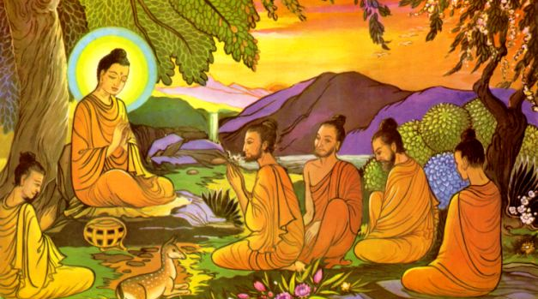
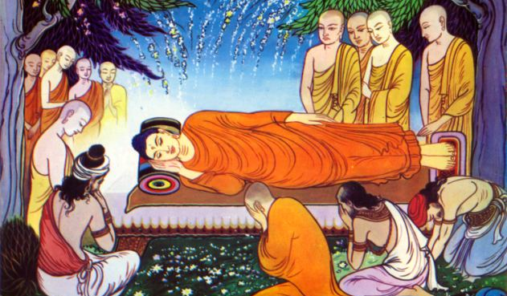
He left the palace to search for the end to suffering.
He came across a holy man who, along with others were looking for the meaning of life.
Siddhartha gave up all his riches and even gave up most food. However this just made him ill.
He began eating again and sat under a Bodhi tree and meditated until, eventually he gained enlightenment.
He began teaching what he had discovered during his enlightenment
He began teaching what he had discovered during his enlightenment.

Slide 4
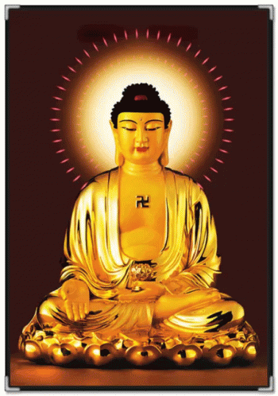
Buddhist Beliefs
Exam questions...
1. Give two ways in which Siddhartha lived a life of
luxury.
2. Give two reasons why Buddha rejected his life of
wealth.

Slide 5
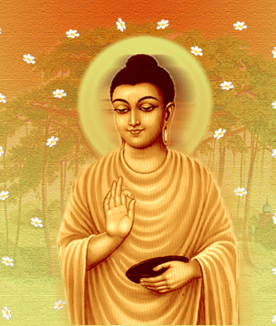
Buddhist Beliefs –
the Enlightenment
Exam questions...
Explain two reasons why stories of Buddha’s birth suggest there was something special about him.
2. Explain two reasons why the Four Sights
led to Buddha’s enlightenment.

Slide 6
Buddhist Beliefs
Things to do... Complete the sheet on Buddha’s
enlightenment.
Exam Questions…
Explain two reasons why Buddha’s enlightenment is important for Buddhists today.
Explain two teachings about the causes of
suffering. (In this question, refer to two causes of
suffering e.g. hatred and greed, and explain why,
with examples these may cause suffering).

