Slide 1

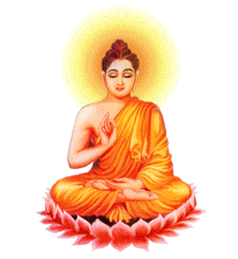
Buddhist Practices Key Words Game

Slide 2
festival

Slide 3
Parinirvana Day

Slide 4
gompa

Slide 5
kamma

Slide 6
Five Moral Precepts

Slide 7
mala

Slide 8
retreat

Slide 9
mandala

Slide 10
mantra

Slide 11
Buddha rupa

Slide 12
stupa

Slide 13
metta

Slide 14
Six Perfections

Slide 15
intoxicants

Slide 16
Mindfulness of
breathing

Slide 17
monastery

Slide 18
Meditation

Slide 19
Sky burial

Slide 20
karuna

Slide 21
Four Sublime States

Slide 22
chanting

Slide 23
puja

Slide 24
Samatha meditation

Slide 25
shrine

Slide 26
skilful

Slide 27
Sky burial

Slide 28
temple

Slide 29
thangka

Slide 30
Wesak

Slide 31
unskilful

Slide 32
vihara

Slide 33
Three Refuges

Slide 34
vipassana

Slide 35
visualisation

Slide 36
Zen

Slide 37
Meditation

Slide 38
Buddha rupa

Slide 39
gompa

Slide 40
intoxicants

Slide 41
kamma

Slide 42
metta

Slide 43
monastery

Slide 44
Six Perfections

Slide 45
Parinirvana Day

Slide 46
puja

Slide 47
retreat

Slide 48
chanting

Slide 49
Samatha meditation

Slide 50
mantra

Slide 51
festival

Slide 52
Three Refuges

Slide 53
Four Sublime States

Slide 54
zazen

Slide 55
Mindfulness of
breathing

Slide 56
Wesak

Slide 57
Sky burial

Slide 58
zazen

Slide 59
shrine

Slide 60
unskilful

Slide 61
karuna

Slide 62
vipassana

Slide 63
thangka

Slide 64
skilful

Slide 65
temple

Slide 66
Zen

Slide 67
Sky burial

Slide 68
mala

Slide 69
mandala

Slide 70
visualisation

Slide 71
stupa

Slide 72
vihara

Slide 73
Five Moral Precepts

