Slide 1
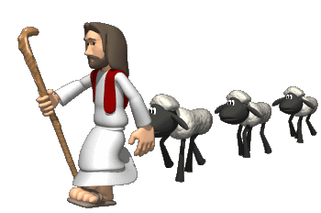
Sin, Salvation and Jesus
Key Question;
What do Christians believe about the nature and origins of sin and the relationship between sin, salvation and Jesus Christ?
To begin…
Quiz.

Slide 2
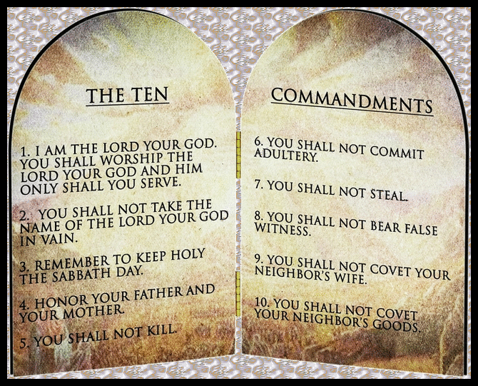
Sin, Salvation and Jesus
Key Terms …
Note down definitions for the key words on page 28 of the text book.
and then…
Note down some examples of sinful thoughts
that could lead to breaking God’s laws.

Slide 3
Sin, Salvation and Jesus
Key Terms …
Using the pictures you will be given explain the idea of original sin.
and then… read page 29…
1. Explain what free will is and why, referring to Christian teachings this does not mean we can do exactly as we like.

Slide 4
Sin, Salvation and Jesus
Salvation;
Explain what salvation is and how Christians believe they can be ‘saved’.
What are they being ‘saved’ from?
Key Terms …
Note down definitions for the key terms on page 30.

Slide 5
Sin, Salvation and Jesus
Salvation through Jesus (page 30);
Note down Romans 6:23. Explain the meaning of the
quotation.
2. Note down 1 Corinthians 15:21. Briefly explain the
meaning of the quotation.
Atonement (page 31)
What does Jesus’ sacrifice and atonement mean for humanity? Refer to 1 John 2:1-2 in your answer.

Slide 6
Sin, Salvation and Jesus
Exam questions…
Read the sample answers on the sheet you will be given.
2. With your neighbour discuss the answer and decide
on a mark /5.
3. How would you improve these answers? In green
add to the answer or change some of it.

