Slide 1
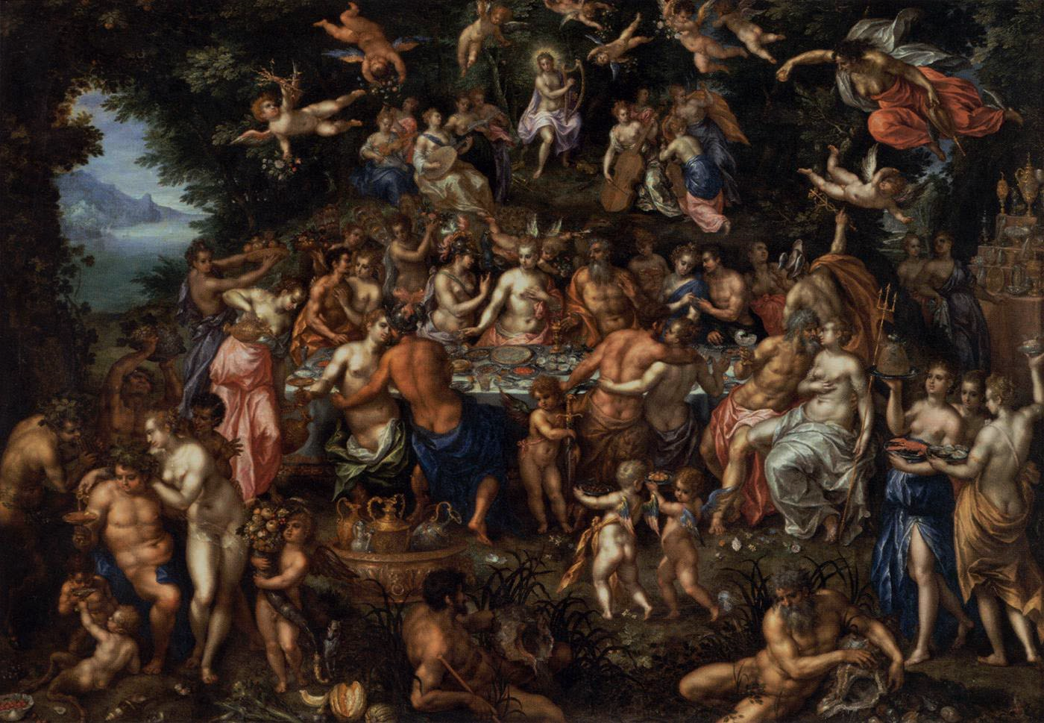
The Afterlife and Judgement
Key Question;
What do Christians believe about the connection between judgement and the afterlife?
To begin…
Key word crossword.
Use the text book to find answers to the clues.
Make sure your key terms sheet is up to date.

Slide 2
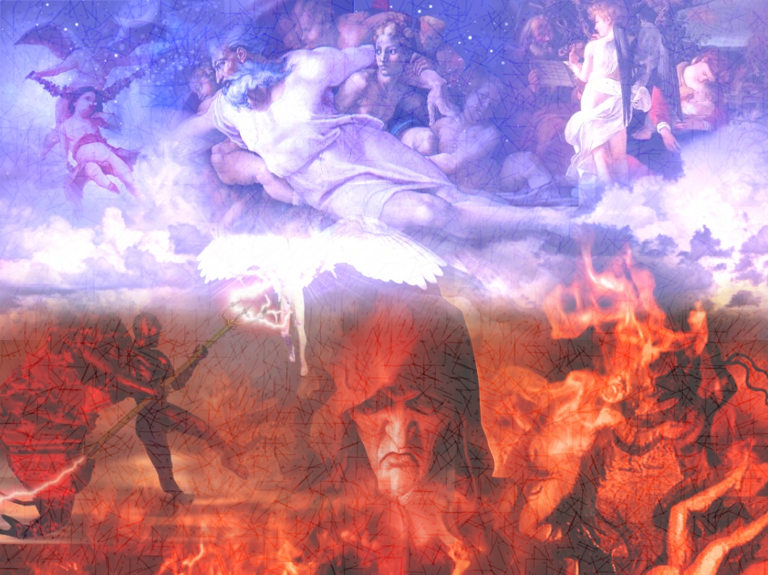
The Afterlife and Judgement
Complete… (page 24)
Read the Apostle’s Creed and complete the tasks on the sheet.
Day of Judgement (page 24-25);
1. Explain what Christians believe about the day of Judgement.
2. How does God judge people?
3. On the sheet provided, briefly explain the parable of the
sheep and the goats. Include the pictures at appropriate
places in the story.
https://www.youtube.com/watch?v=_4d-SaVMeEo

Slide 3
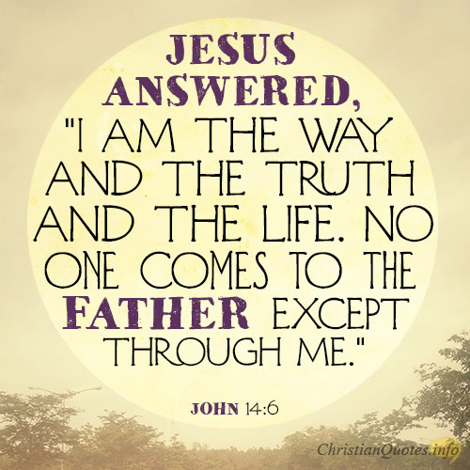
The Afterlife and Judgement
Respond…
‘Judgement is a fair way to
decide who goes to heaven
and who goes to hell’.
Use the quotation on this slide and one other quotation to respond to the statement. Explain two different points of view.
Review…
2. ‘The afterlife is a good way
to get people to behave
themselves and help others’.
Use the quotation on this slide
and examples to explain a
response to this statement.

