Slide 1
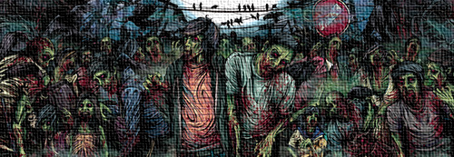
Life after Death - Resurrection
Key Question;
Why do Christians believe about life after death?
To begin… Quick quiz
https://play.kahoot.it/#/?quizId=030e2179-e1a7-4273-8852-b3bdd702f454
Key Terms… Make sure you have noted down definitions for these key terms;
Catholic Orthodox Protestant denomination omnipotent
Omnibenevolent justice trinity Holy Spirit Son of God
Creation the Word resurrection incarnation blasphemy
crucifixion ascension Heaven

Slide 2
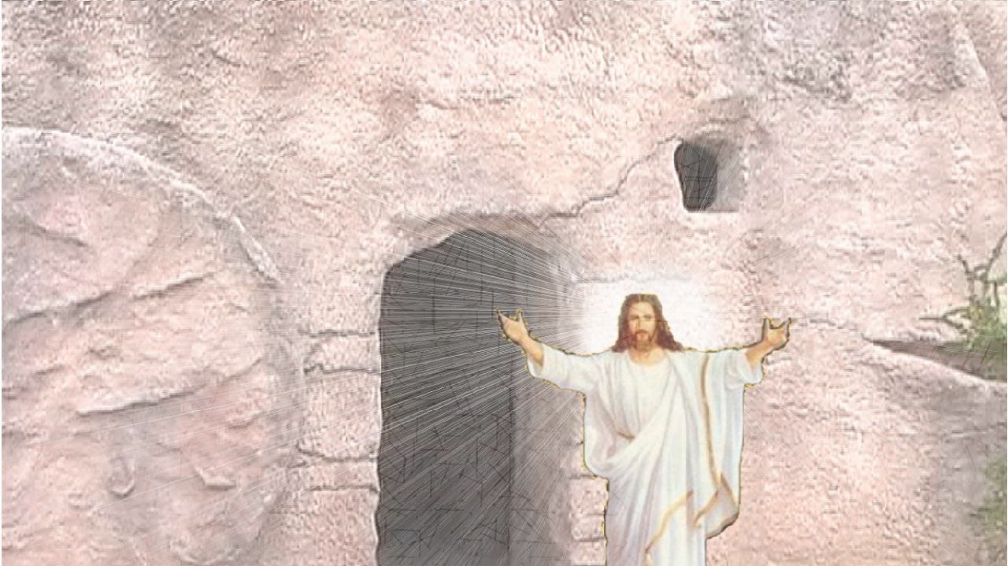
Life after Death - Resurrection
Ideas…?
Note down, or complete a spider diagram outlining as many ideas
about life after death as you can think of.
2. Give at least two reasons why you think people believe in an after
life.
Read and answer (page 22)…
Christians believe that resurrection is a reality. However, there are different beliefs within Christianity about the form that resurrection will take.
Explain, in detail, the differences between the resurrection of the soul and a bodily resurrection.

Slide 3
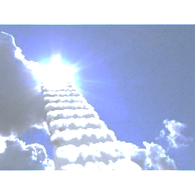
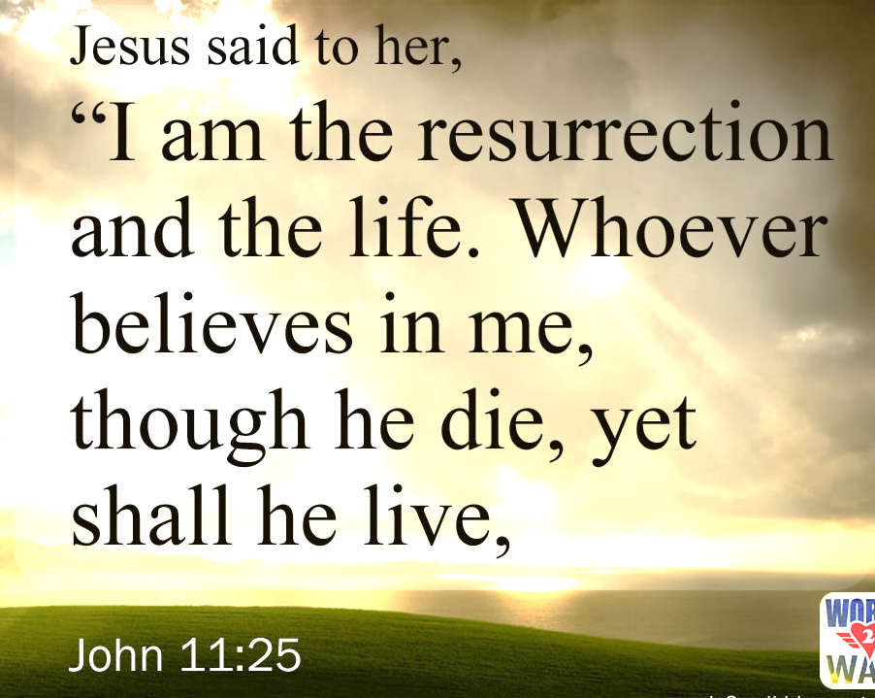
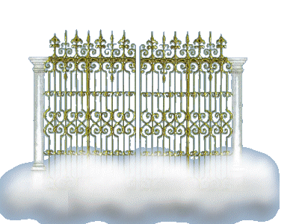
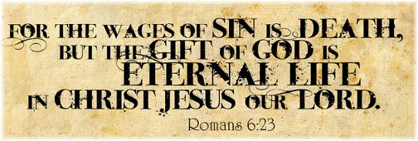
Life after Death - Resurrection
Explain…
Note down and explain the meaning of two of these quotations.
And finally…
How might a belief in resurrection affect how a Christian behaves?

