Slide 1
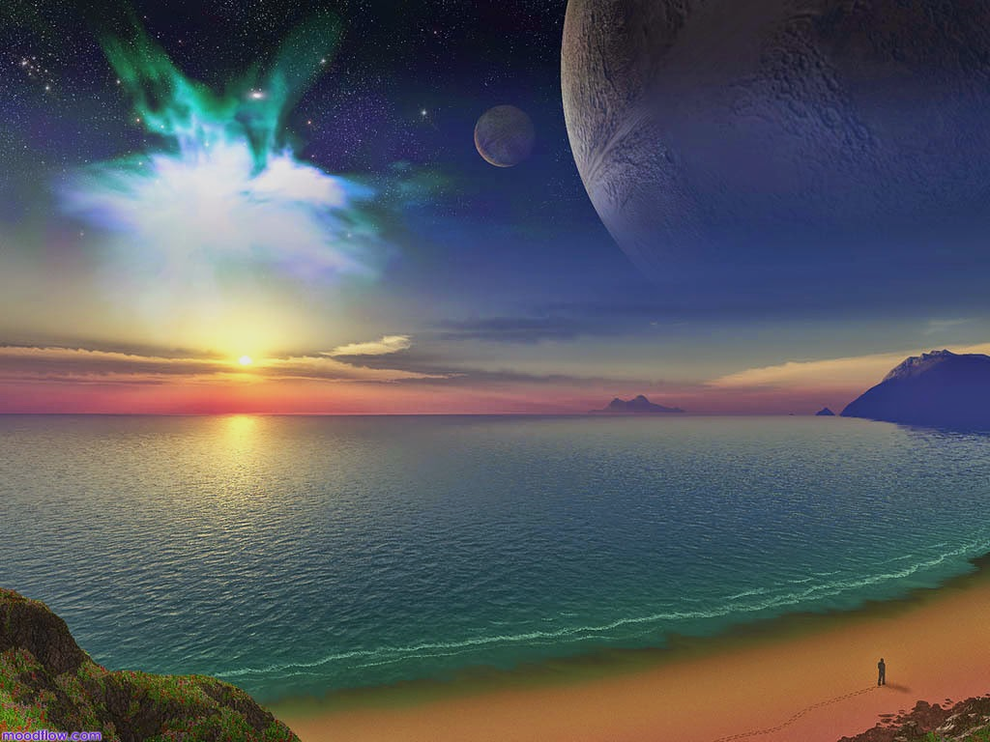
Christian Beliefs about Creation
Key Question;
Why do Christians believe different things about creation?
To begin…
According to the 1st Creation story in the Bible, what did God create on day 1; 4 & 5?
According to the 2nd Creation story in the Bible, in what order were animals, men and women created? How was man created? What were the ‘jobs’ given to man and woman?

Slide 2
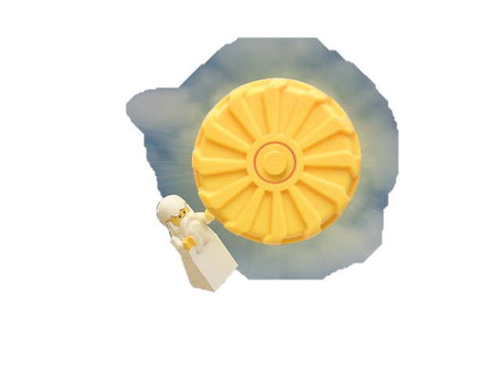
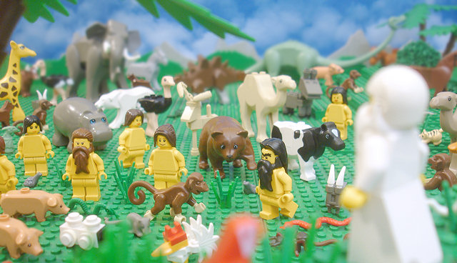
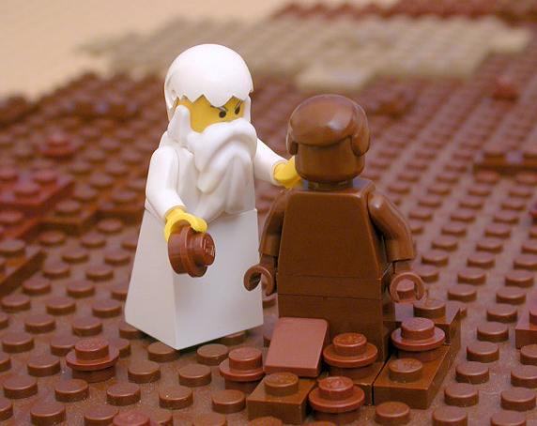
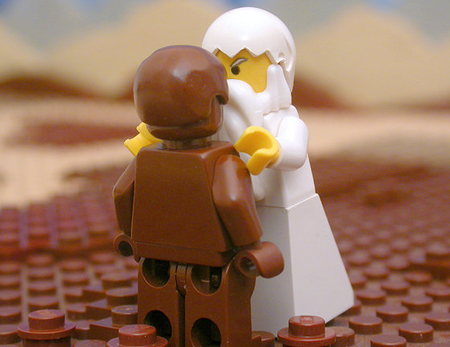
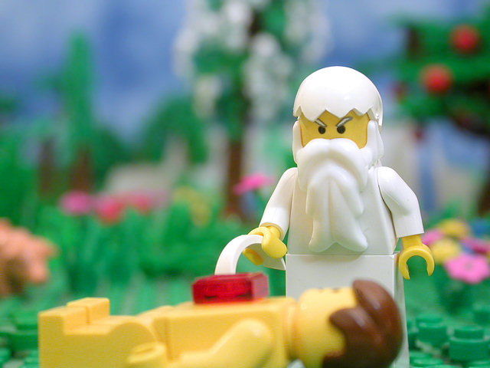
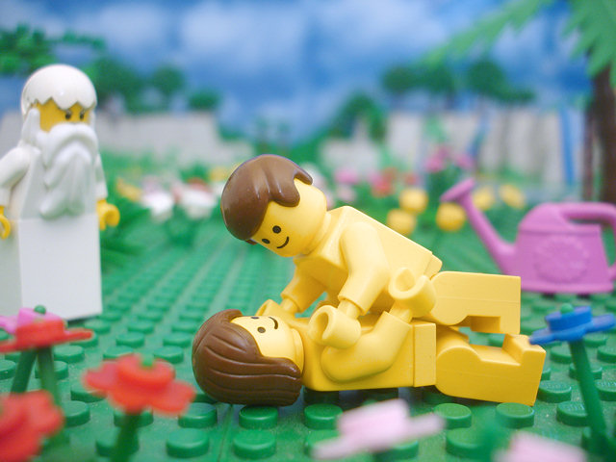
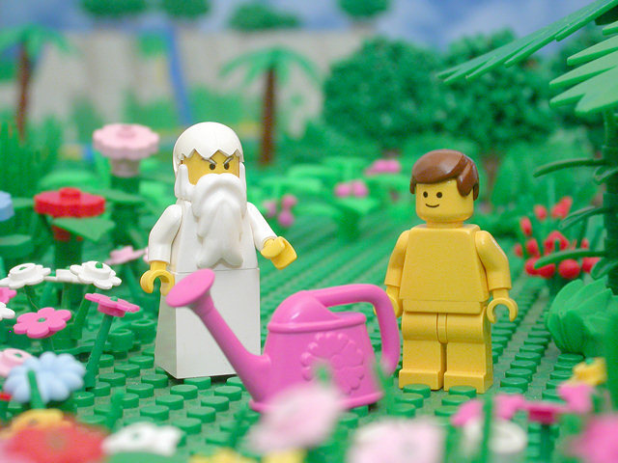
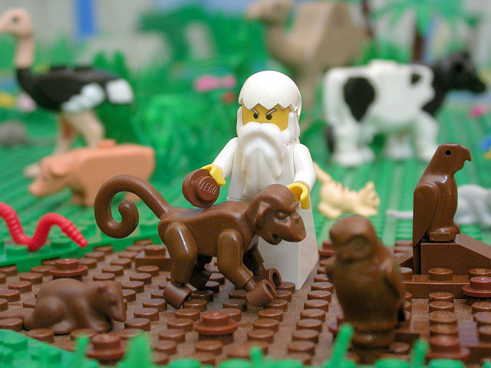
Genesis
1:1-30
Genesis 2:4-24
Use these pictures to help answer
the starter questions.

Slide 3
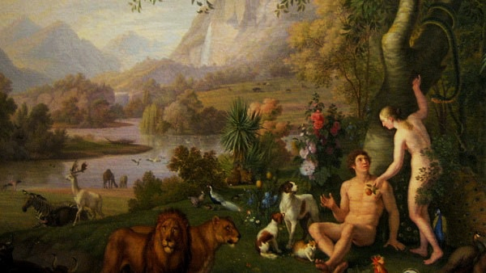
Christian Beliefs about Creation
Genesis 1: The Beginning
1 ‘In the beginning God created the heavens and the earth. 2 Now the earth was formless and empty, darkness was over the surface of the deep, and the Spirit of God was hovering over the waters.’
Questions (page 14)
Write an overview of Christian beliefs about Creation.
2. What does the reference to ‘the Spirit of God’ suggest about the
Holy Spirit’s existence?

Slide 4
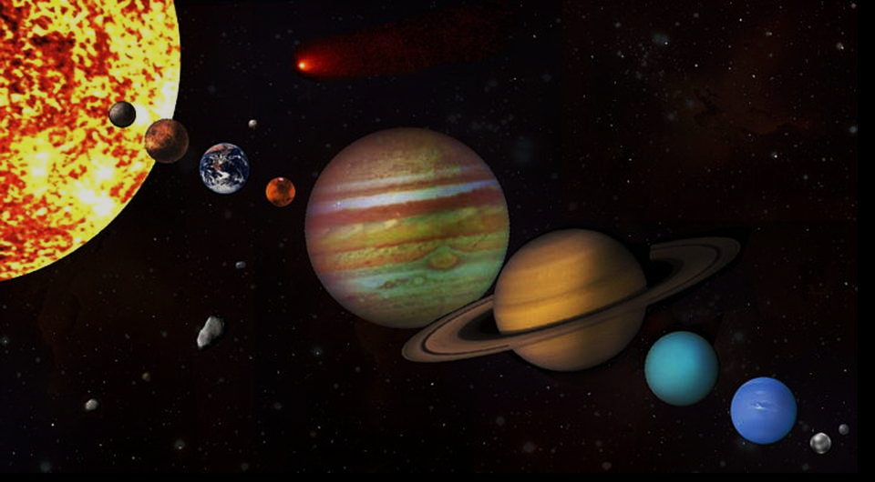
Christian Beliefs about Creation
John 1:1-3 The Word Became Flesh
In the beginning was the Word, and the Word was with
God, and the Word was God. 2 He was with God in the
beginning. 3 Through him all things were made; without
him nothing was made that has been made.
Questions (page 15)
Who does ‘the Word’ refer to?
What does the reference to ‘the Word’ suggest about creation and the Trinity?
Why do Christians suggest humans can never fully understand God?

Slide 5
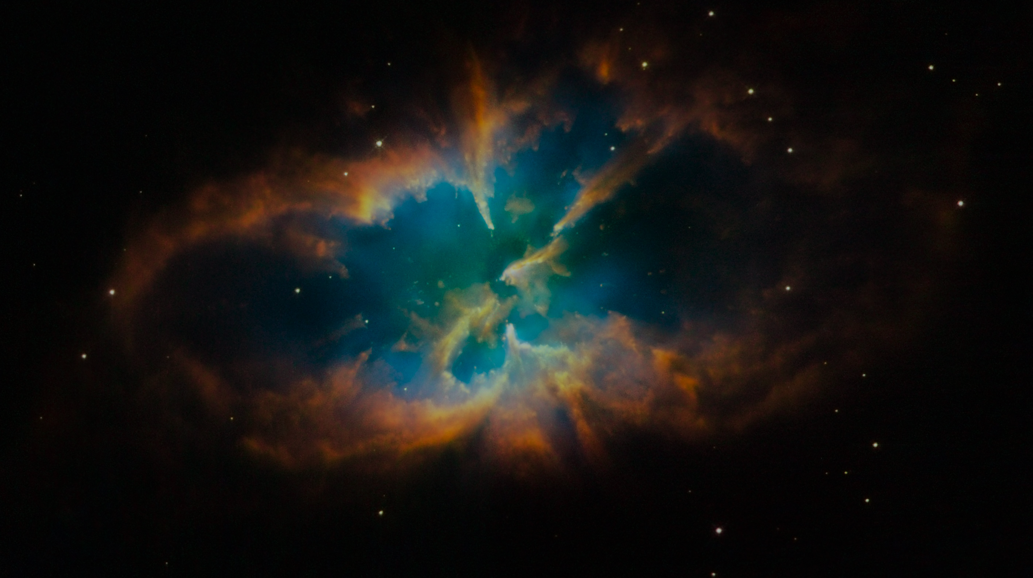
Christian Beliefs about Creation
Truth or Myth?
Some Christians take the Bible literally meaning what it says in the Bible is true word for word. If scientific discoveries disagree with what the Bible says, then science is wrong.
Most Christians believe that God created the universe is a religious truth, but they accept the creation stories in the Bible are myths. The stories are a way of explaining something unknown to humans.
Questions (page 15)
Explain how and why Christians understand the creation stories in different ways.
What do these different beliefs suggest about the compatibility of religious and scientific views about creation?

Slide 6
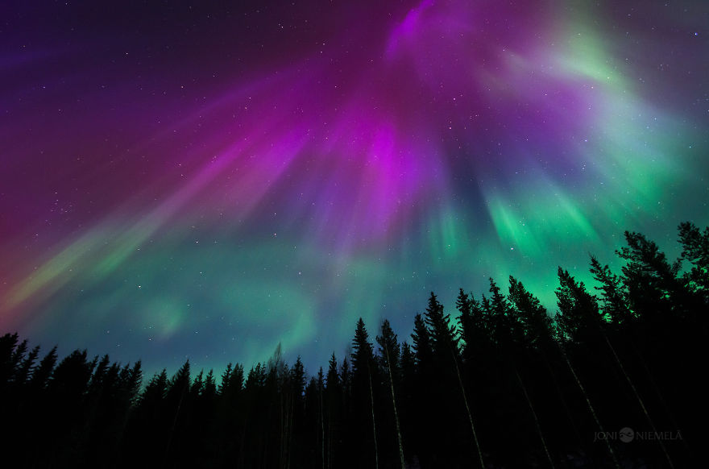
Christian Beliefs about Creation
Review – Exam Questions.
1. Explain two ways in which Christians understand the creation
stories in the Bible. (4 marks).
2. Explain two Christian beliefs about God the creator.
Refer to scripture in your answer. (5 Marks)

