Slide 1
GCSE Paper 1A – Christianity; Beliefs & Teachings
Key Question;
What is this part of the GCSE all about?
To start;
This is the first paper you will sit in summer this year.
It is based on key beliefs and teachings in Buddhism and Christianity.
We will start with Christianity.
Read the information booklet. Any questions?

Slide 2
Christianity - Beliefs about God
The Nature of God.
This section will mainly be a recap of what we have already done in the Philosophy topic for paper 2A.
However, there are some new things we need to learn as well as revisiting some year 7 work!
The Christian Church (text book, page 8).
On a diagram of a tree, briefly explain how the Christian Church split into different denominations (groups).
Explain using the maps, how the Church spread across the world.

Slide 3
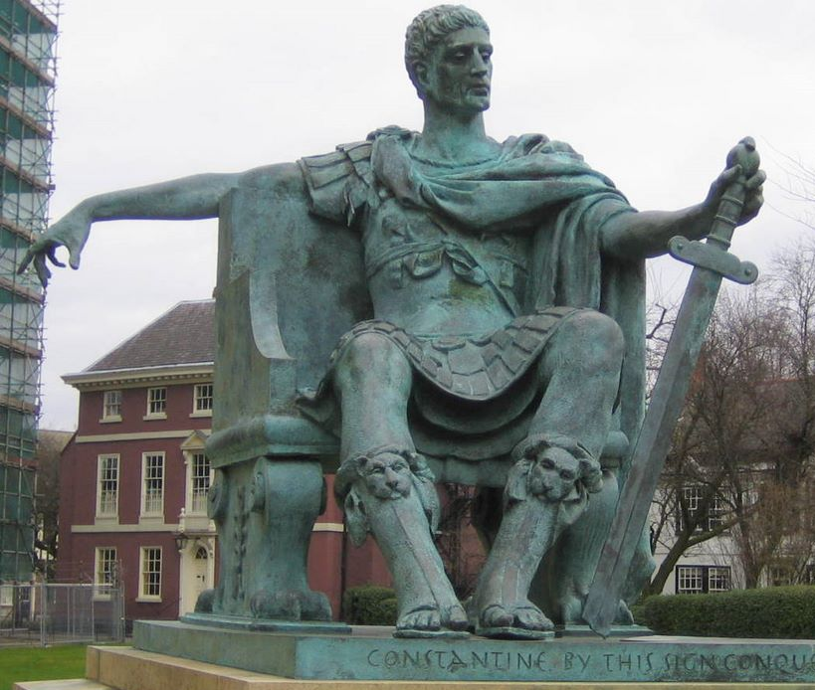
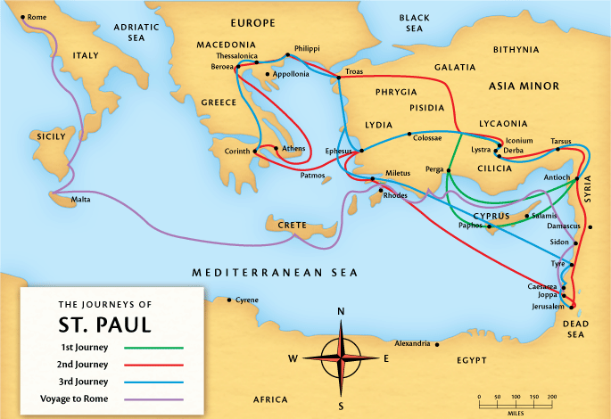
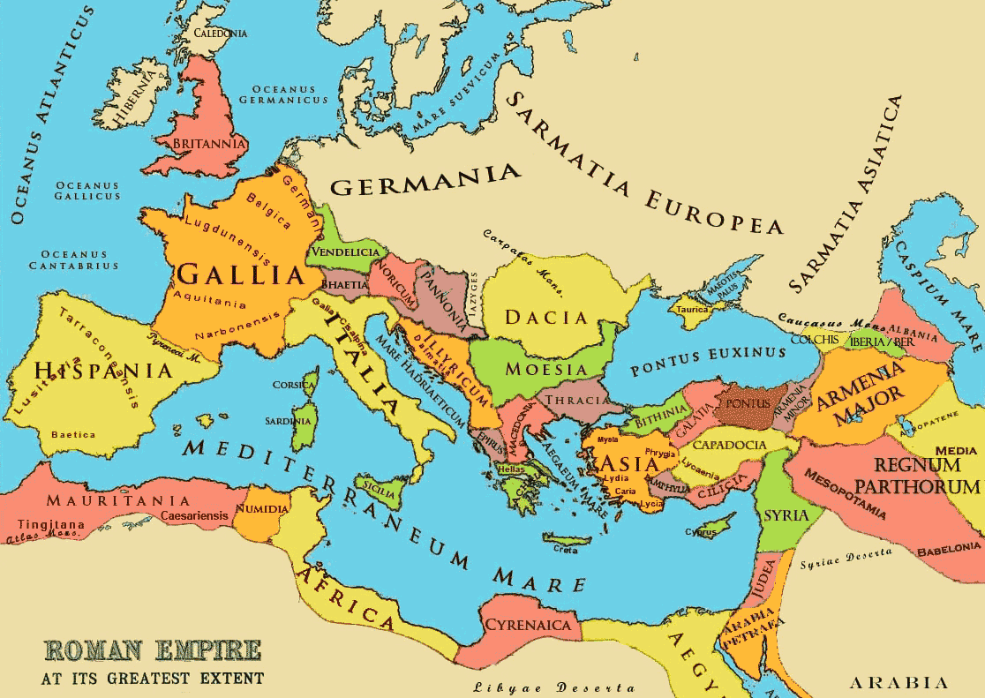
Christianity - Beliefs about God
Emperor Constantine
280-337
Circa 60C.E.

Slide 4
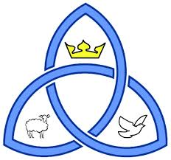
Christianity - Beliefs about God
Key Words;
1. Note down the definitions for the key words on pages 8 & 9 of
the text book.
Christian Denominations and God;
Despite there being many different Christian denominations, worshipping in different ways and having different ideas about lifestyle etc., they all agree that Christianity is a monotheistic religion.
Review;
Using the pictures provided, review your understanding of Christian beliefs about God.

