Slide 1
Religion, Human Rights & Social Justice
Revision of the topic.
Key Question.
What have we learnt and understood about religion,
Human Rights and social justice?
Starter Task – Competitive Taboo.
In teams of 3/4, play taboo with the
key terms. When you get though all the
cards, stand up and shout ‘Justice’. The
winning team will be rewarded!

Slide 2
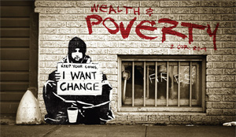
Religion, Human Rights & Social Justice
Revision of the topic.
Revision Quiz.
Answer the revision quiz on Human Rights and Social Justice questions on the sheet.
Swap with your neighbour and mark in green.
Revision Quiz.
Answer the revision quiz questions on
Wealth and Poverty on the sheet.
Swap sheets and mark in green.

Slide 3
Religion, Human Rights & Social Justice
Revision of the topic.
Quotations – fill in the missing words...
Complete the sheet on useful quotations adding the missing words.
Exam Questions.
Answer the exam questions in your exercise
book.
Refer to the advice on the sheet for
help with questions 3, 4 & 5.

