Slide 1
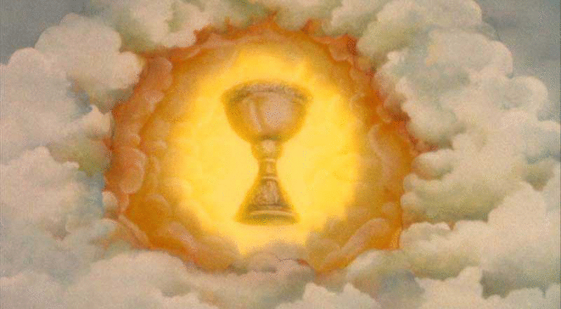
The Existence of God & Revelation
Key Question;
What have we learnt about the existence of God and Revelation?
Starter Task – Competitive Taboo.
In teams of 3/4, play taboo with the key
Terms cards. When you get though all the cards, stand up and shout ‘Vision’. The
winning team will be rewarded!

Slide 2
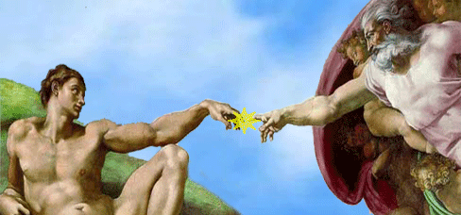
The Existence of God & Revelation
Summary;
Check your notes and add evidence of your knowledge to the summary table.
Revision Quiz.
Answer the revision quiz questions on the topic.
Swap with your neighbour and mark in green.

Slide 3
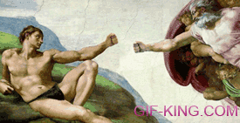
The Existence of God & Revelation
Exam Questions.
Answer the exam questions in your exercise book.
Refer to the advice on the sheet for help with
questions 3, 4 & 5.

