Slide 1
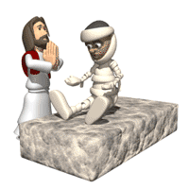
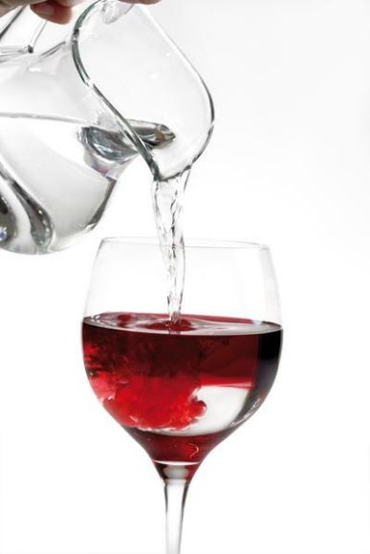
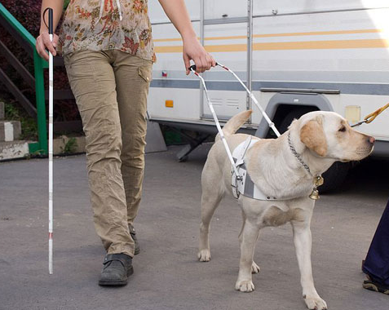
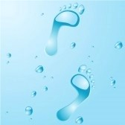
The Argument from Miracles
Key Question;
How do miracles ‘prove’ that God exists?
To begin…
Identify the miracles Jesus is said to have performed
illustrated in the pictures below.

Slide 2
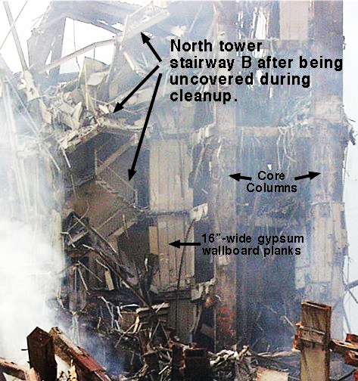
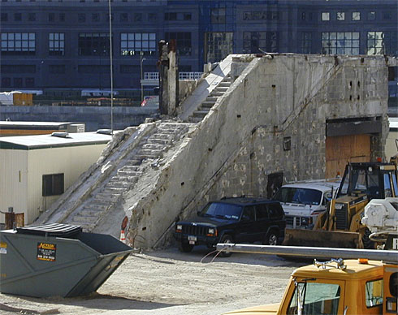
The Argument from Miracles
Discuss and answer…
Was the survival of the 16 people on stairwell ‘B’, a miracle?
Give at least two reasons for both sides of the argument.

Slide 3
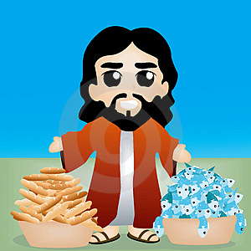
The Argument from Miracles
Complete the following …
o One type of miracles is…
o An example of this type of miracle would be…
o Another type of miracle is…
o An example of this type of miracle would be…
Then…
Write the definition for ‘miracle’, on your key terms sheet.

Slide 4
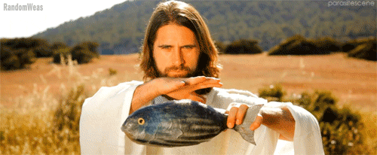
The Argument from Miracles
Complete the following …
o Three reasons why miracles cannot prove the existence of God are…
o Some religious believers do not accept miracles because…
o An example of a miracle at Lourdes was…
o Miracles ‘prove’ the existence of God because…
Exam question…
Explain two contrasting beliefs about the argument from miracles
for the existence of God. Refer to Christianity and non-religious
beliefs in your answer. (4 marks)

