Slide 1
Problems with the Cosmological
and Teleological Arguments.
Key Question.
Do the Cosmological and Teleological Arguments prove that God exists?
Starter Task.
Use the letters in the word PHILOSOPHY to write an acrostic poem and show knowledge and understanding of the Cosmological and Teleological Arguments.

Slide 2
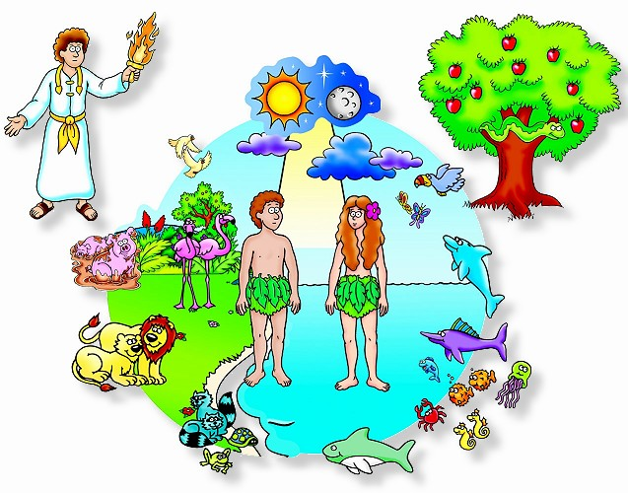
Problems with the Cosmological
and Teleological Arguments.
Lesson Outcomes.
To have shown understanding of the problems of two arguments for the existence of God.
To have applied scientific theories to the arguments for the existence of God.
To have evaluated one of the arguments for the existence of God.

Slide 3
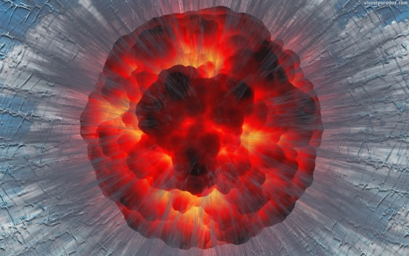
Problems with the Cosmological
and Teleological Arguments.
Things to do (Text book page 14).
1. Note down the definitions of the terms;
Evolution; Big Bang Theory.
2. Briefly outline (or draw and label a diagram) an
explanation of the Big Bang Theory.
3. Explain how the Big Bang Theory
opposes a belief in God.
4. Explain how a theist could accept the Big Bang
Theory whilst still believing in God.

Slide 4
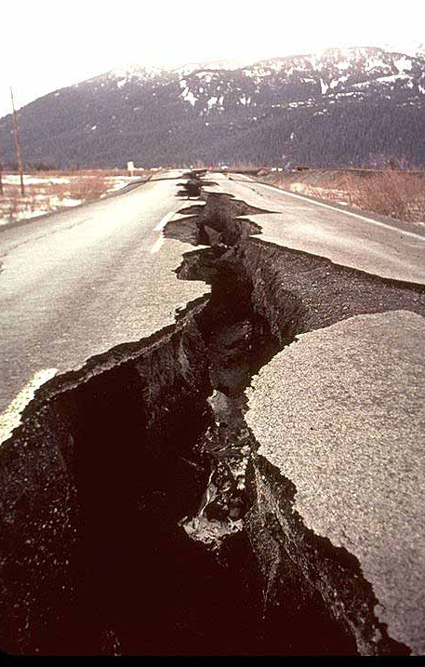
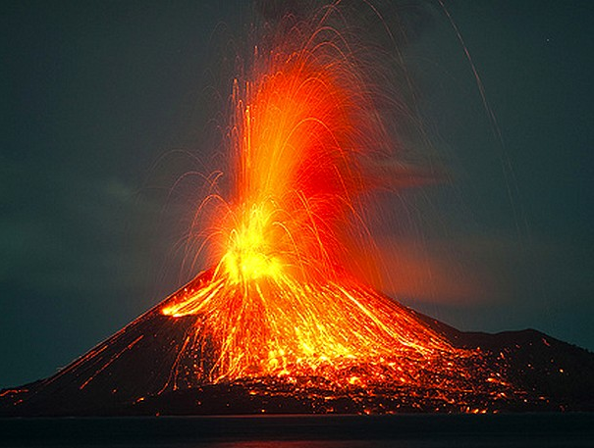
Problems with the Cosmological
and Teleological Arguments.
Things to do (Text book page 15).
Look at the pictures below. How could these pictures disprove the Teleological (Design) Argument?

Slide 5
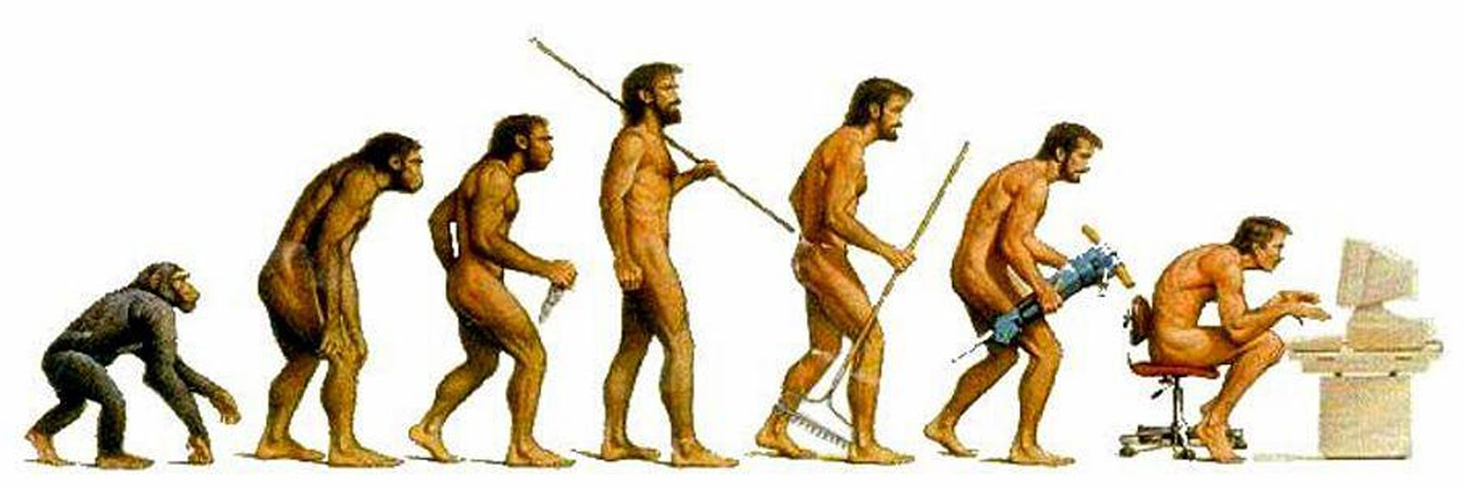
Problems with the Cosmological
and Teleological Arguments.
Things to do (Text book page 15).
2. Explain the basic problem with the Teleological
Argument.
3. Explain how Darwin’s Theory of Evolution can both ‘prove’ and ‘disprove’ the existence of God.

Slide 6
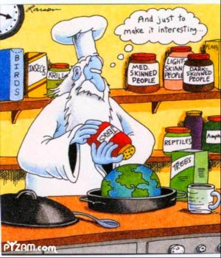
Problems with the Cosmological
and Teleological Arguments.
Evaluate.
‘The Teleological (Design) Argument proves the existence of God’.
Do you agree? Give reasons for
your answer showing you have
thought about more than one
point of view. Refer to religious
teachings in your answer.

