Slide 1
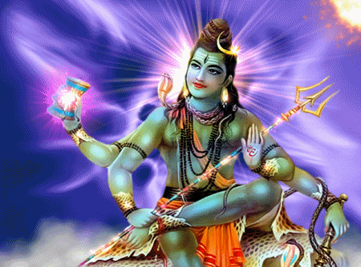
The Existence of God & Revelation
Key Question;
What do people believe about God?
To start;
This topic is based on the philosophical ideas about the nature of God and arguments for and against the existence of God.
Note down a list of reasons for why some people believe in God.
Note down a list of reasons for why some people don’t believe in God.

Slide 2
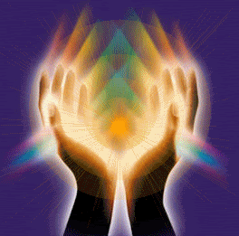
The Existence of God and Revelation
Students must be able to explain contrasting beliefs on the following issues with reference to (Christianity) and non-religious beliefs.
Visions.
Miracles.
Nature as general revelation.
Philosophical arguments for and against the existence of God including • The Design argument - its strengths and weaknesses. • The First Cause argument - its strengths and weaknesses. • The argument from miracles - its strengths and weaknesses, and an example of a miracle.
• Evil and suffering as an argument against the existence of God.
• Arguments based on science against the existence of God.

Slide 3
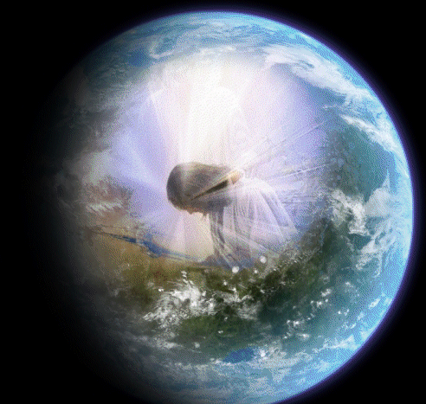
The nature of the divine and revelation
• Special revelation as a source of knowledge about the divine (God
or an ultimate reality) including visions and one example of a vision.
• Enlightenment as a source of knowledge about the divine.
• General revelation: nature and scripture as a way of
understanding the divine.
• Different ideas about the divine that come from these sources:
such as • omnipotent and omniscient • personal and impersonal •
immanent and transcendent.
• The value of general and special revelation and enlightenment as
sources of knowledge about the divine, including: • the problems of
different ideas about the divine arising from these experiences.
• alternative explanations for the experiences, and the possibility
that the people who claimed to have them were lying or mistaken.

Slide 4
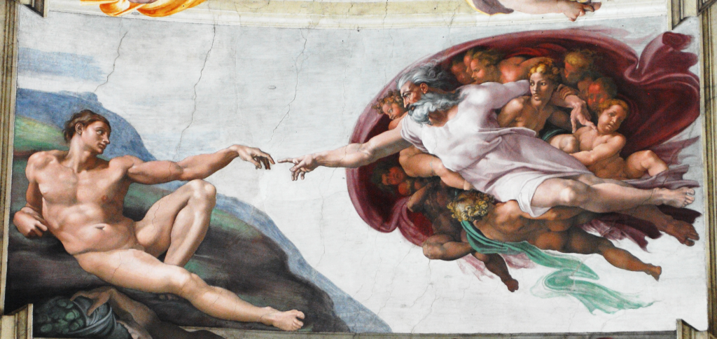
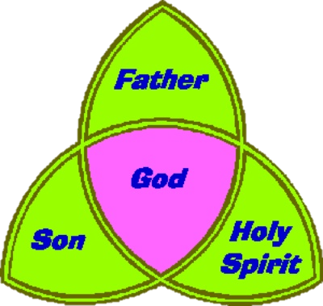
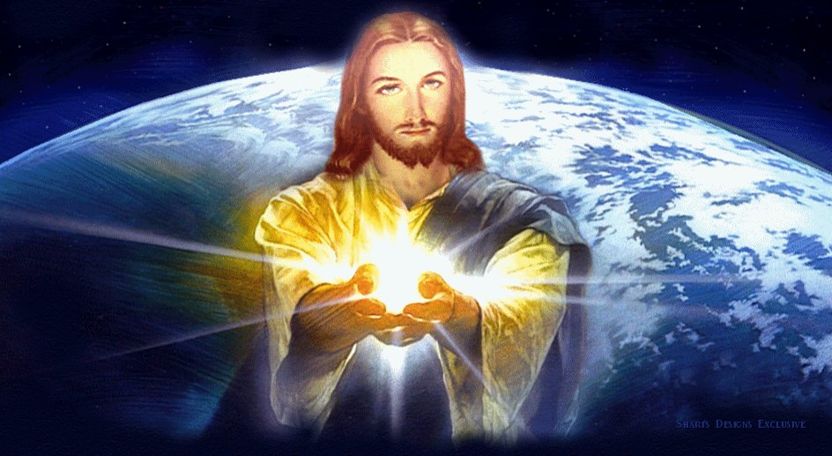
The Existence of God & Revelation
The Trinity;
Draw your own diagram of the Trinity.
Briefly explain each part

Slide 5
The Existence of God & Revelation
Beliefs about the nature of God;
Complete the table matching pictures to key ideas about the nature of God with explanations.
Nature of God in the Bible;
Psalm 139 - Lord, … you know me. You know when I sit and when I rise…
1 John 4:8 - God is love.
Genesis 1.1 - In the beginning God created the heavens and the earth.
Note down each of these teachings and link them to three different aspects of God. Give reasons for your responses.

Slide 6
The Existence of God & Revelation
Buddhism and God;
Explain why Buddhists do not believe in a god.
Review – you should now be able to answer this exam question;
Explain two religious beliefs about the nature of God.
Refer to scripture or sacred writings in your answer. (5 marks)

