Slide 1
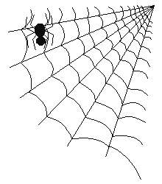
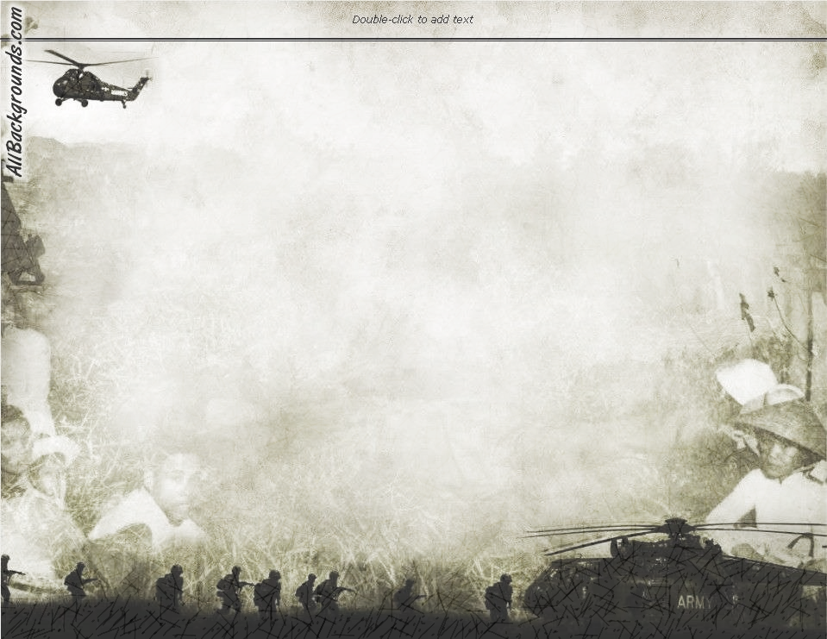
Helping Victims of War
Key Question;
What do religious believers do to help victims of war?
To begin
Complete a list or spider diagram outlining some of the effects of war.

Slide 2
Helping Victims of War
Think and note down…
Consider some of the examples on your spider diagram and think about how they could be helped. Choose two examples and note down your ideas.
Think back and note down…
Which Christian organisation that helps victims of war was featured in the film Hotel Rwanda?
Who did this group help and how did they help?

Slide 3
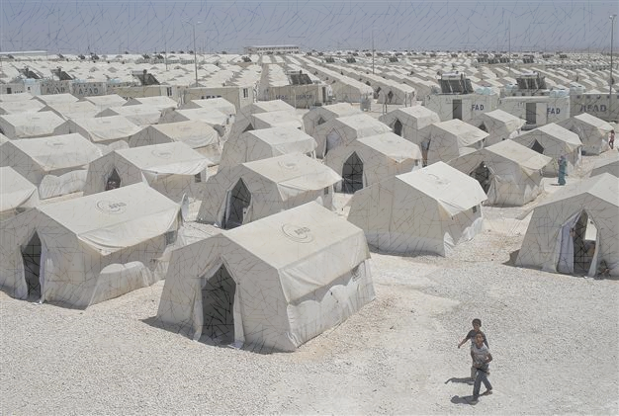
Helping Victims of War
Research…
Complete a table outlining what the Red Cross - http://www.redcross.org.uk/ and the UNHCR - http://www.unhcr.org/uk/ (United Nations High Commission for Refugees) to help victims of war.
Exam questions…
Give two ways in which religious believers would help victims
of war. (2 marks)
Explain two reasons why religious believers should help
victims of war. (5marks)

Slide 4
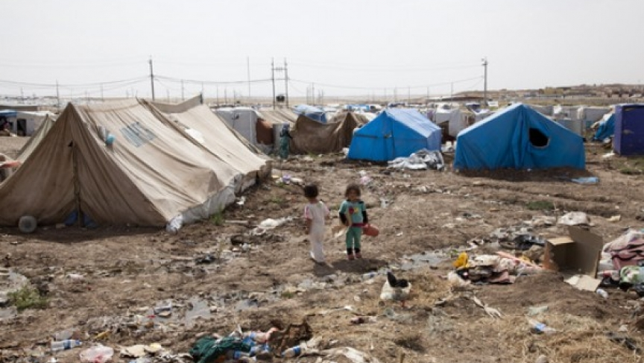
Helping Victims of War
Review/Revise…
Review your notes and make sure they are complete and include work on each of the above topics. Note down one important thing about each bullet point.
Complete this and revise for homework – Assessment on this topic next lesson.

