Slide 1
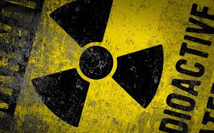
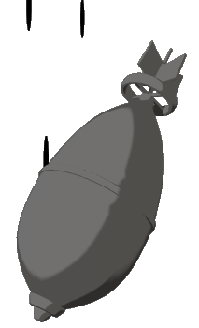
Weapons of Mass destruction
Key Question;
What are WMDs?
To begin
Key Word Wordsearch

Slide 2
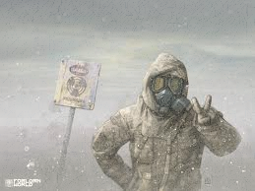
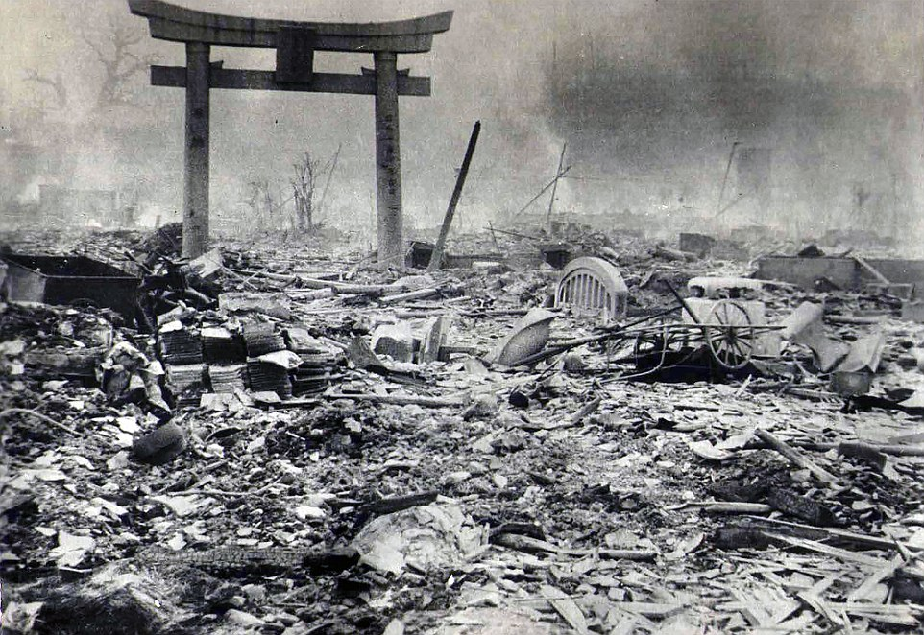
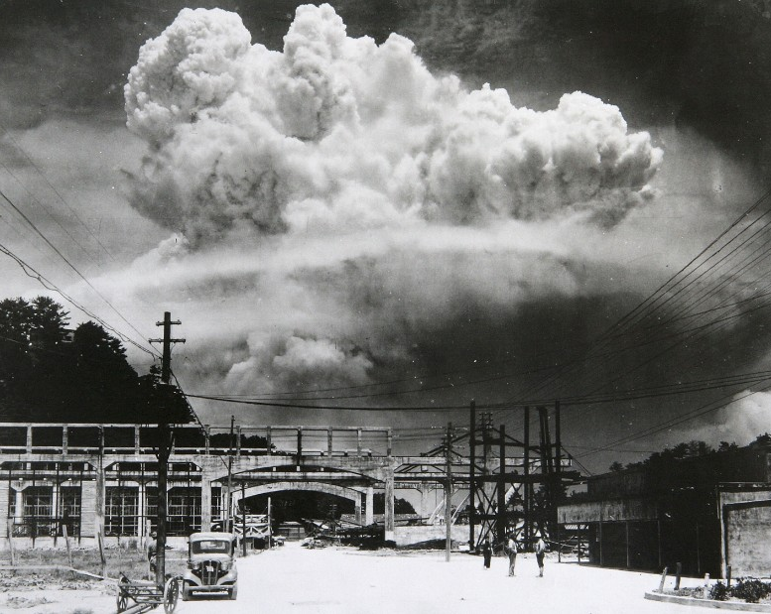
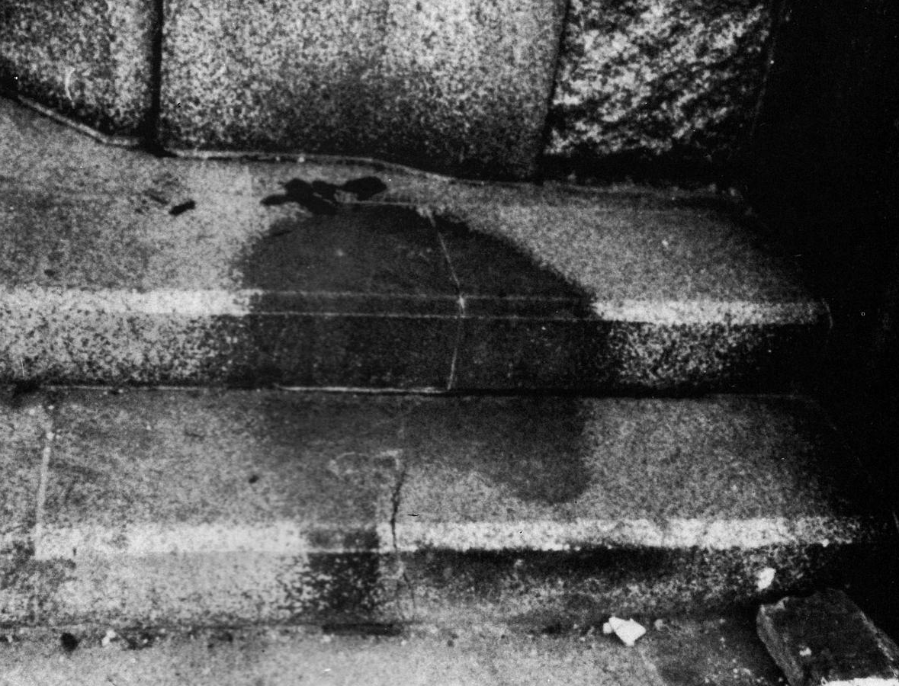
Weapons of Mass destruction
Watch and note down…
…some of the effects on the city, buildings & people, of the atomic bomb on Hiroshima.
https://www.youtube.com/watch?v=b2KKQBGsAHs

Slide 3
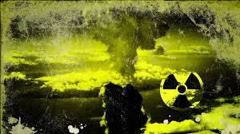
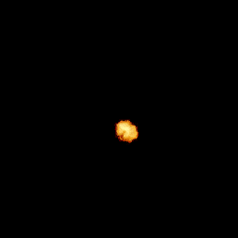
Weapons of Mass destruction
Things to do…
Why would the use of a nuclear bomb go against the Just War criteria?
Where were the only nuclear weapons to be used, dropped?
Who were the main victims of the bombs? Approximately how many died?
Why were these bombs dropped?
1-2-3…
Give one Buddhist teaching; two Christian teachings and three non-religious reasons for why the use of nuclear weapons is wrong.

Slide 4
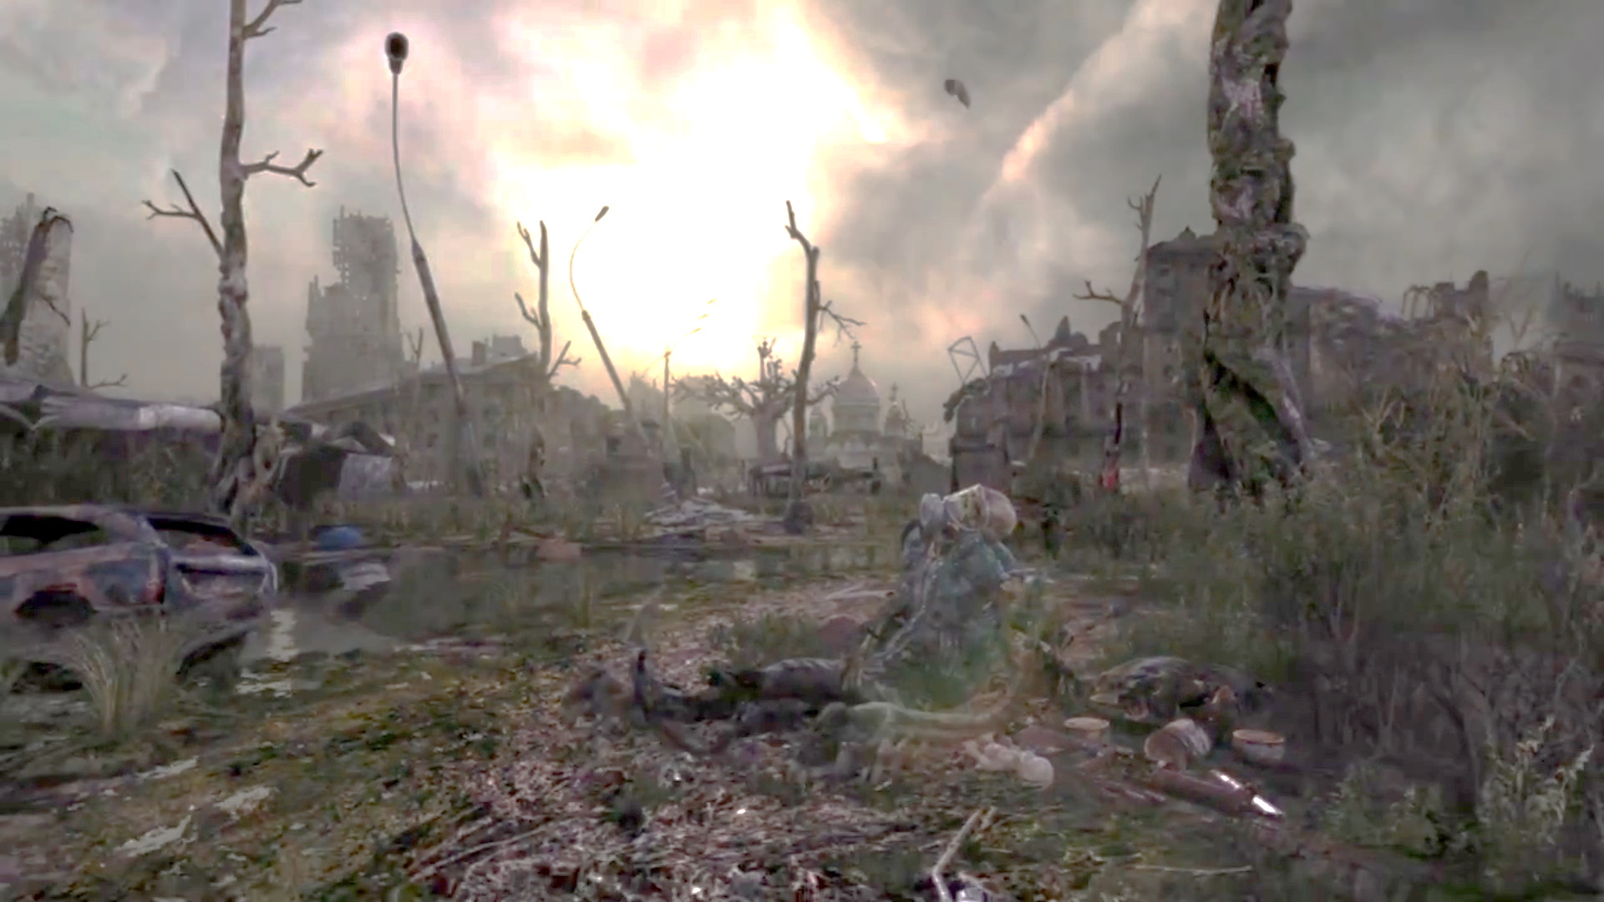
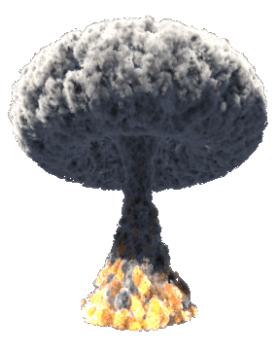
Weapons of Mass destruction
Read and …
Note down three bullet points of information about CND,
including their aims and how they try to achieve their aims.
Note down three bullets point of information about CCND, including who they are, what they do and why they do it.
Note down three bullet points of information about chemical weapons and three bullet points about biological weapons.
4. Note down definitions of the key terms on this sheet.
https://play.kahoot.it/#/?quizId=92235bd3-9a4b-4f4f-b201-e5a385a6242a

Slide 5
Weapons of Mass destruction
‘There are no good reasons for countries to possess nuclear weapons.’
Evaluate this statement. In your answer you:
• should give reasoned arguments in support of this statement
• should give reasoned arguments to support a different point of view
• should refer to religious argument
• may refer to non-religious arguments
• should reach a justified conclusion. [12 marks] SPaG 5 Marks

