Slide 1
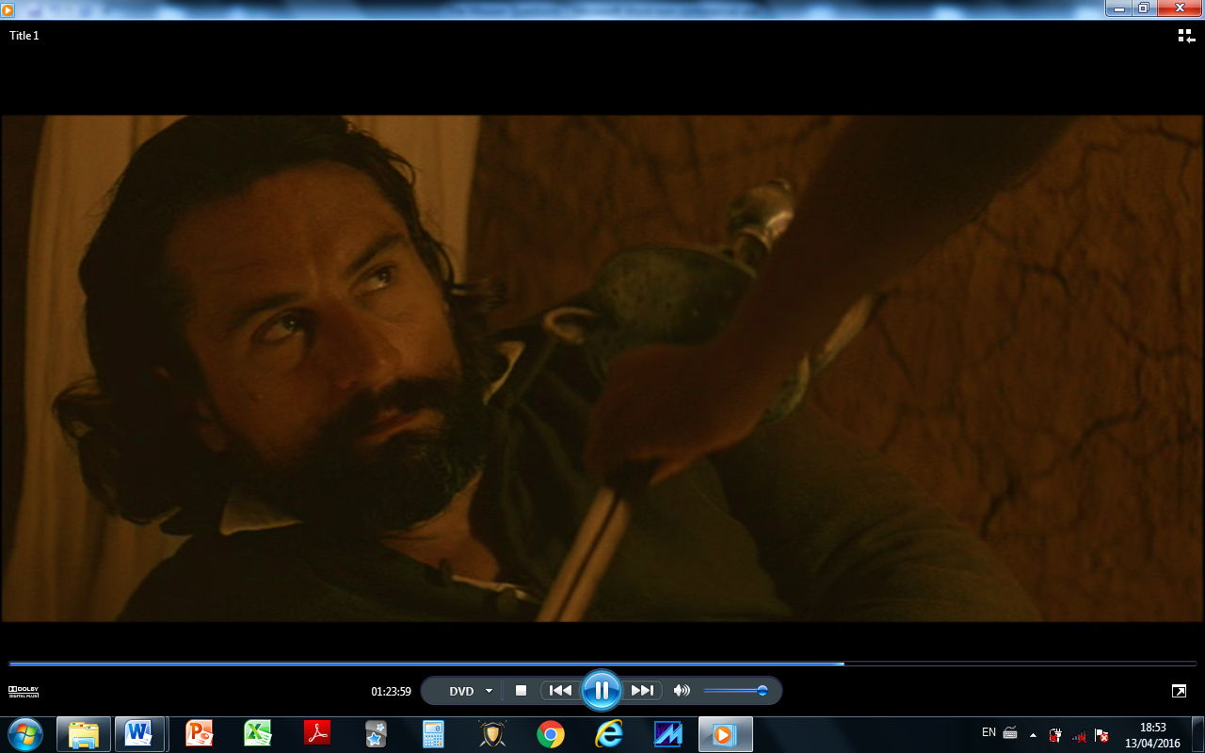
The Mission
To fight or not to fight?
Notes:
For a study and debate on violence and pacifism. Play The Mission as far as 1:27:00 then pause it and show this ppt to slide 7.

Slide 2
The Situation
San Carlos is a Jesuit mission base in South America.
It is in territory that used to belong to Spain but has been handed over to Portugal.
Spain and Portugal both trade slaves in practice.
The mission is a safe haven for Guarani Indians because it belongs to the Catholic Church and cannot be touched.

Slide 3
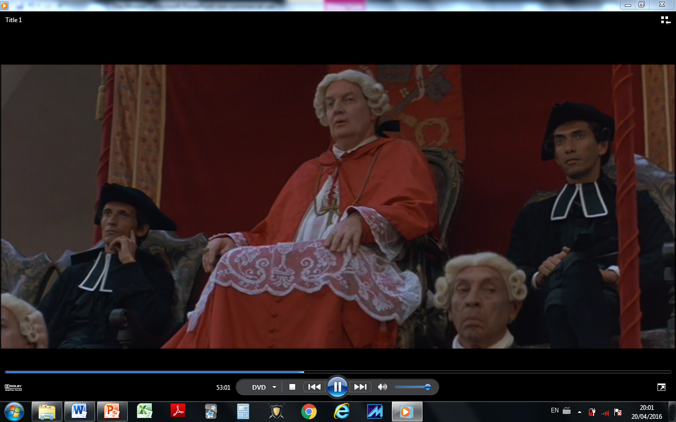
The Situation
The Portuguese want permission to break up the Jesuit missions so that they can enslave the people.
If Cardinal Altamirano says no then thousands of Jesuits will be expelled from Portugal and probably other European countries too because Jesuits are seen as too powerful.
Cardinal Altamirano decides to protect the Jesuits in Europe by allowing the Portuguese to take over the South American missions.

Slide 4
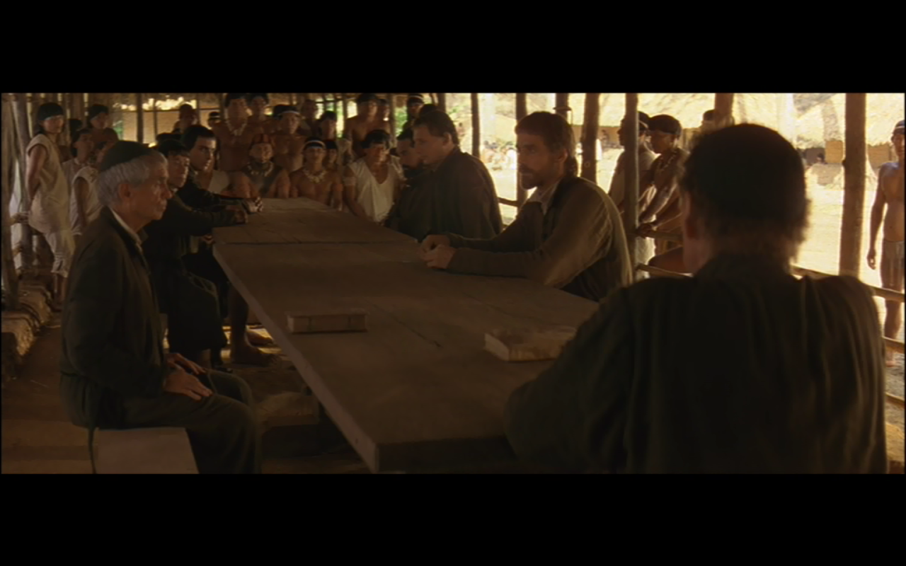
The Situation
Should they fight?
Altamirano tells the Guarani that they must leave the mission and go back to living in the jungle.
They have to give up their homes and go back to a more basic jungle existence again.
If they do this they will also probably be hunted down and enslaved.
If they refuse they will be killed.

Slide 5
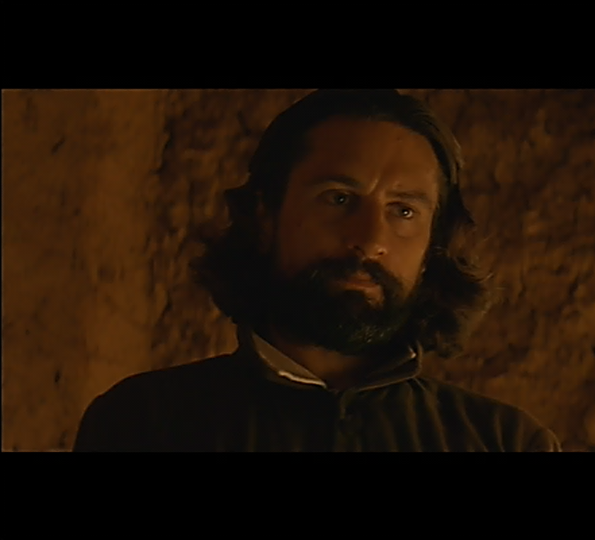
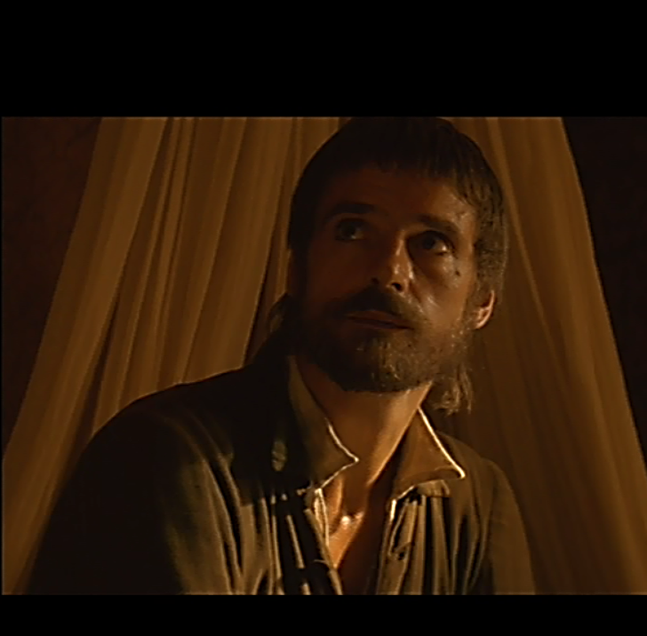
To fight or not to fight?
They want to live, father.
They need my help.
What do you want, captain; an honourable death?
Rodrigo
You promised your life to God and God is love.
If might is right then love has no place in the world.
If you die with blood on your hands, Rodrigo, you betray everything we’ve done.
Help them as a priest.
Father Gabriel
Notes:
Ask pupils to discuss with those around them first what is the meaning of these quotations and then whether they agree with them.

Slide 6
God is love.
1st John 4:16
Notes:
Copy the Bible verse. How can this teaching be applied to war?

Slide 7
The monstrance
This contains the Host (consecrated bread) used in Communion.
Catholics believe the bread actually is the body of Christ.
It is extremely sacred for all Catholics.
Notes:
This slide is purely explanatory. Play the remaining 20 min of the film then go to the next slide.

Slide 8
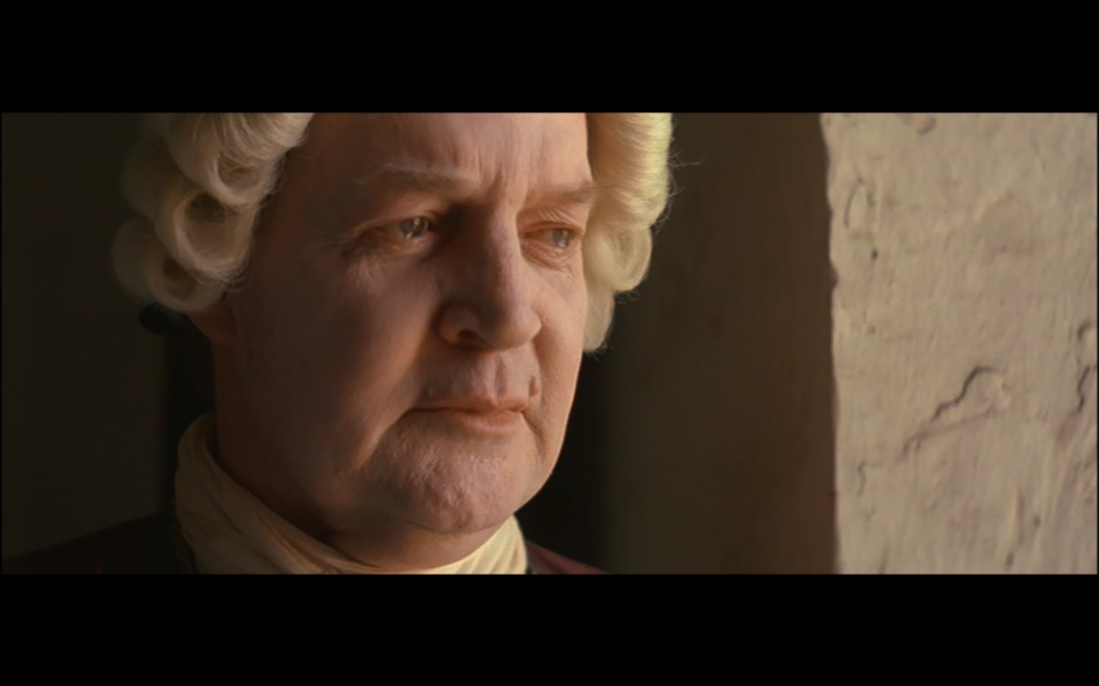
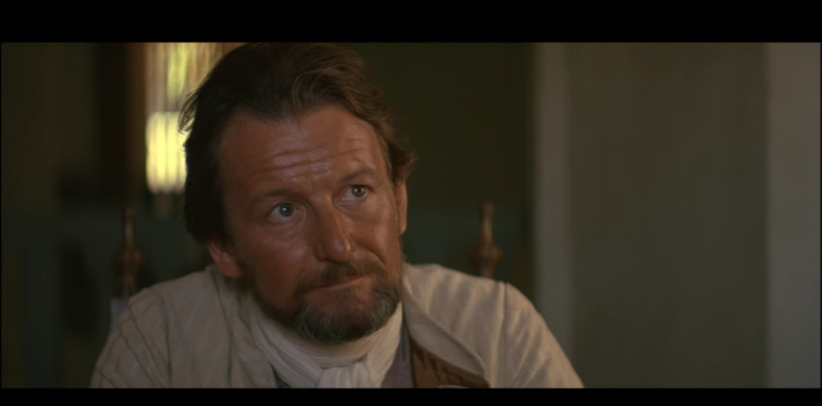
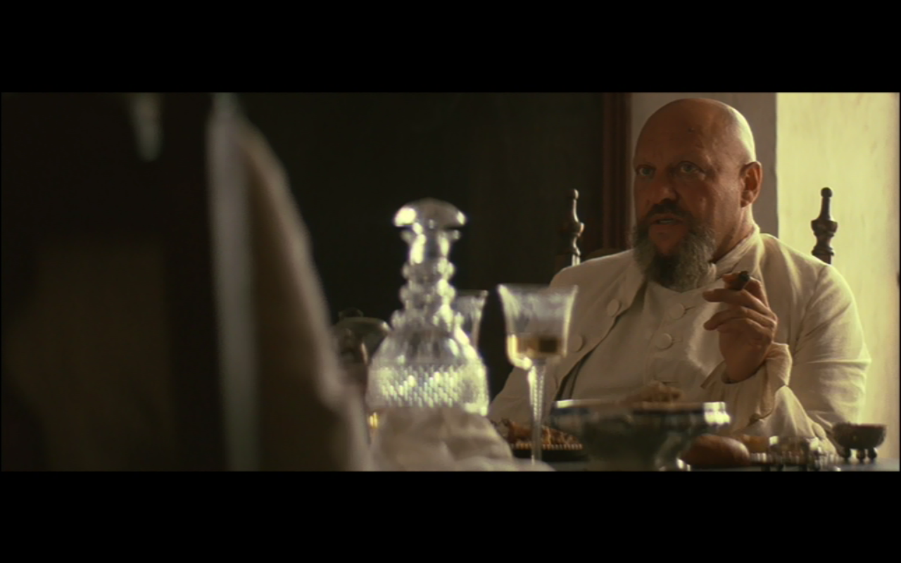
You had no alternative, your eminence. We must work in the world; the world is thus.
No, Señor Hontar; thus have we made the world.
Cardinal Altamirano
Thus have I made it.
Señor Hontar
Don Cabeza
Notes:
These last two slides are for a discussion of the need for/needlessness of war and to sum up the film. In the event, both the fighters and the pacifists met the same fate, at least in earthly terms. Did they meet the same fate in eternity? Could discuss here the relationship between politics and war.

Slide 9
Altamirano’s Remorse
So, Your Holiness, now your priests are dead and I am left alive.
But in truth, it is I who am dead and they who live.

