Slide 1
Pacifism & Pacifists
Key Question.
Why are some religious believers pacifists?
To Start...
Check your key terms sheet. Have you completed the definitions for the terms we have looked at so far?

Slide 2
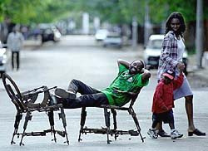
Pacifism & Pacifists
Questions.
What are the chairs the man is sat on made out of?
This was a Christian Aid project in Mozambique. What do you think had happened there at the time of the project?
Read Isaiah 2:4. What is the connection to the project.

Slide 3
Pacifism & Pacifists
Read and complete...
Read about Buddhist and Christian pacifists.
Add information under the headings on the sheet you will be given.
Exam questions...
Give two ways in which religious believers campaign for peace.
Give two reasons why religious believers may be pacifists.

Slide 4
Pacifism & Pacifists
Review - exam question;
Read the exam questions and discuss with your neighbour what level and mark you would give each answer.
Use the 12 mark level descriptor to help.
Don’t forget to also award a SPaG mark out of 5. Use the level descriptors to help. Highlight any SPaG errors.

