Slide 1
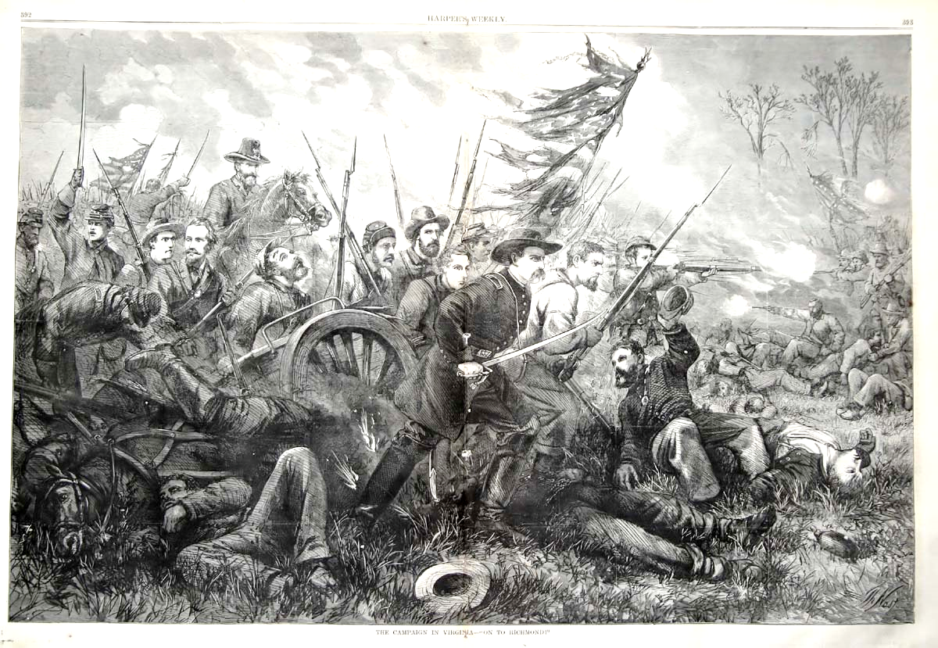
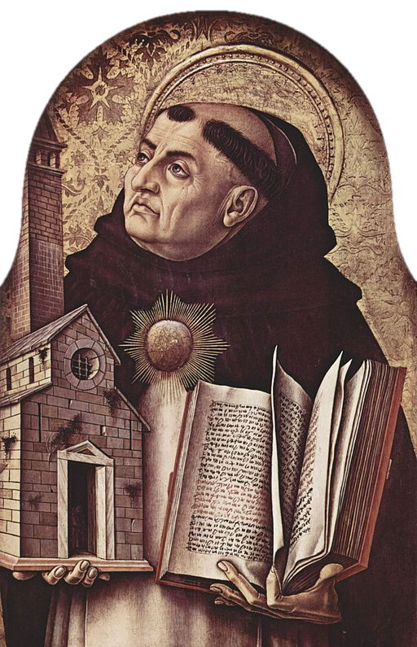
Just War
Key Question…
When is it right for Christians to fight in a war?
To begin…
Crossword.
DLOs…
To know the criteria for a Just War.
To show links between the Just War criteria and examples of wars
To apply the Just War criteria to the Falklands Conflict.

Slide 2
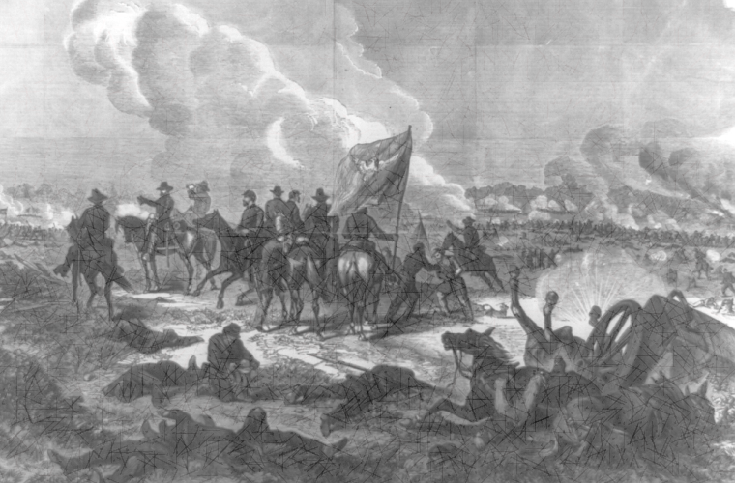
Just War
Note down…
Each of the criteria of a Just War.
Explain each criteria and add examples.
Watch and Note down…
…some of the Geneva Conventions.
https://www.icrc.org/en/document/rules-war-nutshell

Slide 3
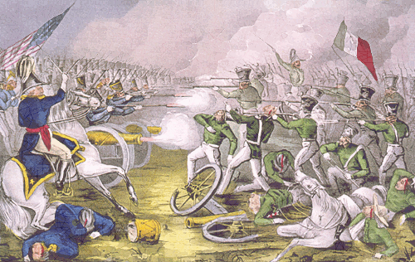
Just War
Explain …
Read about the Falklands Islands War.
Apply the Just War criteria to the Falklands War. Was it a Just War?

