Slide 1
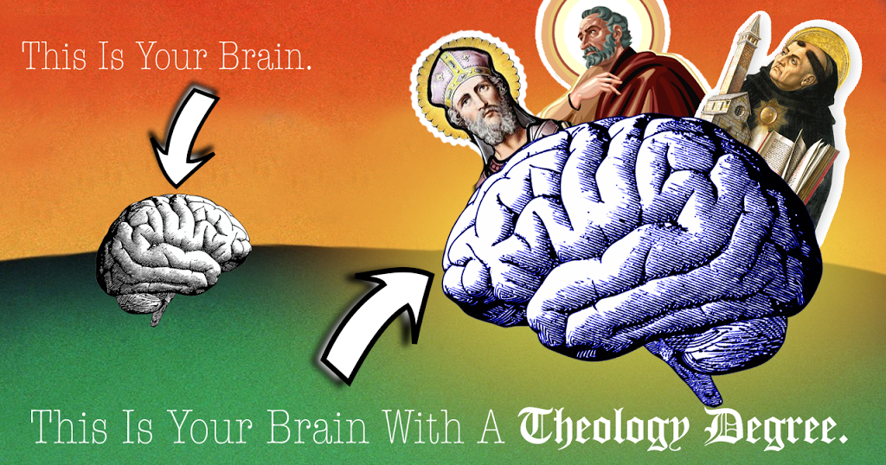

Slide 2
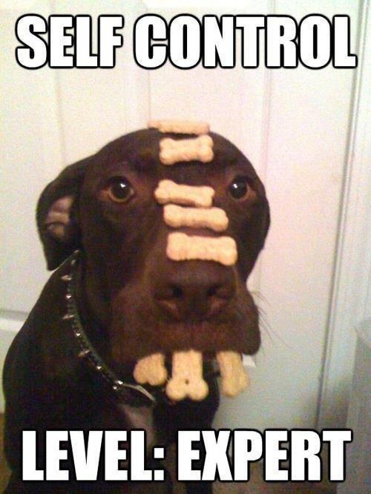

Slide 3
Desmond Doss
A pacifist’s tale
Key Question: What are the arguments for & against pacifism?
Notes:
This is a true story. This PowerPoint is designed to go with CAREFULLY SELECTED scenes from the film Hacksaw Ridge. Warning: the full film is rated 15 and contains gory images. It may not be suitable for sensitive viewers.

Slide 4
Learning outcomes
All: will be able to explain what is pacifism;
Many: you will be able to explain difficulties of putting non-violence into practice;
Some: will be able to answer an exam question on this with 8/12 or higher.

Slide 5
Scenes from the film Hacksaw Ridge

Slide 6
Desmond fights Hal
What Bible teaching is mentioned here?
Notes:
The boys fight and Desmond nearly kills his brother. The commandment, ‘Thou shalt not kill.’ is featured on the wall.

Slide 7
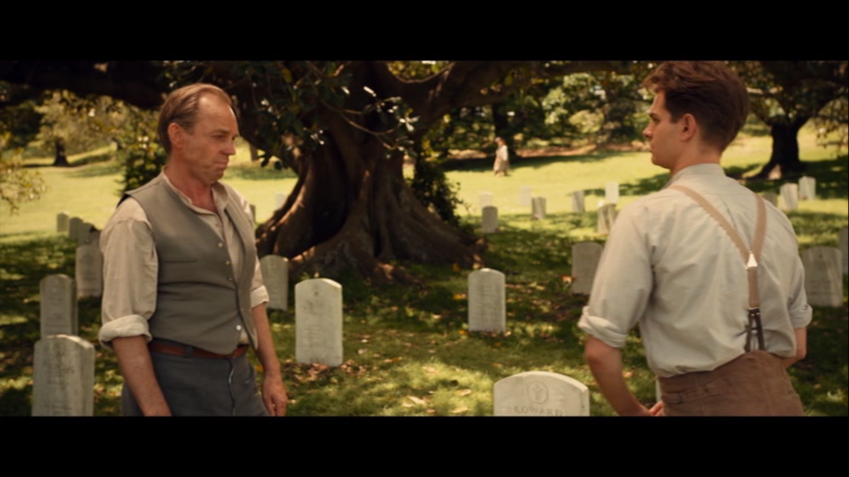
Graveyard scene
1. What reasons does his father give against going to war?
Notes:
Thomas Doss was in WW1 and is visiting the graves of his friends who were killed as young me. He does not want to visit the graves of his sons. Desmond is ‘rushing in’ to a war that will not fit in with Desmond’s beliefs.

Slide 8
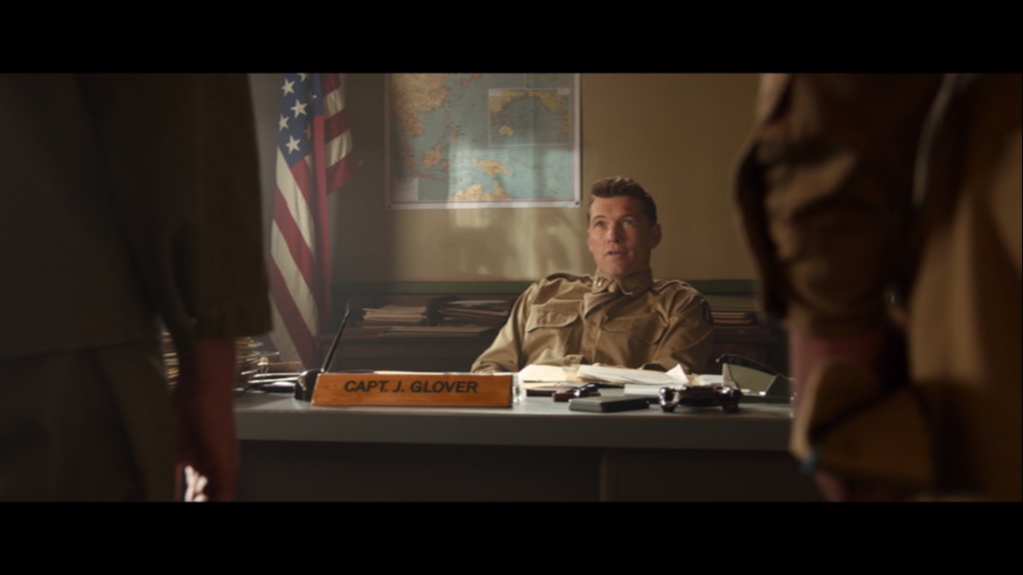
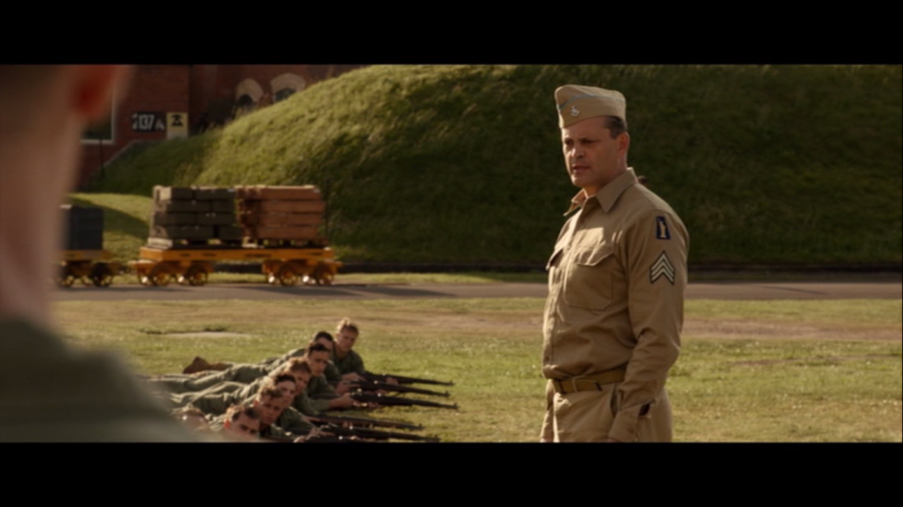
Conscientious objector
2. Why is Desmond mocked by Captain Glover?
3. What two reasons does Sarge give why Doss is wrong?
Notes:
2. The Japanese will not avoid attacking on a Saturday to fit in with Desmond Doss. Doss joined the army; there is ‘quiet a lot of killing’ in war. 3. Doss is failing to protect women and children. People will die because of his lack of fighting.

Slide 9
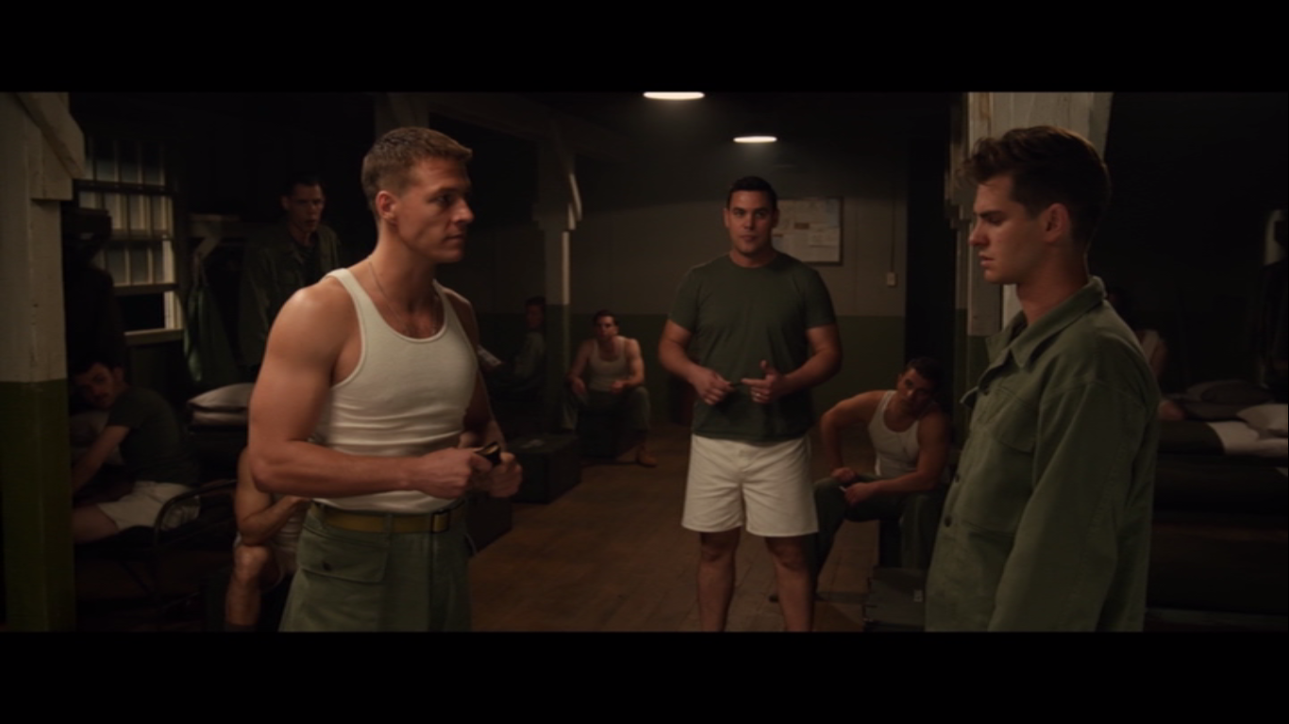
Confrontation with Smiddy
What Bible teaching does Smiddy mention?
Notes:
Jesus teaches that when someone strikes you on one cheek, turn the other cheek rather than fighting back. (Overcome evil with good.)

Slide 10
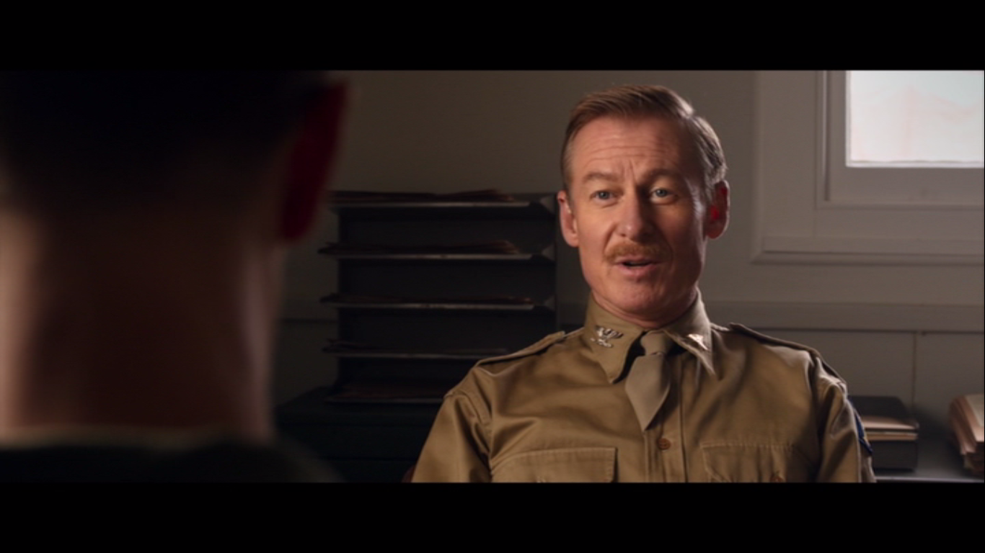
Section 8 interview
What Bible teaching does Desmond mention here?
Notes:
‘Love one another as I have loved you.’

Slide 11
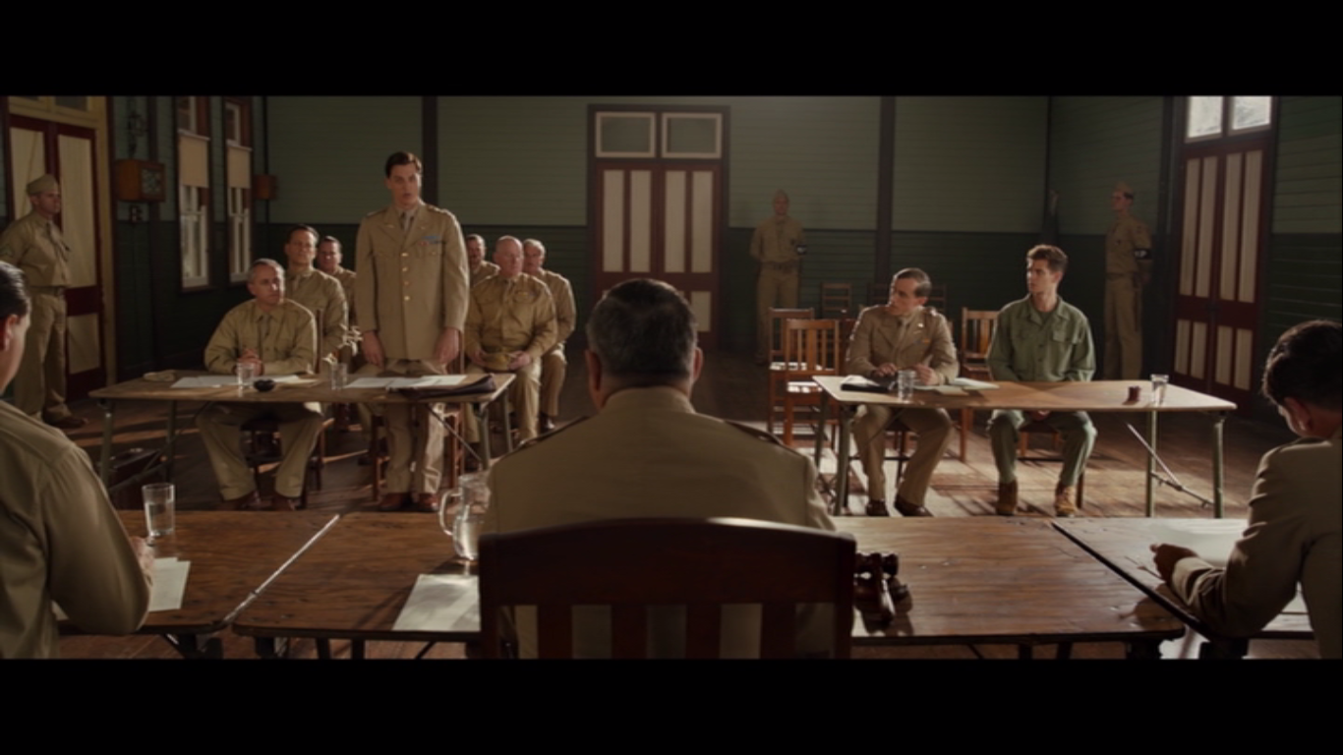
The court martial
4. Give one reason against Doss and one in his defence.
Notes:
Disobeying orders; Doss has a sense of moral superiority; In a world where people are tearing one another apart Doss wants to save lives.

Slide 12
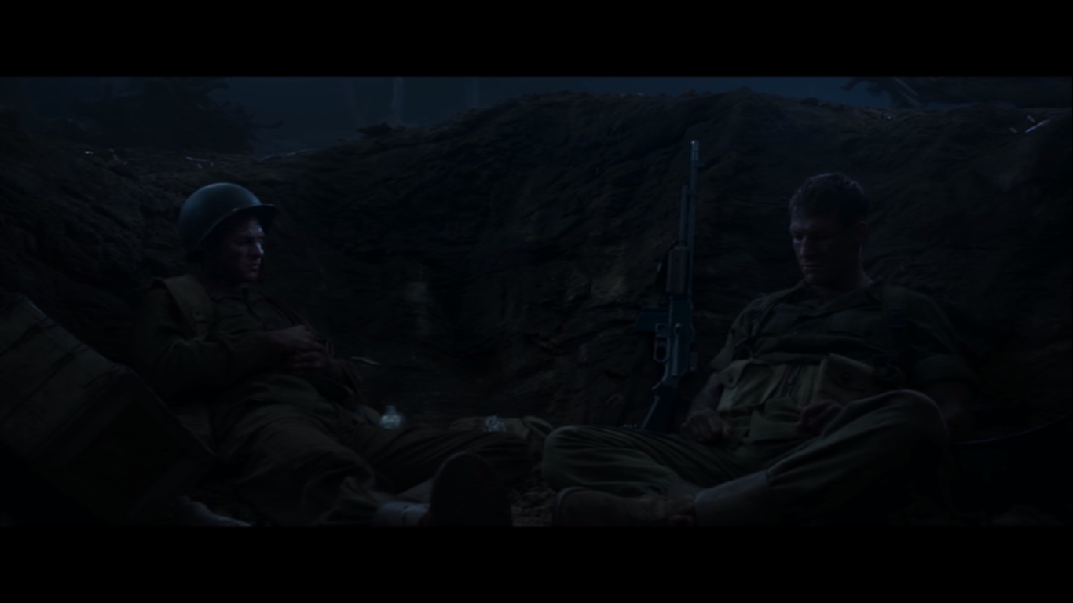
Scene in a crater
5. What personal reason does Desmond give Smiddy why he won’t touch a weapon?
Notes:
His father used to beat his mother and Desmond grabbed a gun and nearly killed him. He promised God he would never touch a gun again.

Slide 13
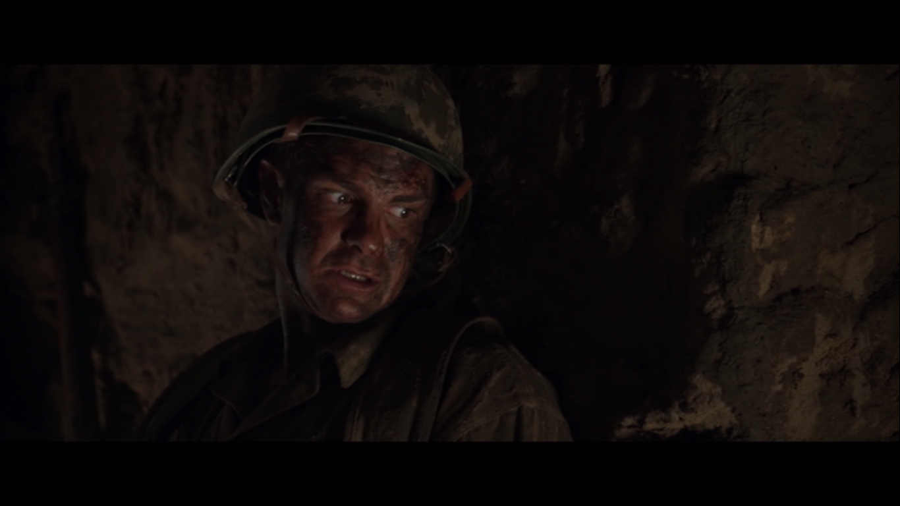
Underground scene
6. What Bible teaching does he demonstrate by his behaviour here?
Notes:
‘Love your enemies.’

Slide 14
The rescued
Notes:
Question 7 on the sheet.

Slide 15
The honour
Notes:
Question 8 on the sheet.

Slide 16
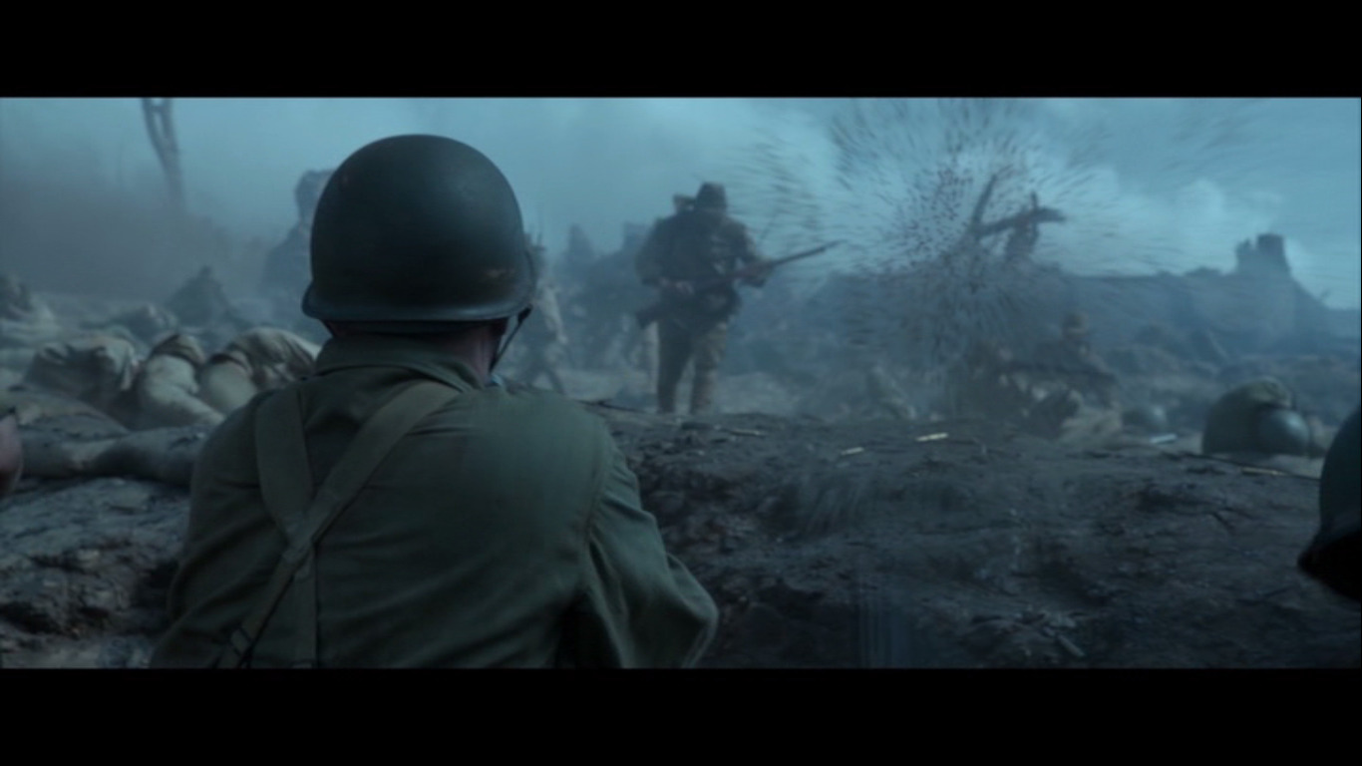
The exam question
‘Pacifism cannot work in the real world.’ Do you agree?
[12 marks]

