Slide 1
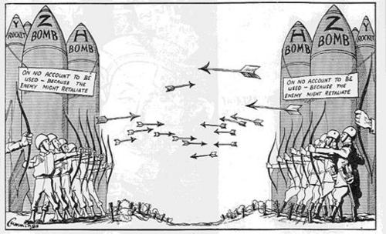
Causes of War
Key Question…
What are some of the causes of war?
https://www.youtube.com/watch?v=zy5JqEtCZfg
To begin…
Identify the potential causes of war in the pictures above.

Slide 2
Causes of War
Read and explain…
Read about Greed, self-defence and retaliation then complete the following...
1. Explain two reasons why religious believers would not agree to war. Refer to greed and retaliation and appropriate religious teachings in your answer.
2. Explain religious views about fighting in self-defence.

Slide 3
Causes of War
Read and explain…
Read about religion and war and war in the Bible, then complete the following...
1. Use a religious teaching and an example to explain why some Christians would find going to war acceptable.
2. Use a religious teaching and an example to explain why some Christians would not find it acceptable to go to war.
3. Note down some examples of where religions have been involved in violence.
4. Explain an example of a war started by a religious leader.
5. Briefly outline the story of the fall of Jericho as an example of war in the Bible.

Slide 4
Causes of War
Read and explain…
Read about modern Christian and Buddhist views about war...
Add definitions for key words on your key word sheet.
Exam Questions…
Which one of the following is not a reason for war?
A) Self-defence B) Greed C) Retaliation D) Forgiveness. [1 mark]
2. Give two religious beliefs that show that violence is wrong. [2 marks].

Slide 5
Causes of War
5 ‘There are no good reasons for religious believers to fight in a war.’
Evaluate this statement.
In your answer you:
• should give reasoned arguments in support of this statement
• should give reasoned arguments to support a different point of view
• should refer to religious argument
• may refer to non-religious arguments
• should reach a justified conclusion. [12 marks] SPaG 5 Marks

