Slide 1
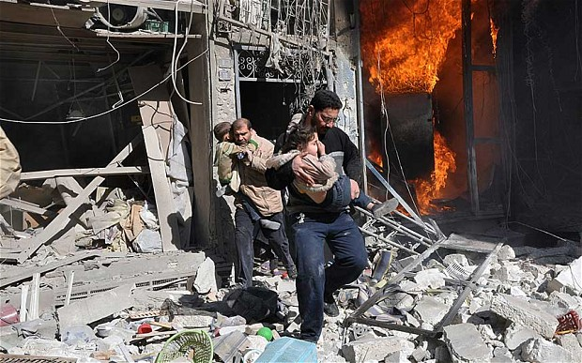
Violence, Violent Protest & Terrorism
Key Question…
What do religious believers think about the use of violence to get a message across?
To begin…
Add information in the boxes around the picture.
There are correct answers to the questions about the picture, but consider what could be the answers. Try to give a variety of answers.

Slide 2
Violence, Violent Protest & Terrorism
Protest…
Briefly explain the UK law on
protest.
Would religious believers agree
with what happened after the
killing of Mark Duggan
(Tottenham man killed by the
police). Explain different points
of view.
Note down the definitions for
the key terms on your key terms
sheet.
Terrorism…
Explain an example of a
religious believer who has
used peaceful protest to
achieve his aims.
Explain what terrorism is and
give two examples of terrorist
actions.
Why would Christians and
Buddhists not agree with
terrorism?

Slide 3
Violence, Violent Protest & Terrorism
and finally…
Explain two contrasting beliefs in contemporary British society about whether it is right to fight in a war. (4 marks).
Explain two religious beliefs about the right to protest. Refer to scripture or sacred writings in your answer. (5 marks).
Give an example of a war Christians would be prepared to fight in. Give reasons specific to the example you have given.

