Slide 1
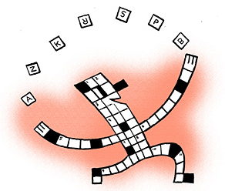
Prisons
Key Question.
Why do we send criminals to prison?
To begin…
Crossword.

Slide 2
Prisons
Which criminals should be sent to prison?
What should the conditions in prisons be like?
What should be done to help reform prisoners?
How effective are prisons?
Suggest answers to the above questions.

Slide 3
Prisons
Numbers of People in prison on September 9th 2016
https://www.gov.uk/government/statistics/prison-population-figures-2016

Slide 4
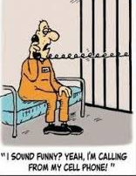
Prisons
Assess...
Considering all the information from this lesson outline arguments for and against the use of prison as a punishment for criminals.
Answer and evaluate…
Explain three reasons why young offenders are treated differently to adult criminals.
‘A life sentence should mean life in prison’. Do you agree? Explain your answer and include different points of view and religious views.

