Slide 1
Religion
&
Crime
Key Question.
Why do some people commit crime?
To begin… The legal process...
Sort the pictures you will be given to outline the process from a crime being committed to the punishment.
Write a sentence matching the picture to outline what happens to someone who is accused of committing a crime. Start with the crime happening.

Slide 2
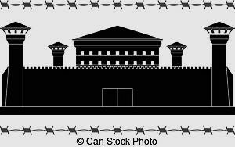
Religion & Crime
Read and respond...
Read the information on the sheet about the different kinds of law and different types crime.
Complete the tasks.
Definitions...
Write the definitions on your key word sheet.

Slide 3
Religion & Crime
Good and Evil Intentions & Actions...
Read about the causes of evil. Complete the following…
Explain, with examples, how (a) greed, (b) hatred and (c) ignorance, can lead to people committing evil actions.
Explain what Christians believe about the causes of evil.
How should we deal with people who commit evil actions?
What do religious people do to help victims of crime?
Add a definition for evil on your key terms sheet.

Slide 4
Religion
&
Crime
Review and Evaluate.
1. ‘Following a religion prevents evil from
happening’.
Do you think this is true? Give reasons for your answer, refer to examples to ‘prove your points and make sure you refer to religious beliefs/views.
2. ‘People are not evil, some just do evil
things’.
Do you think this is true? Give reasons for your answer, refer to examples to ‘prove your points and make sure you refer to religious beliefs/views.

