Slide 1
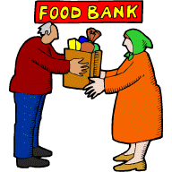
Exploiting and Helping the Poor
Key Questions.
What does it mean to exploit the poor?
How should the poor be helped?

Slide 2
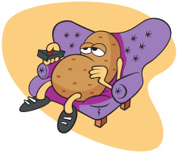
Exploitation of the Poor
Issues relating to the exploitation of the poor;
• fair pay
• excessive interest on loans
• people-trafficking.
• The responsibilities of those living in poverty to help
themselves overcome the difficulties they face.
• Charity, including issues related to giving money to the poor.
Complete the table to explain and give examples of how the poor might be exploited.

Slide 3
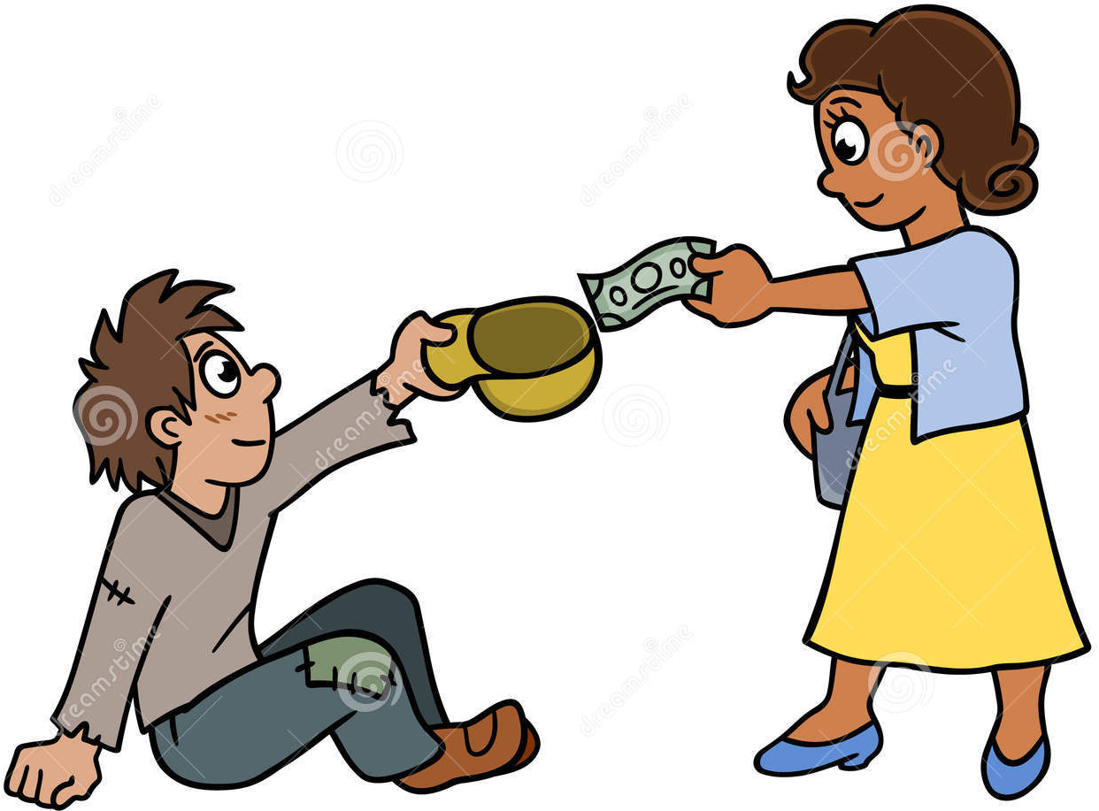
Helping the Poor
Picture Task.
Use the pictures to explain how we help the poor.
Key Terms;
Exploitation
Human Trafficking
Emergency aid
Long-term aid
Definitions;
Misuse of power or money to get others to do things for little or no money
The illegal movement of people often for the purpose of forced labour or the sex trade
Short term aid given to communities during a crisis such as an earthquake or flood
Aid given to a poor country over a long time with lasting effects

Slide 4
Exploiting and helping the Poor – Religious Views
Note down these Christian and Buddhist teachings on the sheet you will be given.
‘Do not exploit the poor because they are poor.’ Bible
‘The one who is unwilling to work shall not eat’. Bible
‘Love thy neighbour’ Jesus
“My religion
is kindness”
Dalai Lama
“Whoever has two tunics is to share with him who has none, and whoever has food is to do likewise.” Bible

Slide 5
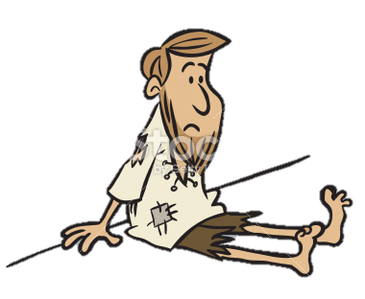
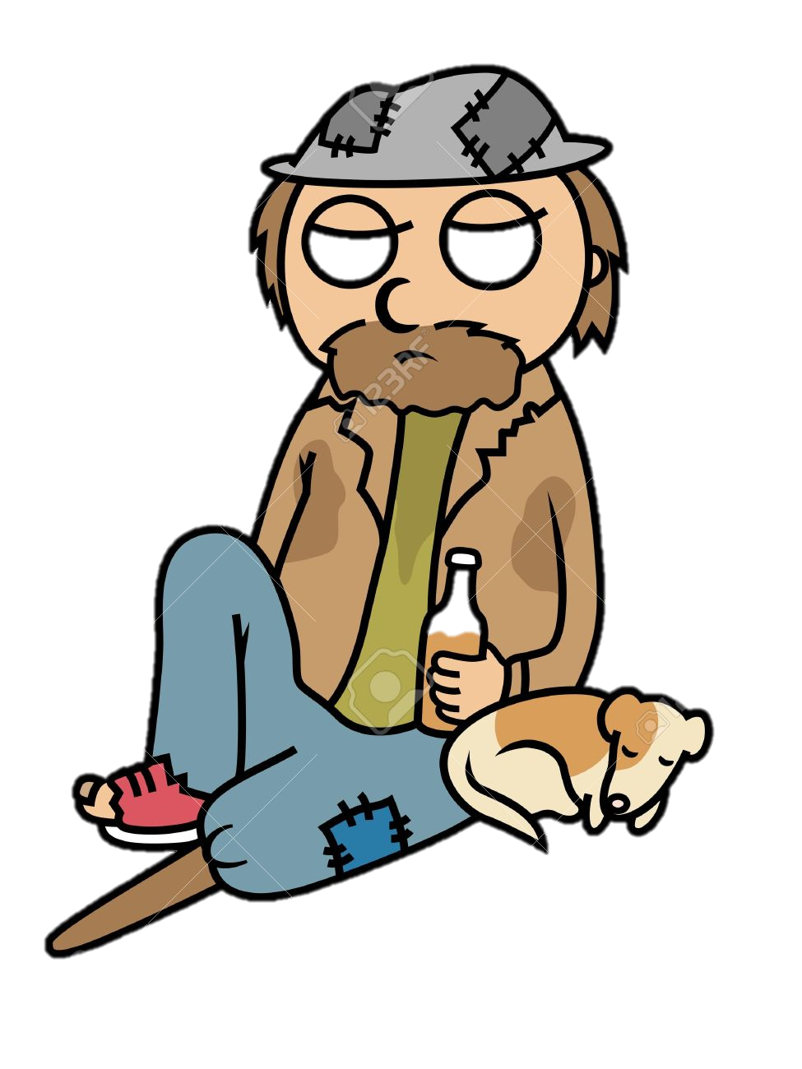
Exploitation of the Poor
Exam Questions.
Which of the following is a charity of the main religious tradition in Britain? (1 mark)
Give two ways in which the poor can be helped. (2 marks)
Explain two religious beliefs about helping the poor. Refer to scripture or sacred writings in your answer. (5 marks)
(a) Red Crescent (b) Karuna (c) Red Cross (d) Islamic Relief

