Slide 1
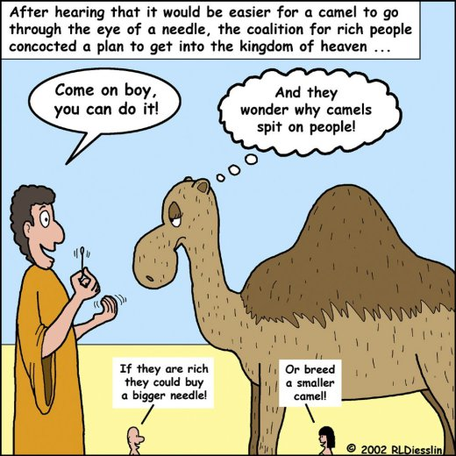
Religious Beliefs about Wealth
Key Question
What do Christians and Buddhists say about wealth?
Starter Task
Note down the quotation below and explain what it means:
‘It is easier for a camel to go through the eye of a needle than for a rich man
to enter the kingdom of God.’ (Jesus)

Slide 2
Religious Beliefs about Wealth
DLOs
To understand key teaching about wealth
To explain how teachings affect how religious people use wealth.
To apply religious teachings to questions about uses of wealth.
Definitions
Note down definitions for the following terms:
Poverty -
Tithe -
Being without money and the basic needs of life
One tenth of annual earnings or wealth, given away.

Slide 3
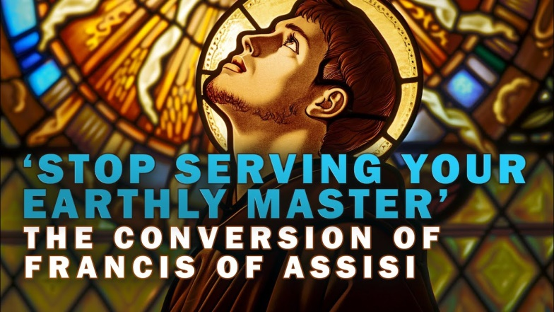
Religious Beliefs about Wealth
i) Put a subheading The Eye of a Needle
ii) Click the link & read Luke 18:18-30.
iii) What does Jesus tell the rich young ruler to do to get into heaven?
iv) Why doesn’t he do what Jesus says?
v) What rewards does Jesus promise for those who give up all of their money & possessions?
https://www.blueletterbible.org/nasb95/luk/18/18-30/s_991018
Optional research homework:
Centuries later, Francis of Assisi was a selfish spoilt rich kid from Italy who really did give up everything to follow Jesus. How did his life turn out? What sort of human being did he become?

Slide 4
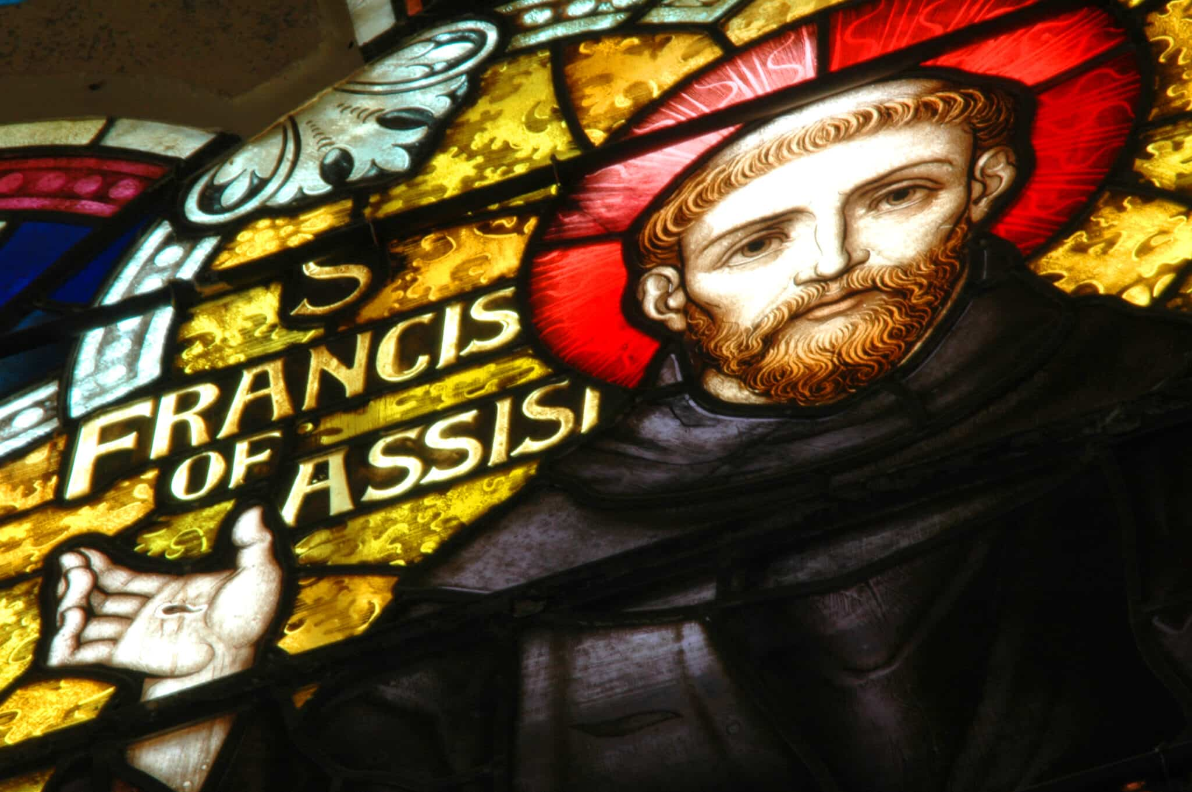
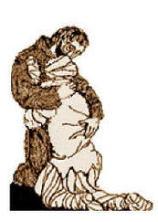
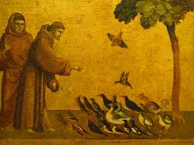
Religious Beliefs about Wealth
Optional research homework:
Francis of Assisi was a selfish spoilt rich kid from Italy who really did give up everything to follow Jesus. How did his life turn out? What sort of human being did he become?
When I was in my sins, it seemed a thing too bitter to look on lepers, and the Lord himself led me among them and I showed them mercy. And when I left them, what had seemed bitter to me was changed into sweetness of mind and body.
– St. Francis of Assisi

Slide 5
Religious Beliefs about Wealth
Put a subheading, Uses of wealth.
Write a quick bullet-point list of good and bad uses of wealth, e.g. buying food, bribing GCSE examiners.

Slide 6
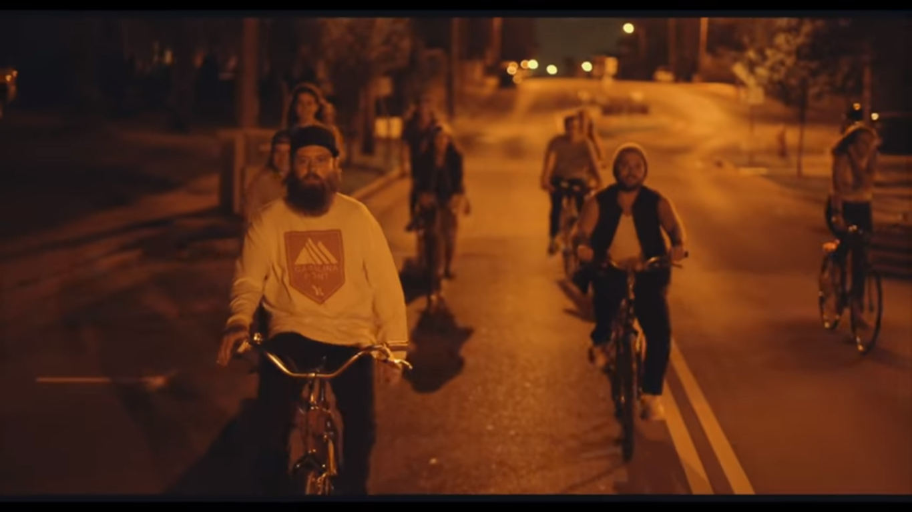
Religious Beliefs about Wealth
Music https://www.youtube.com/watch?v=ytFxvbu4ziU
Put the subheading, ‘Rich Kids’ by Judah & the Lion (a Christian band). Click the link.
Task: 1. What problems do they mention about spending your life trying to make lots of money (e.g. missing out on things)?
2. They ‘don’t got no money’. In what ways can they be said to be rich?
(Click for lyrics)
You spend your life tryna make all your money.
Your accounts are full but all you've found is that you're empty.
Ain't it funny how the simple things in life are the only things that really matter?
Your life is complicated found your dreams were overrated now you're old and wanna go back, but you can't.
We're rich, but we don't got no money.
We're just a bunch of kids, we're rich, but we don't got no money.
You spend your life runnin' away from your family.
In your old age now it's all that you're wanting.
Ain't it funny how the simple things in life are the only things that really matter?
Your life is complicated found your dreams were overrated now you're old and wanna go back, but you can't.
We're just a bunch of kids, we're rich, and we don't need your money.

Slide 7
Religious Beliefs about Wealth
Task Open the document called, ‘Religion & Wealth info’ and read page 1.
Read the story of Zacchaeus.
Do a bullet point summary or story board with words to summarise the story.
Answer questions 1-2 on the sheet.

Slide 8
Religious Beliefs about Wealth
Task
Read page 3 of the sheet.
Answer the questions.
There is an easier version on page 4.

Slide 9
Religious Beliefs about Wealth
Give two causes of poverty. (2 marks)
2. Give two ways in which people become wealthy. (2 marks)
3. Explain two religious beliefs about the correct use of money.
Refer to Christianity and Buddhism in your answer. (5 marks)

