Slide 1
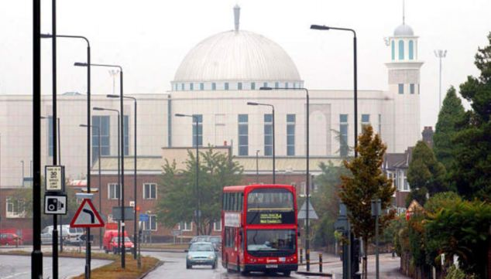
Starter: Copy the key word.
Religious Prejudice
Key word: Islamophobia – prejudice against Muslims

Slide 2
Religious Attitudes to Prejudice.
Lesson Outcomes.
To consider the harmful effects of stereotyping
To explain an example of a Muslim who does not fit the stereotype
To learn some Muslim teachings treatment of others
To evaluate whether prejudice can be stopped.

Slide 3
Watch the video.
What stereotype of Muslims does the
bully present?
The bullies and victims are actors pretending but the public reactions are real.
https://www.youtube.com/watch?v=wZVqUU_R9Vc

Slide 4
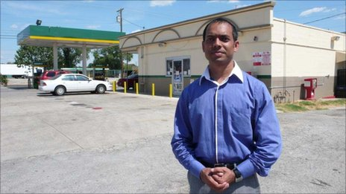
The Story of Rais Bhuiyan
B) Copy the questions.
C) Watch the three videos on this and the next slide and answer the questions with short answers.
What happened to Rais Bhuiyan in 2001?
What stereotype did the other person have of him?
What did Rais do about it?
Extension questions:
Where was Rais from?
In what ways did Mark Stroman’s actions show ignorance?
http://www.bbc.co.uk/news/world-us-canada-14199078

Slide 5
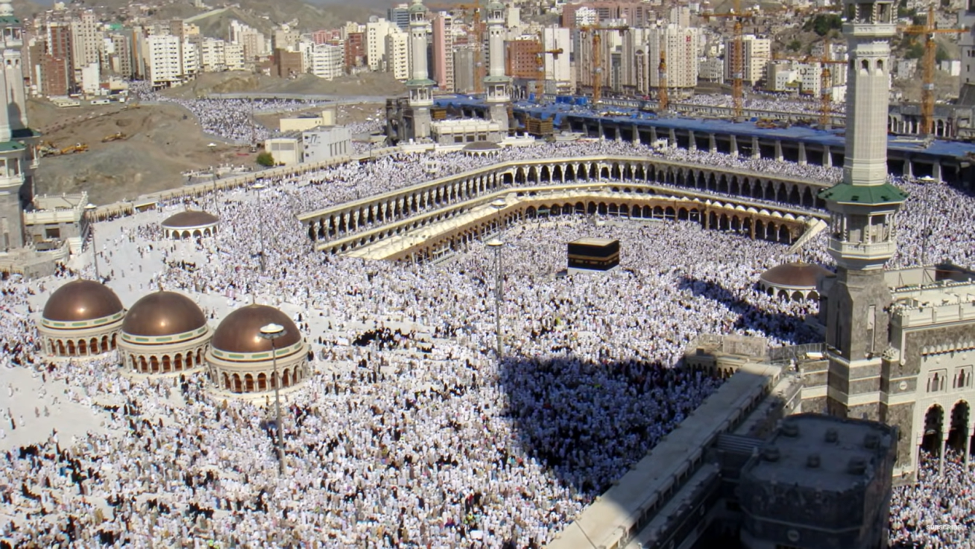
The Story of Rais Bhuiyan
Video 2 questions
What injuries did Rais receive?
What promise did he make to God on his death bed?
Video 3 questions
6) What did his mother pray on the Hajj pilgrimage?
7) ‘Islam teaches saving a human life is like …’
Extension questions:
iii) How has Islam influenced Rais’s actions?
iv) What effect did forgiveness have on Rais?
v) In Britain today what things can we do to break down prejudice in ourselves and in others?
https://www.youtube.com/watch?v=fqqpvswk46Q
https://www.youtube.com/watch?v=dMlvidnkEwY

Slide 6
D) Copy down one of the quotations and explain it.
Islamic Quotations
Humanity is but a single brotherhood. So make peace with your Brethren. Qur’an 49:10
“Anybody who believes in Allah should not harm his neighbour, and anybody who believes in Allah and the Last Day should talk what is good or keep quiet.” Prophet Muhammad, Hadith 47.
A strong person is not the person who throws his enemies to the ground. A strong person is the one who contains himself when he is angry.
Prophet Muhammad
Extension:
Do the same for the other two quotations.

Slide 7
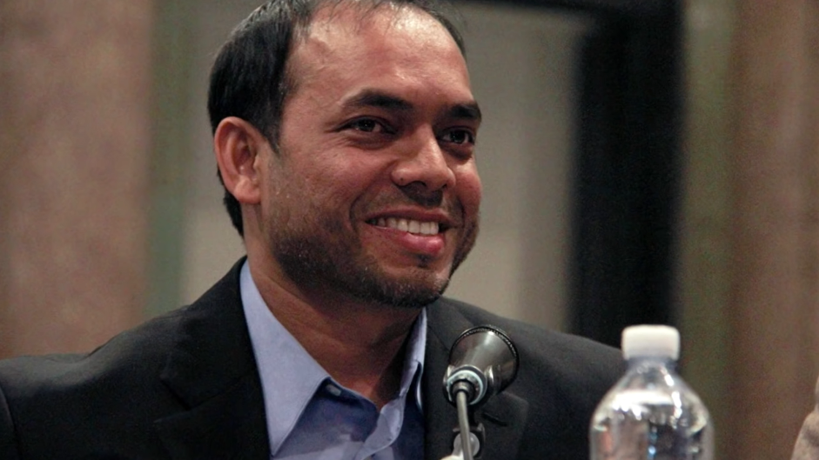
The Story of Rais Bhuiyan
E) Answer the reflection & evaluation questions.
Reflection & evaluation
i) Is it right to lump all Muslims in the same group as the violent extremists? Give a reason.
ii) Did Rais achieve anything by his campaign?
Extension
iii) Can someone criticise Islam without being Islamophobic? Give reasons and examples.
iv) Explain ways in which it is difficult to be an immigrant from a minority religion into a new country.
v) How can you help people in that situation?

Slide 8
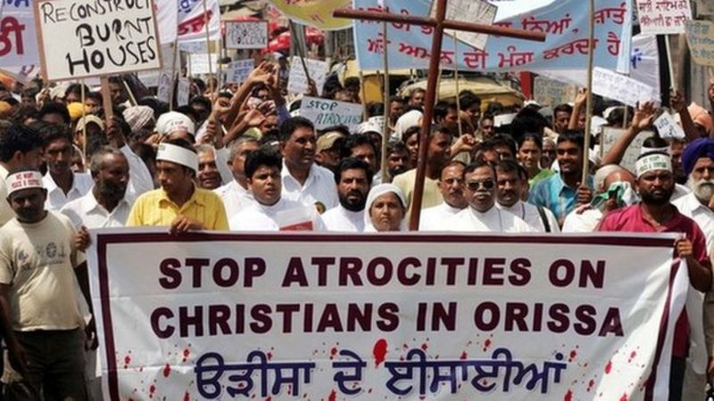
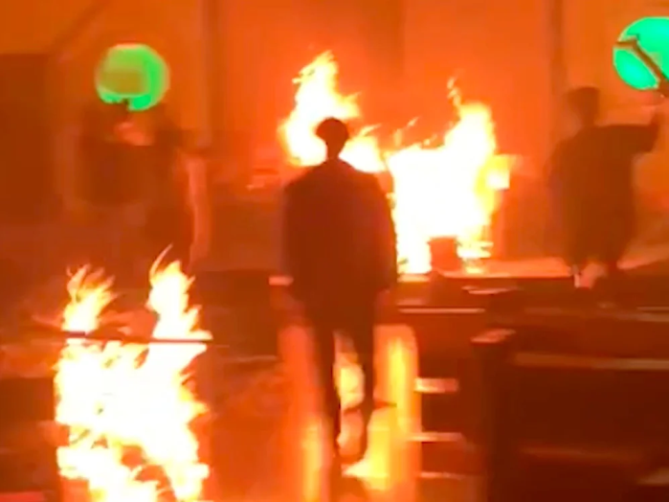
Religious Freedom
F) Open the Christianity Textbook to pages 164-5.
Copy the key words.
Read the text.
Do the activities.
Victims protest
May 2023 – Rioters burning a church in Manipur, India

Slide 9
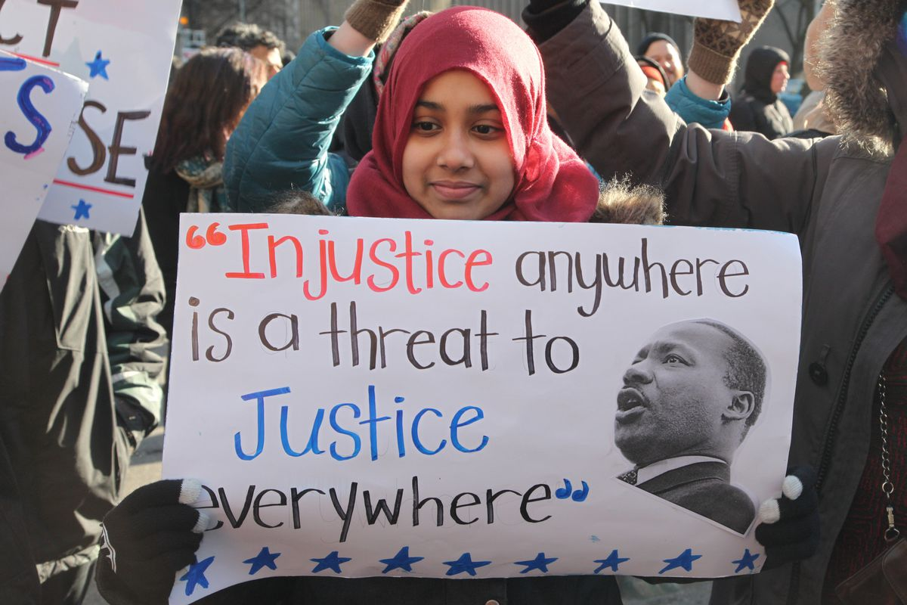
G) Answer the question. You may use arguments from any religion in exam questions although, normally, it’s easier to use Christianity & Buddhism.
Exam question
‘You cannot stop people from being prejudiced.’
Evaluate this statement.
In your answer you:
should give reasoned arguments in support of this statement
should give reasoned arguments to support a different point of view
should refer to religious arguments
may refer to non-religious arguments
should reach a justified conclusion. [12 marks]

