Slide 1
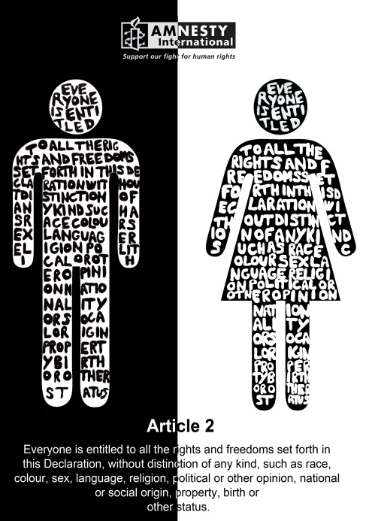
Religion, Human Rights & Social Justice
Key Questions;
What does the RE GCSE course involve?
What are Human Rights?
H
U
M
Starter Task
From what you have learnt about the Holocaust, note down words or short sentences you think relate to Human Rights, using each of the letters in Human Rights.
A
N
R
I
G
H
T
S

Slide 2
Religion, Human Rights & Social Justice
DLOs;
To know about the GCSE course and the first topic to be studied.
To show understanding of the Human Rights and their importance.
To have evaluated the effects of Human Rights.
Read the course booklet;
You will be given the booklet for the RE GCSE course. Stick it into your exercise book and read through it.
Any questions?

Slide 3
Religion, Human Rights &
Social Justice
RE GCSE;
The course involves the study of various aspects of religions (Buddhism and Christianity) and the study of philosophical and moral issues.
There are two exam papers, both to be sat in May/June in year 11. The questions are a mix of multiple choice, short explanation questions and a longer evaluation style question. There is no coursework.
The first topic we will study follows on from the work we have done on the Holocaust. We will be learning about Human Rights and Social Justice and what religious believers think about these issues.

Slide 4
Religion, Human Rights & Social Justice
What you need to know for the first topic;
Religious teachings, beliefs and non-religious beliefs about the following issues;
Human rights and the responsibilities that come with rights, including the responsibility to respect the rights of others
social justice
issues of equality, freedom of religion, belief religious expression
prejudice and discrimination in religion and belief including treatment of gender, sexuality, disability and race.
Wealth and poverty – the use and responsibilities of wealth, including the duty to tackle poverty and its causes
exploitation of the poor including issues relating to fair pay, excessive interest on loans and people trafficking
the responsibilities of those living in poverty
charity including issues related to giving money to the poor.
Notes:
Print this slide to give to the students to stick in exercise books as a frontispiece for this topic.

Slide 5
Religion & Human Rights
The Universal Declaration of Human Rights, 1948.
You will be given a copy of the 30 Articles of the Universal Declaration of Human Rights. Stick it in your exercise books. Read through some of the Rights you, and everyone on the planet is entitled to.
Why do you think this document was necessary at the time it was ratified?
The document has been in place for almost 70 years. Does this mean everyone gets all the rights they are entitled to? Give examples if you think they do not.
In the UK, the Human Rights Act 1998, put the European version of the Declaration into law. What should this mean for someone who does not allow people to have their Rights?

Slide 6
Religion & Human Rights
Things to do.
Picture observation – in pairs, look at the pictures you will
be given.
Note down what you see in each picture.
Note down your thoughts and feelings about each picture.
Which Articles of the Declaration of Human Rights are being broken in the pictures.
Explain links between these pictures and what you have learnt about the Holocaust.

Slide 7
Religion & Human Rights
Independent Learning;
My Human Rights Charter;
If you were to write a charter for Human Rights, what would be your ‘top ten’ Rights that everyone should be entitled to?
Write a list in order of importance. You could illustrate some of these if you wish.
Explain your reasons for choosing your most important ‘Right’.
Notes:
Print this page to enable students to take instructions home with them.

Slide 8
Religion & Human Rights
Review; What did you learn about the connections between the Holocaust and Human Rights?
Complete a ‘who, what, why, where and when’
giving examples from what you have learnt about the Holocaust and about Human Rights.
Who
What
Where
When
Why
Human
Rights
Extension Review:
Evaluate the impact Human Rights have had on peoples’ lives. Give examples to ‘prove your points’.

