Slide 1
What is a Force?
What’s all this fuss about a boson?

Slide 2
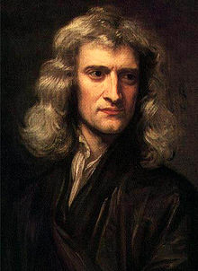
Newton explained that the Sun and planets were held together by the same force that pulls an apple to Earth.
He even produced an equation which describes it
$F=G_{\frac{M_{1}M_{2}}{r^{2}}}$
r
M₂
M₁

Slide 3
M₂
M₁
?
BUT……..’he was asked what caused this force.
He replied “I do not hypothesise”
In 17th century language this meant
“I don’t know and I won’t even guess! “

Slide 4
M₂
M₁
?
It was a puzzle for centuries.
There were three forces known
Gravity
Magnetism
Static Electricity
They all seem to reach out across empty space in an unexplained way.
(A description, even with an elegant equation is NOT an explanation!)

Slide 5
M₂
M₁
?
Forces were “spooky”
“Action at a Distance”
+++++

Slide 6
More Problems:
In 1911 the nucleus was discovered in the centre of the atom
Protons and neutrons in a nucleus
All the protons are positively charged.
It should blast apart!
Another NEW force must hold it together!

Slide 7
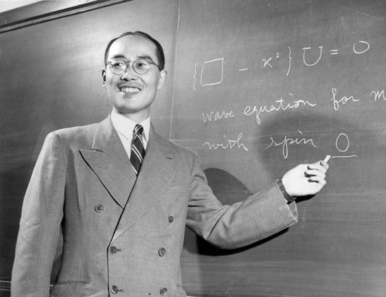
Hideki Yukawa
The genius who EXPLAINED forces

Slide 8
Forces and Exchange particles
Yukawa became interested in how forces work. His particular interest was in how the nucleus of an atom could be held together despite the electromagnetic repulsion of the protons within it. In 1935 he developed an idea based on a very simple model

Slide 9
A hydrogen atom with a single proton and electron

Slide 10
A molecule of hydrogen gas is bound together by the influence of 2 electrons which are passed back and forth between them

Slide 11
Even simpler is an H₂⁺ ion which has only one electron being passed around
The “exchange” particle holding the protons together could not be the electron. The electron does not even take part in the strong force.
Yukawa suggested that there should be a totally new particle of exchange. He predicted the properties it should have.

Slide 12
Yukawa suggested that there should be a totally new particle of exchange.
This particle would be holding not only protons to protons
but protons to neutrons and neutrons to neutrons
He predicted the properties the new particle should have. The neutral pion (π⁰)
was discovered in 1947 and it was thought to be totally responsible for the strong force.
We now know this is not the case, because protons are actually built of simpler particles.
BUT the idea of “exchange particles” being
responsible for forces has been very successful.

Slide 13
The Virtual Photon
The exchange particle or
“vector boson”
of the electromagnetic force

Slide 14
The electromagnetic force
The electromagnetic force only applies to particles with charge.
When charged particles interact electromagnetically, they exchange photons

Slide 15
What’s the MATTER?
By the second half of the 20 century all forces had been explained in terms of exchange particles… (although one of them has not been found yet!)
Particle physics still had a major problem……….. Explaining what CAUSES mass.

Slide 16
What Is Mass?
Mass is really a measure of how hard it is to move things given the same push. It is a measure of INERTIA!

Slide 17
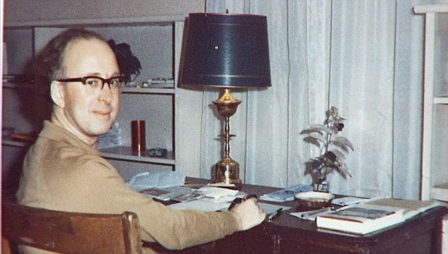
The Higgs Boson
Peter Higgs in the sixties
Peter Higgs suggested that perhaps there is a mass field throughout space somewhat like a magnetic field or gravitational field.
Just as particles are exchanged when forces act, Higgs proposed that particles could be exchanged between the mass field and the particles which make up the moving object.
This constant exchange of particles IS responsible for INERTIA

