Slide 1
Draw the two diagrams to represent:
Indirect Tax
Identify the consumer and producer burden on both.
RECAP: What is PED?

Slide 2
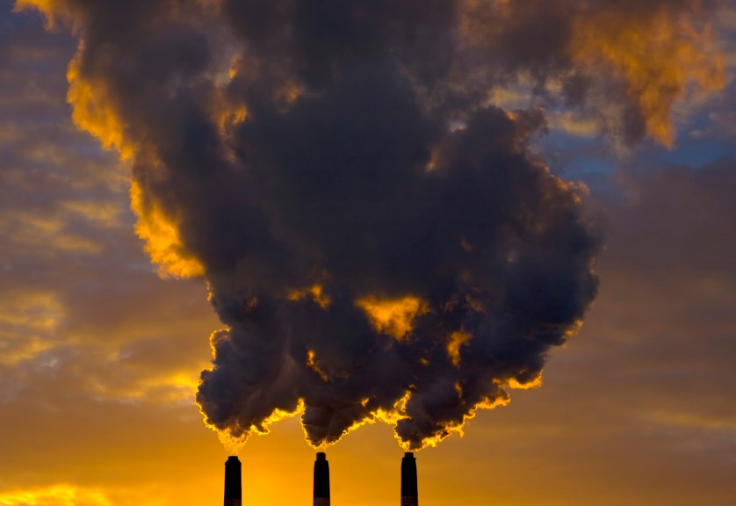
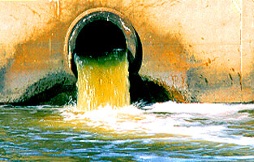
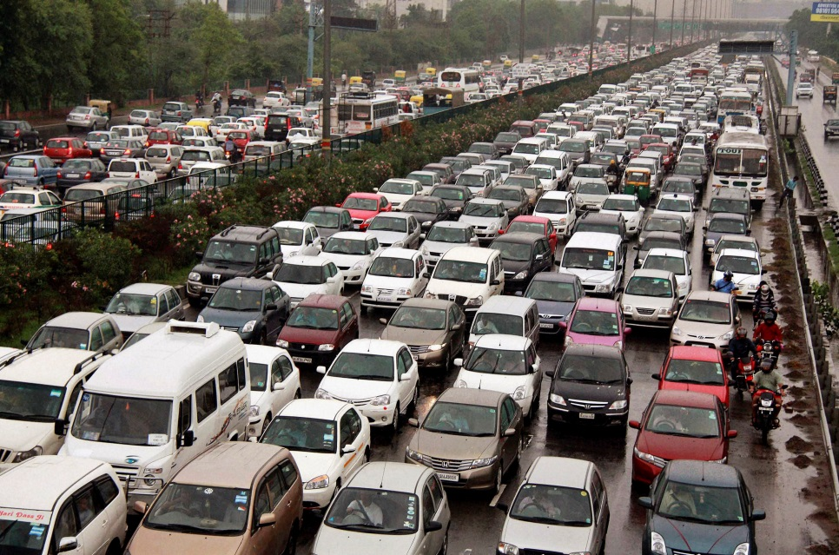
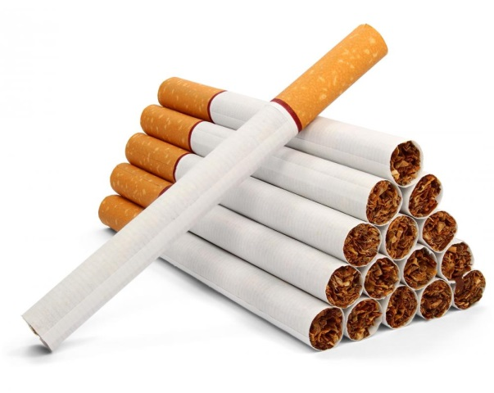
SOLUTION TO THE FOLLOWING?

Slide 3
LEARNING OBJECTIVES
Lo1: Explain what is meant by a subsidy.
Lo2: Analyse the impacts of elasticity upon subsidies.
Lo3: Evaluate the impacts of subsidies on consumers, producers and government – diagrammatically.

Slide 4
SUBSIDIES
Edexcel definition…
“Grant from government to increase production and reduce price. It is the opposite of a tax.”
http://www.youtube.com/watch?v=NykcR3RhyR4

Slide 5
Merit goods as those goods/services that provide a positive benefit to society (we come back to this).
SUBSIDIES
Why subsidise certain goods?
Often they are goods that are under-consumed and offer a benefit to society.
They may also have a positive XED (substitute) with a product that is negative to society.
http://www.youtube.com/watch?v=NykcR3RhyR4

Slide 6
SUBSIDIES
Encourage production/supply of a good by lowering production costs.
Shifts the supply to the right – lowers price, more output. Same amount of subsidy for every unit.
Consumer doesn’t experience the whole benefit of the subsidy, producers holds onto some.

Slide 7
HOW A SUBSIDY WORKS
Total government expenditure = producer + consumer areas.
Only part of the subsidy is passed onto the consumer, some is retained by the producer.
Price
S1
Vertical distance represents subsidy for one unit.
TAKE NOTE: The producer portion is now on the top. Consumer on the bottom. Opposite of taxation diagram – because the market price (what the consumer pays) has fallen, this therefore impacts the consumer.
Producer
S2
Quantity supplied and demanded increases from Q1 – Q2
P1
Consumer
Government offers subsidy to producers – supply curve shifts to the right
P2
D
Equilibrium before introduction of a subsidy
0
Q1
Q2
Quantity
Notes:
Merit good: Beneficial to society and worth of public funding, because if left to market forces – they may well be under produced and/or too expensive.
Positive Externality: Positive externalities exist when the marginal social benefit of production and/or consumption exceeds the marginal private benefit i.e. production and/or consumption generate external benefits.

Slide 8
Inelastic Demand + Subsidy
Producers know that they will have to pass on a large amount of the subsidy, in order to get reasonable change in Q.
Price
S1
Vertical distance represents subsidy for one unit.
Producer
S2
P1
Consumer
It would be unwise for the producer to absorb the entire subsidy – this is taxpayers money after all! They would get a bad reputation with customers and may be punished by the government.
P2
D
0
Q1
Q2
Quantity
Notes:
Merit good: Beneficial to society and worth of public funding, because if left to market forces – they may well be under produced and/or too expensive.
Positive Externality: Positive externalities exist when the marginal social benefit of production and/or consumption exceeds the marginal private benefit i.e. production and/or consumption generate external benefits.

Slide 9
Elastic Demand + Subsidy
Price
The producers knows that they only have to pass on a small amount of the subsidy, to get a larger change in Q.
S1
Vertical distance represents subsidy for one unit.
Producer
S2
P1
Consumer
P2
The rest of the subsidy would be kept by the firm, perhaps for research and development purpose.
D
0
Q1
Q2
Quantity
Notes:
Merit good: Beneficial to society and worth of public funding, because if left to market forces – they may well be under produced and/or too expensive.
Positive Externality: Positive externalities exist when the marginal social benefit of production and/or consumption exceeds the marginal private benefit i.e. production and/or consumption generate external benefits.

Slide 10
TASK – 10 MINUTES
Starting with the basic D&S curves at equilibrium
Draw the Indirect Taxation diagram in 3 stages - labelling/explaining what is happening
Finishing with the total revenue gained by the Government – and consumer/producer portion.

Slide 11
Merit goods as those goods/services that provide a positive benefit to society (we come back to this).
SUBSIDIES – Why bother?
Encourage the production of merit goods – products that are beneficial to society.
Cheaper prices mean that supply increase and this brings the price down, which encourages consumption.
Supports unestablished industries, that might otherwise not grow due to competition.
http://www.youtube.com/watch?v=NykcR3RhyR4

Slide 12
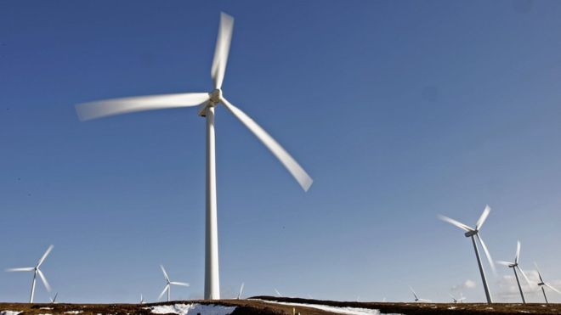
SUBSIDIES – Recent Examples
Read the article about one of three recent subsidy examples.
Answer the questions and be ready to discuss with the class.

Slide 14
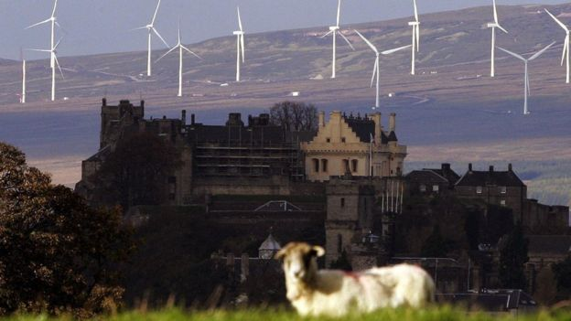

Slide 15
