Slide 1
Edexcel A2 Business
2.4.2 Capacity Utilisation
Revisionstation

Slide 2
Calculators will be needed for this topic

Slide 3
Worksheet

Slide 4
From Edexcel
a) Capacity utilisation:
current output (divided by) maximum possible output (x 100)
b) Implications of under- and over-utilisation of capacity
c) Ways of improving capacity utilisation

Slide 5
Starter
If you ran a factory and the maximum “Nibnobs” you could make in a day was 200, would you make:
A) 200 Nibnobs a day
B) 185 Nibnobs a day
C) 210 Nibnobs a day
Explain your answer
Notes:
Obviously A is full capacity, B is probably about right to allow time to fix machines, training, but could be argued that it is under-capacity C is over-capacxi

Slide 6
Definition: Capacity Utilisation
Capacity utilisation is the extent to which the maximum capacity for output that is being used – it is normally expressed as a % of maximum output e.g. 80%

Slide 7
Capacity utilisation

Slide 8
Capacity utilisation explained
In any business there are decisions to be made about how best to use resources
An operations manager will need to make daily decisions about how best to turn inputs such as machinery, labour and capital into outputs such as products and services
Capacity utilisation is how best to use those resources for the benefit of the business

Slide 9
Capacity utilisation explained continued
If a business cannot increase its output it is at full capacity
For example, a 295 seat plane if it is full then it is running at full capacity
If the plane is half full then it is running at 50% capacity
How can an airplane improve their capacity utilisation?
Notes:
Offer off peak and cheaper deals at less busy times, cheaper flights tend to be at night when no-one wants to travel.

Slide 10
Capacity utilisation explained continued
Capacity utilisation is important as it has a bearing on average cost per unit and therefore EOS (Economies of scale)
In high capacity utilisation the fixed costs are spread over more units of production
In low capacity utilisation the fixed costs can be too high to stay in business or keep producing that product

Slide 11
Ways of improving capacity utilisation

Slide 12
How to improve capacity utilisation
A business could increase demand for the product through a price cut sale or through promotion
In order to increase usage at off peak times the business could offer special deals such as Meerkat Movies on Tuesdays and Wednesdays (remember Orange Wednesdays?)

Slide 13
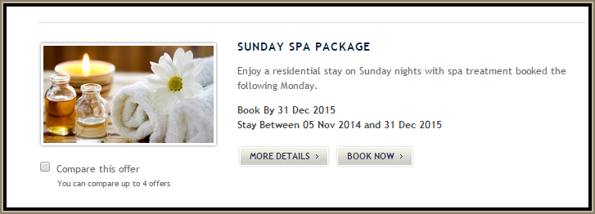
More ways to improve capacity utilisation
The business could make staff (resources) redundant
The business could sell assets (resources)such as machinery
The business could lease capacity out to other businesses
A spa could offer special prices for the quieter nights of the week;

Slide 14
Improving capacity utilisation
The business could move to smaller premises and rationalise
They could also increase sales (cut prices) or increase usage (Off peak travel)
The business could balance seasonal demand production (produce Christmas tree decorations in August)

Slide 15
5 ways challenge
Name 5 ways that this train company can improve their capacity utilisation

Slide 16
5 ways challenge
Name 5 actions this airline should take to reduce this cost

Slide 17
5 ways challenge
Name 5 ways this cinema company could spread their fixed costs

Slide 18
5 ways challenge
Name 5 ways this restaurant could make better use of their resources

Slide 19
Capacity utilisation formula
We can calculate the capacity utilisation of a business:
Current output
________________ x 100
Maximum output

Slide 20
Example calculation
Notes:
Taken from the A2 2017 paper but the principle is the same

Slide 21
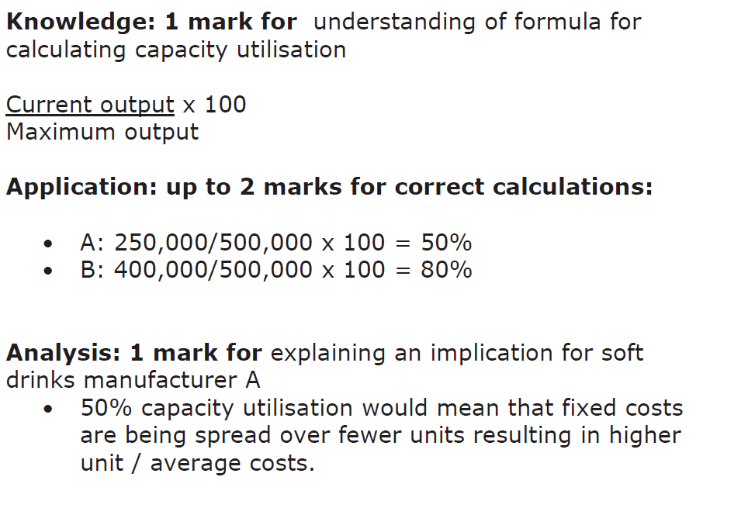
Example calculation answer

Slide 22
Implications of under- and over-utilisation of capacity

Slide 23
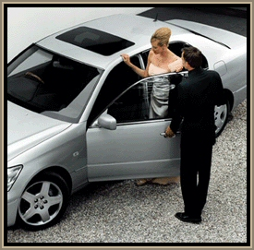
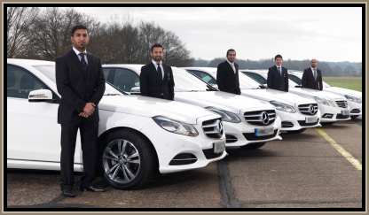
Why would running at 80% be OK?
100% capacity is often not possible. A bus that is not quite full or a cinema film that has spare seats.
This means the business can be flexible and can provide some times a rush order for a particular client. Example an executive car company that rents out chauffeured cars. They have two cars spare not working but when a regular client rings up they are able to meet their order.
This regular customer may make up the bulk of the business and also refer the car company on to other prestige clients

Slide 24
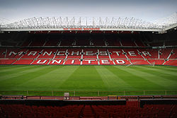
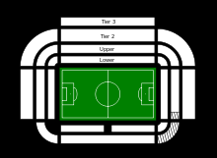
Capacity
Capacity is the maximum possible output of a business
Old Trafford the football ground of Manchester United has a maximum capacity of 75,731 people
Capacity Under-utilisation would mean that not all the tickets had been sold for a match
Capacity Over-utilisation would mean they had sold too many seats and some fans would not have anywhere to sit
Notes:
Source; http://en.wikipedia.org/wiki/Old_Trafford

Slide 25
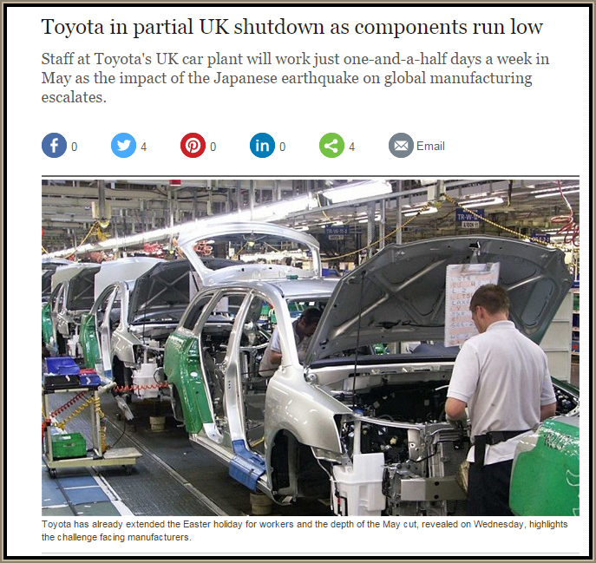
Implications of under-utilisation
Higher fixed costs per unit
Unmotivated staff standing around, not busy
Impact on brand image (empty restaurant)
Business may need to rationalise
Can mean redundancies
Sale of assets
Hiring temporary staff instead of full time permanent
Reduction in overtime hours for workers
Partial shutdown (see article)
Increases flexibility of business
Able to accept a non-standard order
Have time to maintain the machinery or update technology
Have time to train staff

Slide 26
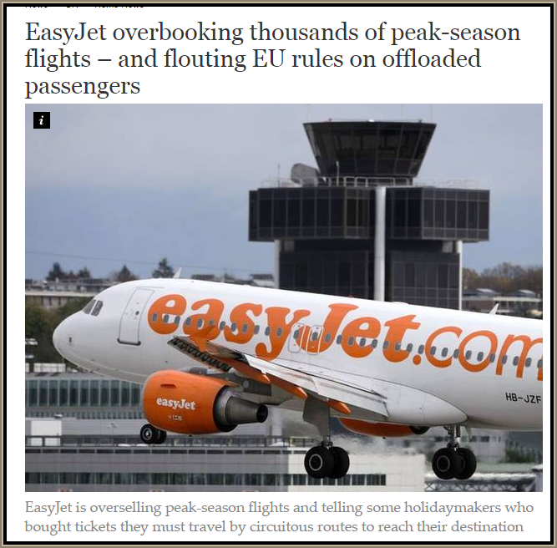
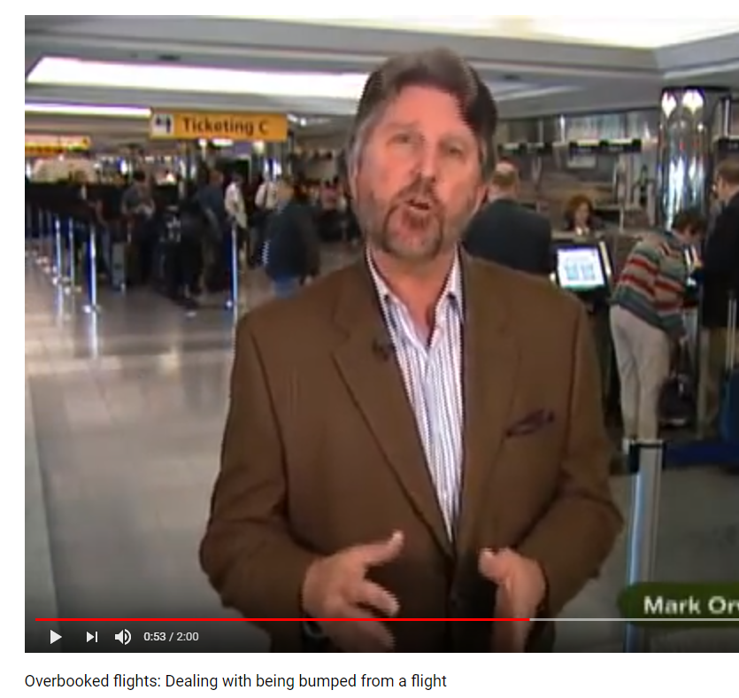
Implications of over-utilisation
Can damage reputation of the business
In manufacturing it can put too much strain on resources
Staff may do too much overtime and so have accidents when tired
Means there is no time to maintain machinery or train staff
Quality suffers as mistakes are made in production

Slide 27
Revision video
Notes:
https://www.youtube.com/watch?v=9SiNowSrUPs&list=PLXzd3vidJkSf1uUwn9irtz98wQanxw_Gf&index=4

Slide 28
Sample Edexcel A2 questions

Slide 29
Case study for question
Notes:
Taken from an international A level paper which is why it’s 6 marks

Slide 30
Sample question 1
Knowledge 2
Application 2
Analysis
2

Slide 31
Answer sample question 1

Slide 32
Glossary
Capacity utilisation; Current output as a % of maximum output
Under-utilisation; Current output is less than maximum output
Over-utilisation; Current output is more than maximum output

