Slide 1
BLOOD BROTHERS
LO: To understand the context of Blood Brothers.

Slide 2
Learning Outcomes.
By the end of the lesson you should be able to…
Recall who wrote the play and the basic storyline.
Describe how it felt to be a child.
Explain the methods an actor may use to develop a character that is much younger than themselves.

Slide 3
Willy Russell
Willy Russell was born in 1947 into a working-class family near to Liverpool. He left school at 15 without academic qualifications and became a hairdresser. By the age of 20 he felt the need to return to education and, after leaving university, he became a teacher at a comprehensive school in his home city.
During this time Russell wrote songs for performers and for radio shows. One of his early plays was about the Liverpool pop group the Beatles. He has a love of popular music and this can be seen in many of his plays, but especially in Blood Brothers.

Slide 4
The Plot and Characters
Mrs Johnstone
Mrs
Lyons
Mr
Lyons
The
Narrator

Slide 5
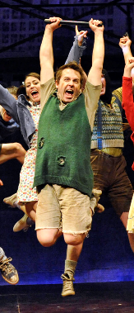
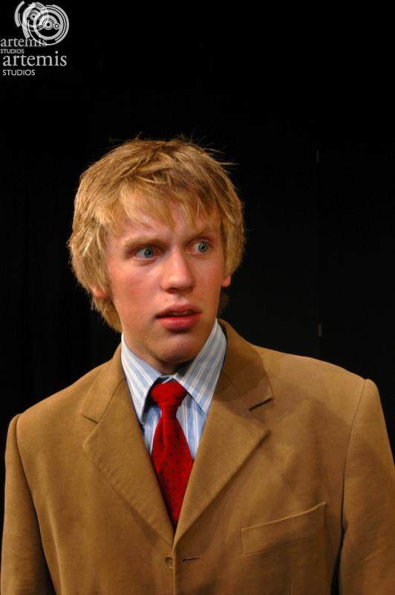
The Twins
Mickey: Poor Eddie: Rich

Slide 6
Plenary
Was the lesson successful in making you feel like a 7 year old?
How?
What contributions from other people really made you remember?

