Slide 1
The Written Paper
Section A: Devised Piece.
Snow White and Robin Hood.

Slide 2
Learning Outcomes.
By the end of the lesson you should be able to…
Recall specific lines from your chosen play.
Describe how you performed those lines in terms of movement, voice and facial expressions.
Explain why you performed the character in the way that you did.

Slide 3
Important Information
You must answer question 1 in section A.
There are four parts to this question.
Answer ALL parts in section A.
Section A should be on a devised piece of work.

Slide 4
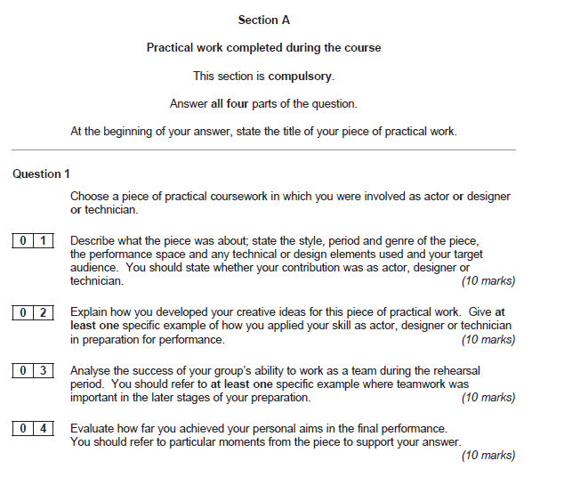
READ THE PAPER!!!

Slide 5
Part 01: Describe
The title.
What the play was about. The context. 4/5 sentences about the play.
The Style
The Genre
Period
Performance Space
Target audience
Tech/Design= Briefly
Own Contribution.

Slide 6
10 marks… Easy!!
The Title: One piece of practical work I completed during the course was a piece of improvisation called ‘Snow White’/ ‘Robin Hood’. 1 Mark.

Slide 7
10 marks… Easy!!
Description: Snow White: The piece was about a woman who meets 7 dwarfs, but eats a poised apple and falls into a deep sleep. The handsome prince rescues her. 1 Mark
Description: Robin Hood: The piece was about an outlaw who stole from the rich to give to the poor. He overcomes obstacles to marry the maid Marion. 1 Mark

Slide 8
10 marks… Easy!!
The Style: The style of this pantomime was non-naturalistic (1 mark) as we used unrealistic characters and techniques such as interacting with the audience and breaking the ‘fourth wall’.
The Genre: The genre of the pantomime was comedy and autobiographical (1 mark) as we told the story of Snow white/ Robin Hood in a humorous way as to make the audience laugh.

Slide 9
10 marks… Easy!!
The Period: We set the pantomime in modern day (1 mark) so that the audience could relate to some of the situations and they would find it amusing.
The target audience: Our target audience for the pantomime were young children and their families.(1 mark) We did this as pantomimes are traditional performed to family audiences.

Slide 10
10 marks… Easy!!
The Performance space: We performed in the school hall on a thrust stage.(1 mark) We used this type of stage so that we could go into the audience to interact with them and this broke the ‘fourth wall’.
Your contribution: My contribution was as an actor. (1 mark)

Slide 11
10 marks… Easy!!
The Tech and design: We used basic lighting such as a general wash and we used a backdrop for our set. (1 mark)

Slide 12
The answer for Snow White.
Q1. 01
One piece of practical work I completed during the course was a piece of improvisation called Snow White. The piece was about a woman who meets 7 dwarfs, but eats a poised apple and falls into a deep sleep. The handsome prince rescues her. The style of this pantomime was non-naturalistic as we used unrealistic characters and techniques such as interacting with the audience and breaking the ‘fourth wall’. The genre of the pantomime was comedy and autobiographical as we told the story of Snow White in a humorous way as to make the audience laugh. We set the pantomime in modern day so that the audience could relate to some of the situations and they would find it amusing. Our target audience for the pantomime were young children and their families. We did this as pantomimes are traditional performed to family audiences. We performed in the school hall on a thrust stage. We used this type of stage so that we could go into the audience to interact with them and this broke the ‘fourth wall’. My contribution was as an actor. We used basic lighting such as a general wash and we used a backdrop for our set.

Slide 13
The answer for Robin Hood.
Q1. 01
One piece of practical work I completed during the course was a piece of improvisation called Robin Hood. The piece was about an outlaw who stole from the rich to give to the poor. He overcomes obstacles to marry the maid Marion. The style of this pantomime was non-naturalistic as we used unrealistic characters and techniques such as interacting with the audience and breaking the ‘fourth wall’. The genre of the pantomime was comedy and autobiographical as we told the story of Robin Hood in a humorous way as to make the audience laugh. We set the pantomime in modern day so that the audience could relate to some of the situations and they would find it amusing. Our target audience for the pantomime were young children and their families. We did this as pantomimes are traditional performed to family audiences. We performed in the school hall on a thrust stage. We used this type of stage so that we could go into the audience to interact with them and this broke the ‘fourth wall’. My contribution was as an actor. We used basic lighting such as a general wash and we used a backdrop for our set.

Slide 14
Part 02: Explain
Explain the nature of the activity done.
Read the question and relate your answer to the question.

Slide 15
10 marks… explain!!!
What did you do?
What character did you play and what dramatic skills did you bring to the character?
Mention the different aspects of the character. Voice, movement, facial expressions.
E.g. I was unsure of the character I was playing so I used role on the wall, hot seating, I prepared a monologue so that I could develop my character further.
Read the question if it says ‘how did you?’ it means YOU! so use the term I! If it says ‘how did your group?’ it means WE/OUR.
You need to give a specific example in this question so relate it to your piece/ back to your character.

Slide 16
10 marks… explain!!!
Ideas to use
1. Monologues/ Duologues: voice: Pace, pitch, power, pressure, and pause.
2. Interaction with other characters: levels/ status
3. Space on the stage: getting from on scene to the next
4. Multi rolling: changing characters on the stage.
5. Creating of mood/ atmosphere. How did you explore this?
Remember: HOW AND WHY ARE VERY IMPORTANT!!!

Slide 17
Example question.
Explain how you developed your creative ideas. Give one specific example.
As an actor I developed my creative ideas by using…
How have you got from one stage to the next?
Did you change your voice PPPPP?

Slide 18
Part 03: Analyse.
Analysis of a process undertaken.
Looking back at a process that you have done. Make sure you relate it to your chosen skill.

Slide 19
10 marks… Analyse.
This is commenting on the later stages of your work.
You need to be specific to the piece that you are doing.
So there needs to be a connection between the question answered and your piece.
This question maybe about team work, but it may be about your own work. READ THE QUESTION.
Make sure you are supporting your answer fully with how and why.
Do not comment on line learning, people being absent, cancelled rehearsals and personality clashes as this is irrelevant. Be productive.

Slide 20
10 marks… Analyse.
So refer to moments such as…
Characterisation/demands of the role.
Vocal skills.
The creation of specific effects for an audience
Sharing decision making
Shaping, refining, discarding or polishing the work in the final stages of preparation.
The team approach to the resolution of problems or the creation and resolution of ideas.

Slide 21
Remember
How and why????
Relate it back to your final piece?
Why are you doing it?
What are you trying to achieve?

Slide 22
Part 04: Evaluate
Evaluate the effectiveness of your contribution.
Looking back on your performance.

Slide 23
10 Marks…Evaluate
Your actual performance that you were marked on/filmed. You are talking as if you are now looking back on it and reflecting on it.
How did you feel you succeeded?
Good or not good. Make it specific. What were your strengths weaknesses? How does your final performance meet your personal aims?
Pick out specific moments and talk about the strengths / weaknesses. In relation to the following aspects……..
Audience reaction
Recognition of the creative journey
Team work
level of commitment
Improvement of identified skills / performance.

Slide 24
Remember
Write clearly and be very specific and…
READ THE QUESTION!!!!!!!!!!

