Slide 1
Edexcel A2 Business
1.3.5 Marketing Strategy
Revisionstation

Slide 2
Worksheet

Slide 3
From Edexcel
a) The product life cycle
b) Extension strategies:
product
promotion

Slide 4
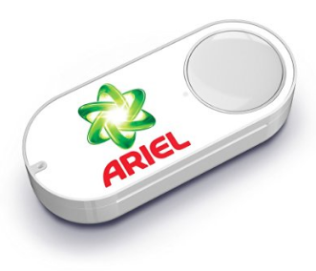
Starter
What do you think these are? How do they work? What do they cost?
Notes:
Amazon Dash Button is a Wi-Fi-connected device that reorders your favourite product with the press of a button.
Each Dash Button is paired with a product of your choice, which is selected through the Amazon App on your Android or iOS smartphone during the set-up process.
Easy to use. Press the Dash Button and never run out of your favourite products
Set the button to re-order the products you like – it is attached to wifi.

Slide 5
Definition of marketing and marketing strategy
Marketing: The management process of identifying, anticipating and satisfying consumer demands for profit
Marketing strategy: The methods used by a business to achieve their marketing objectives

Slide 6
You will need a ruler and selection of colours for this lesson

Slide 7
The product life cycle

Slide 8
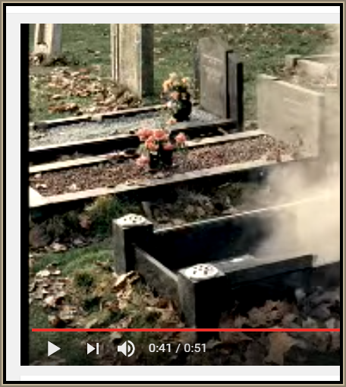
Product lifecycles
Like humans - products go through a lifecycle
From research and development at the start to launch (birth) and through to decline (death)
Some products take longer than others to go through the lifecycle
The marketing mix will change depending on the stage of the lifecycle the product is at
Watch the cradle to grave XBOX ad and explain how humans go through a lifecycle
Notes:
Note – there is a semi naked man in this advert – watch it first to asses its suitability for your learners

Slide 9
Draw a product lifecycle diagram
Revenue £
Time

Slide 10
Product life cycle
Development
Introduction
Growth
Maturity
Decline
Revenue £
Time
Notes:
© S Hilton for revisionstation

Slide 11
Product Development
This is the first stage of the product lifecycle where a product is designed and market research is analysed to produce a product which will satisfy customer needs
Cash flow at this point is tight, this is a very expensive phase and at this point the product is not making any revenue and therefore no profit
All capital at this point will just be an investment, there is always a risk of the product not being a success
Watch the video – how many of these products have actually been launched on the market or are they all still in development?

Slide 12
Introduction of product to market
The introduction phase will involve high costs in research and development and the product may have been test marketed before launching, so profits may be negative
Sales will be low as customers may not yet be aware of the products
Advertising will be informative to let customers know that the product has been launched

Slide 13
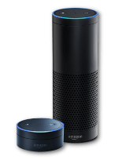
Growth phase
Growth phase products are enjoying rapid growth in sales and profits
At this stage the customers are aware of the product and demand is high
A business may advertise the product to take advantage of the high demand
Amazon Echo Dot Alexa tech gadgets are in the growth phase – watch the video to see some of the things customers can do with it!

Slide 14
Maturity phase
Why are laptops in the maturity phase of the product lifecycle?
Maturity phase products face intense competition now all the producers have joined the market
Market is starting to be saturated – everyone has bought the product who is likely to buy
Sales are high but profits are starting to fall
Products have to be discounted to keep sales high – so prices may be lowered or the product may be put on sale

Slide 15
Decline phase
Decline phase products may be limited in production
At this stage profits and sales have fallen and the product may be withdrawn from sale
The business may decide to heavily discount to get any last sales before the product becomes obsolete
There is a trend towards more disposable items rather than products that can be fixed or repair – they are simply replaced with new ones, therefore repairable goods are in decline phase
What year was the Blackberry withdrawn?
a) 2006
b) 2016
C) 2010
Notes:
b) 2016

Slide 16
Extension strategies

Slide 17
Product lifecycle extension strategies
There are lots of ways that a business can extend the lifecycle of a product rather than withdrawing it. This may be to use to a store of raw materials or to keep loyal customers happy. The five ways that your exam board would like you to be able to discuss are:
updating packaging
adding more or different features
changing target market
advertising
price reduction
Get ready to make some notes on these ways on the next few slides.

Slide 18
Product life cycle - extension
Development
Introduction
Growth
Maturity
Decline
Revenue £
Time
Notes:
© S Hilton for revisionstation

Slide 19
Watch the theory video on extension strategies and make notes

Slide 20
Assess the impact of Lucozade's use of an extension strategy for the product?

Slide 21
Assess the impact of Lucozade's use of an extension strategy for the product?

Slide 22
Assess the impact of Lucozade's use of an extension strategy for the product?
1972 –
Who is the drink targeted at?
What is the purpose of the drink?
Why is it sold in such a big bottle?
What is the end slogan?
Late 1980’s –
Who is the drink now marketed at?
What adjective is used to describe the drink and why?
Why does the ingredient `Glucose` get mentioned?
Mid 1980’s –
Has the target market changed?
What image does Lucozade now want?
Why has the bottle shrunk?
How and why has the end slogan changed?
1990’s –
Why are Lucozade introducing words like `Isotonic`?
What do you notice about the packaging?
Why is Lucozade using cans?

Slide 23
Assess the impact of Lucozade's use of an extension strategy for the product?
2012
How different is it from the first advert?
Was the rebranding of Lucozade a success?
2015
How different is it from the last advert?
Who is the target audience?
What is the marketing message?
2019
Who is the target audience?
How are they appealing to this target audience?
Why has the packaging changed?
How long will this campaign run for?

Slide 24
Activities
The length of time it takes for the life cycle to move from development to decline can vary massively from product to product. Can you think of any products:
That spend years in development?
That decline within weeks?
That are around for many years?
​Why is it important to monitor a product's life cycle?

Slide 25
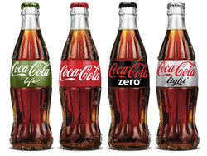
Product Lifecycle – extension strategies
Change the product
Development or modification of a product
B. Change the promotion
Rebranding or relaunching of products

Slide 26
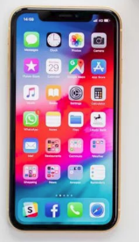
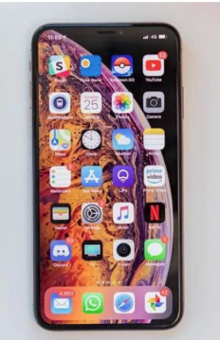
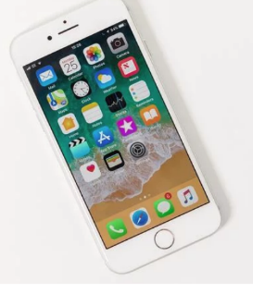
Product lifecycle extension– modification of the product
Since its launch in 2007 the iPhone has been undergoing constant modification, adding new features and benefits to encourage consumers to buy the latest version. Which version do you have? Are the labels correct?
iPhone XS Max
£1099
iPhone XR £799
iPhone 8 £749
Notes:
Yes all labels correct

Slide 27
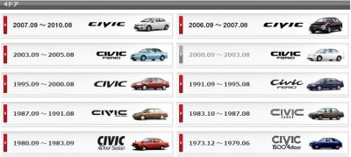
Product lifecycle extension: product modification
Extension strategies are designed to extend the life of the product before it goes into decline
One of the methods of extending the lifecycle is through product modification and a good example of this is cars, which retain the same engine but change the styling
This strategy will either sell to a new market or remind the old market that its time to change the products to the new version

Slide 28
Suggested activity – timeline
Find a car you are interested in and create a visual timeline by printing out images
Can you show how the product has been modified over the years
Can you also explain on your timeline how the product lifecycle extension will enable a business to continue to see the product in its modified form
Your timeline could be horizontal or vertical

Slide 29
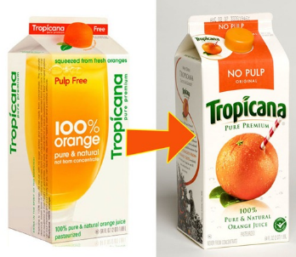
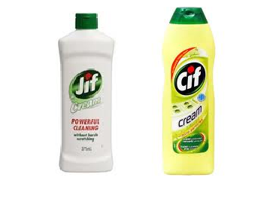
Product lifecycle extension - rebranding
Many brands over the years have been through rebranding JIF to CIF is one of the most famous changes, others may be as simple as a pack or logo change, can you think of any other examples?
Notes:
Examples of re-branding

Slide 30
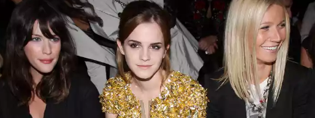
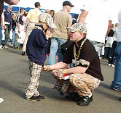
Product lifecycle extension – relaunch product
Just over 10 years ago, Burberry’s famous check design was banned in pubs and clubs from Aberdeen to Leicester for its association with hooliganism. Today, the company boasts brand ambassadors – can you name them?
Notes:
Emma Watson and Cara Delavigne

Slide 31
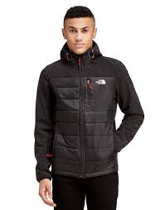
Product lifecycle extension – promotion
The North Face has found a new target market in teenagers
Daily Mail article – on colouring books for adults here

