Slide 1
Edexcel A2 Business
1.5.4 Forms of Business
Revisionstation

Slide 2
Worksheet

Slide 3
From Edexcel
a) Sole trader, partnership and private limited company
b) Franchising, social enterprise, lifestyle businesses, online businesses
c) Growth to PLC and stock market flotation

Slide 4
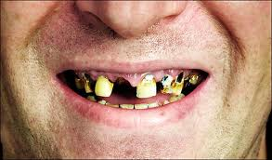
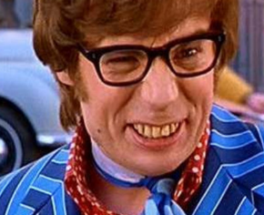
Starter
Have you ever been to the dentist?
Have you ever needed to send a pet to the vet?
Have your family ever used a solicitor (maybe to help them buy a house)?
What do these 3 types of business have in common?
Notes:
All run by a team of experts and possibly all a partnership business

Slide 5
Definition: Business forms
A business form is the legal structure that it takes (in the UK). It could be a sole trader, a partnership, a private limited company (Ltd) or a public limited company (PLC).
Most (but not all) businesses in the UK are a Ltd – this is so that they can sell shares to friends and family to raise money to expand AND they get the benefit of limited liability (next slide)

Slide 6
Definition: Limited liability
Limited liability means that the owner of the business has no personal liability for business debts. The owner has a separate legal identity from the business and is NOT liable for payment of the debts from their own personal funds.

Slide 7
Unlimited liability
If a business gains debts, or goes bust or is sued this could be a problem for the owner
If there is no money in the business then the owner would need to pay using their own savings, finances, they may even have to reportage their home or even sell their car to pay the debts
This is unlimited liability
Watch the video can you now explain limited and unlimited liability to someone else?

Slide 8
Sole trader, partnership and private limited company

Slide 9
Growth of a business
Partnership
Sole trader
A
Public Limited Company (Plc)
Limited company (Ltd)
B
Notes:
Two pathways A = sole trader > partnership
B= sole trader > ltd >plc

Slide 10
Sole trader
Business owned by one owner, but they can take on staff
Also known as a sole proprietor
Can employ people but they will not be involved in control of business
Tend to be small businesses
Has unlimited liability
Examples include; small shops, accountants that work from home, online traders, plumbers etc

Slide 11
Suggested activity - Sole trader
Watch the video then in pairs make a list of possible sole trader jobs and professions
Sher these with another pair until your class builds up a large list
How many of these types of businesses would be in trouble if they remained a limited liability company? To answer this consider if they are likely to accrue large debts or be sued.

Slide 12
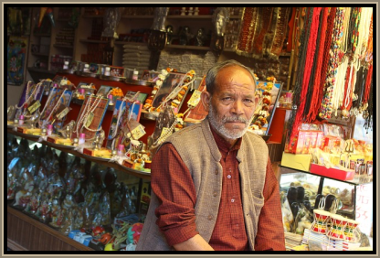
Sole trader
Disadvantages
Unlimited liability, this means that if the business has financial difficulties the sole trader could lose their own assets like their savings, house or car
Difficult to raise money – seen as a risk
Don’t have economies of scale (buying in bulk)
No one to take over for ill-health or holidays
Advantages
Easy to set up – no complicated forms
Make decisions quickly
Less capital needed
All profits kept by the owner
Can offer personal attention to customers
Don’t have to make any information about the company public
They are their own boss

Slide 13
Partnerships
Two or more people – ie the partners - share the risks, costs and responsibilities of being in business
The profits and gains of the partnership are shared among the partners, unless the partnership agreement states otherwise
Each partner is personally responsible for paying tax on their share of the profits and gains, and for their National Insurance contributions
Partners raise money for the business out of their own assets and/or with loans
The partners themselves usually manage the business, although they can delegate certain responsibilities to employees
It is possible to have 'sleeping' partners who contribute capital investment to the business but are not involved in running the business
Notes:
Adapted from: https://www.nibusinessinfo.co.uk/content/business-partnerships

Slide 14
Suggested activity - partnerships
Partnerships tend to be groups of experts who can all work in a practice together
For example a dentists practice may be a group of dentists who have started the business as a partnership
Carry out some research and create a list of likely partnership professions
Also find out what an LLP is - it is outside the scope of you’re a Level but important to know

Slide 15
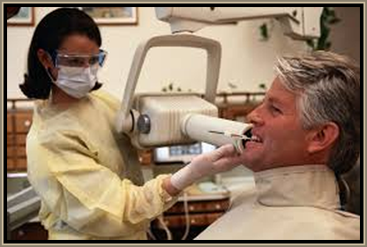
Partnership
Disadvantages
Unlimited liability
Partners may have disagreements about;
Control of business
Sharing of profits
Withdrawal from the partnership
Inviting new partners into the business
Advantages
Easier than a sole trader to raise extra capital, as partners all have their own sources of finance e.g. savings
Profits go to partners, which is very motivating
Smaller business means good working relationships
No need to make public any information
Partners contribute with range of skills
Shared problems and decisions

Slide 16
Private limited company (ltd)
Sole traders may grow and expand and want to become a ltd company
Friends and family can buy shares in the business, this will make them part owners
Shares cannot be bought by the public
Owners control who buys the shares
Expand by selling more shares, giving the business more capital
Normally medium sized businesses
Have the benefit of limited liability, those that own or buy shares in the business can only lose their original investment, their private assets remain safe
Examples; building firms, scaffold firms, delivery business Eddie Stobart

Slide 17
Suggested activity - Ltds
Limited companies tend to be businesses where having limited liability is critical.
For example a scaffolding company could be worried about a pole falling on the head of someone underneath and being sued. Limited liability gives the owners some protection over their personal finances
Carry out some research and find 10 limited liability businesses in your local area. Use check-a-trade and yell

Slide 18
Ltd
Disadvantages
Accounts of the company cannot be kept private
Audited each year
Copy sent to Registrar of Companies
Available for public to see
More difficult and expensive to set up - more administration
Cannot sell shares on stock exchange, which limits the amount of capital that it can raise
Advantages
Limited liability
Can raise extra capital by selling more shares, to friends and family, making it easier to expand
Can employ managers to run business if the owners don’t want to do it themselves
Has its own legal status – separate from the shareholders

Slide 19
Franchising, social enterprise, lifestyle businesses, online businesses

Slide 20
Franchising introduction
An entrepreneur may choose to set up with an established business name and buy a franchise
For example an entrepreneur may wish to open their own sandwich bar and call it “Bob’s sandwiches” or they could buy the Subway franchise
Which do you think will gain the most revenue?
Watch the video, can you now explain franchising to someone else?

Slide 21
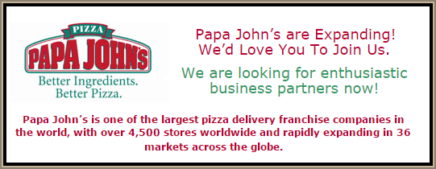
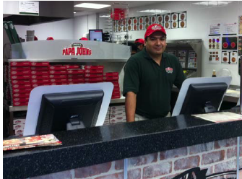
What is a franchise?
Imagine a company has a great and successful business. It wants to expand but it doesn’t want the problems and expense of opening more stores – so it sells the business idea.
If you buy a franchise it is a “business in a box”, as well as signage and training you get support of a national company and a brand that customers already know.

Slide 22
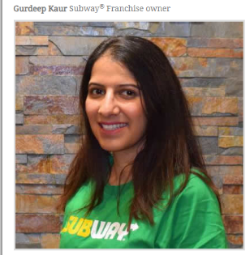
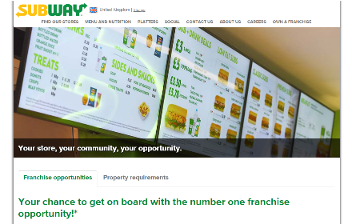
Franchising vocab
Franchisee; This is the business owner who is buying the rights e.g. Gurdeep
Franchisor; this is the business that is selling the rights e.g. Subway

Slide 23
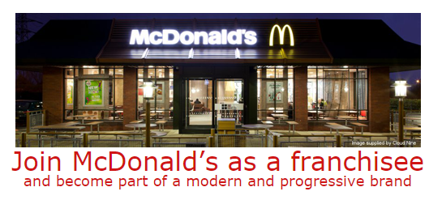
Cost of a franchise
When a business person decides to buy a franchise they will need to take into consideration the costs
Cost of buying the franchise rights at the start
Monthly royalty payment to the franchisor
Have a look at the McDonald’s website for franchising

Slide 24
Suggested activity - franchising
Have a look at the franchising websites on the Internet
Choose a franchise and find out how much it would cost to start up
Include any yearly royalties and the cost of premises and staff
Present your franchise to the rest of the group and explain how much revenue you expect to earn in the first year

Slide 25
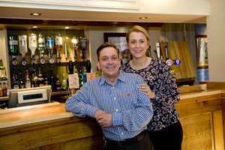
Franchising pros and cons
Disadvantages
Franchisee’s do not have freedom of running their own business;
Bound by rules e.g. Can’t vary product or price
Franchisee pays percentage of profits in royalties
Franchisee will never own the business outright
Advantages
The franchisor chooses the franchisees carefully – knows what characteristic that make a successful franchisee
The franchisor decides how much money the franchisee must invest in the business
The franchisor provides support – management advice & training – help franchisee solve problems.

Slide 26
Social enterprise
A social enterprise is a business that trades for a social and/or environmental purpose.
Have you ever bought a bar of Divine Chocolate?
At the core of a social enterprise is the objective to help society or the planet in some way, they are not charities (which rely on donations)
Notes:
Taken from: http://www.socialenterprise.org.uk/uploads/editor/files/Why_Social_Enterprise.pdf

Slide 27
Lifestyle business
The aim of a start-up is to grow big enough to provide a return of investment for investors
The aim of a lifestyle business is to provide great quality of life for the owner
Owners start a business hoping to sustain a certain level of income
They may start a business doing something they really enjoy
It allows an entrepreneur to live how they want and still run a business

Slide 28
Online business
Easy to set up, for example an eBay business could be up and running in an hour after some online form filling
PayPal used to take money from customers, who can now use credit cards and it converts it to PayPal money for the business owner
Available to the customer 24/7
Can be managed from anywhere, owner does not need to be sat in an office
Watch the video – what do you think is involved in the day-to-day running of an eBay business?

Slide 29
Growth to PLC and stock market flotation

Slide 30
Growth to plc
Once a limited (Ltd) company has grown in size and needs further investment, which it cannot get from its current pool of owners, it may consider becoming a PLC
If it intends to float shares on the stock market, so they can be bought by anyone, it will need to first issue a prospectus where potential investors are invited to purchase share before flotation (called an IPO)
Going public is expensive
Lawyers to draw up legal paperwork
Publications
Advertising and admin
Company must have £50,000 in share capital

Slide 31
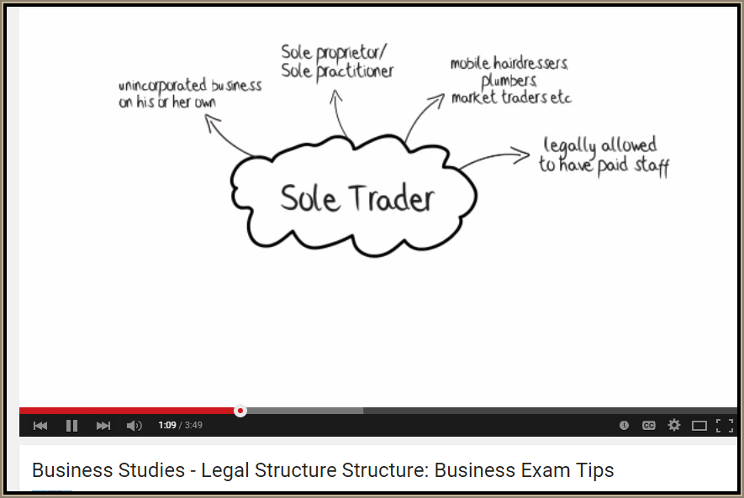
Revision Video

Slide 32
Sample Edexcel A2 questions

Slide 33
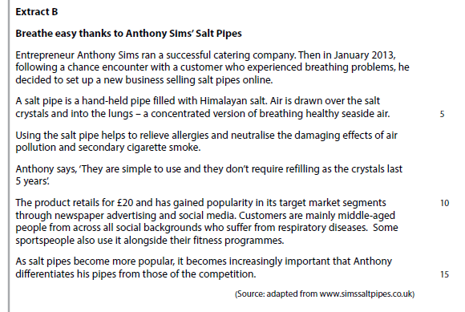
Case study for question 1

Slide 34
Sample question 1
Knowledge 2
Application 2
Analysis
3
Evaluation
3

Slide 35
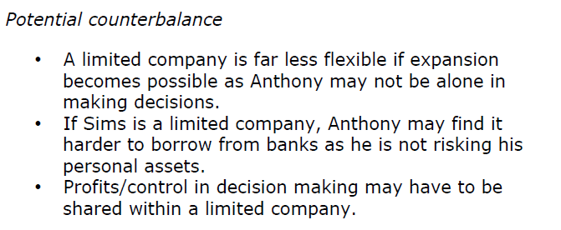
Answer sample question 1

Slide 36
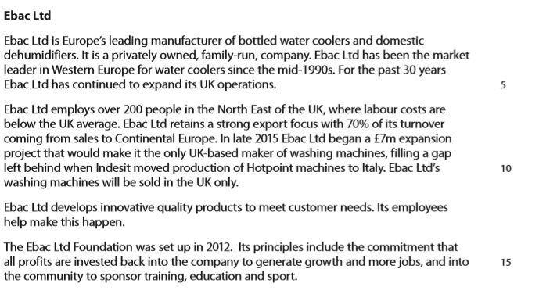
Case study for question 2

Slide 37
Sample question 2
Knowledge 2
Application 2
Analysis
3
Evaluation
3

Slide 38
Answer sample question 2

Slide 39
Answer sample question 2

Slide 40
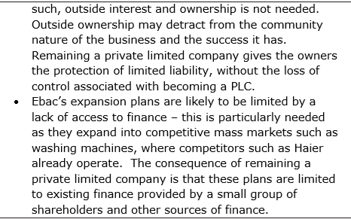
Answer sample question 2

Slide 41
Glossary
Sole trader; a person who sets up business on their own, they can have employees but there is only one owner
Partnership; two to 20 people who set up a business together as joint owners e.g. vets, solicitors, dentists
PLC; stands for public limited company, shares are floated on the stock market and can be bought by anyone
LTD; stands for private limited company, shares can only be sold to friends and family
Franchise; a business idea which is sold to other owners who run it under a licence and pay royalties, in return they get branding and marketing support e.g. Subway
Franchisor; the person who sells the franchise
Franchisee; the person who buys the franchise

