Slide 1
Edexcel A2 Business
4.1.2 International trade and business growth
Revisionstation

Slide 2
Worksheet

Slide 3
From Edexcel
a) Exports and imports
b) The link between business specialisation and comparative advantage
c) Foreign direct investment (FDI) and link to business growth

Slide 4
Starter
You are in an Italian restaurant in the UK. You are with your family and they order a bottle of wine. The wine that arrives at your table is (of course) Italian wine.
Has the restaurant:
A) imported this wine from Italy
B) exported this wine from Italy
Notes:
Answer is (of course) A

Slide 5
Exports and Imports

Slide 6
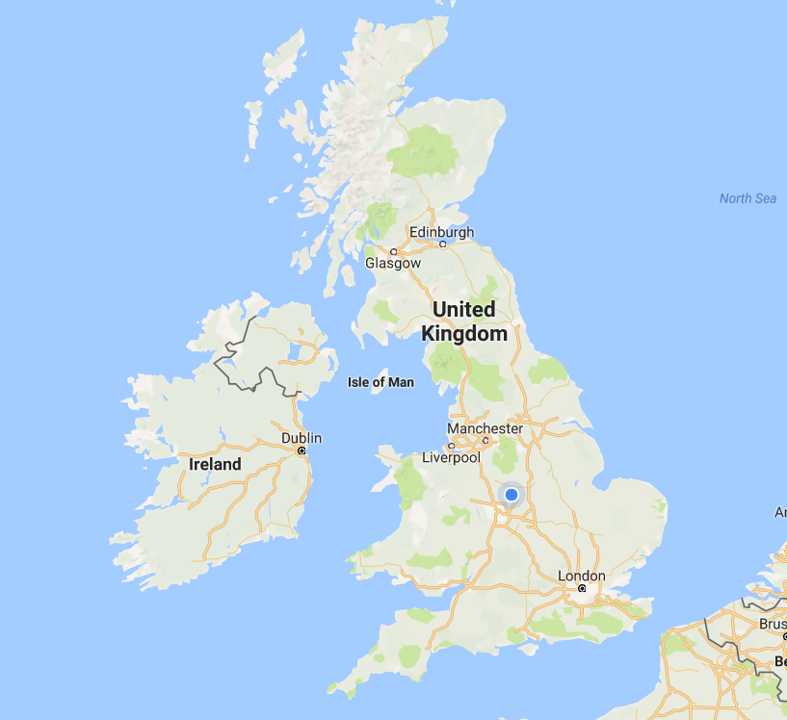
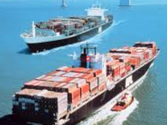
Imports explained
The UK is only a small Island so we need to bring in goods from other countries that we might need. This is called importing.
Some countries specialise in producing certain goods, and with their low labour costs they can make products at more attractive prices than we can in the UK

Slide 7
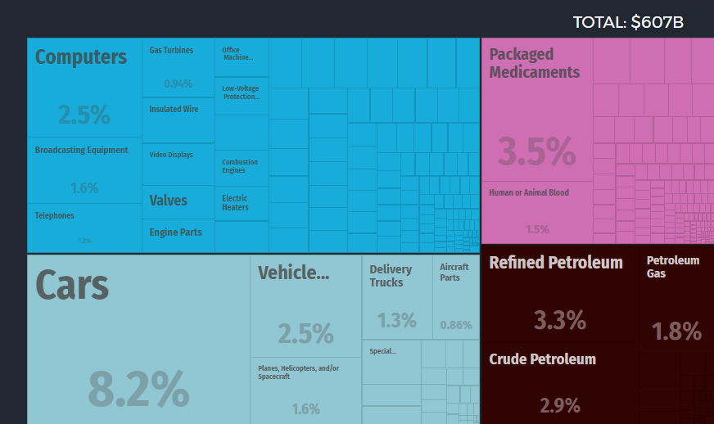
What does the UK import? Graphic HERE
In 2015 the United Kingdom imported $606B, making it the 4th largest importer in the world.

Slide 8
Where does the UK import from?
The UK imports cars from Germany – BMWs, MINIs etc.
The UK imports planes and helicopters from USA
The UK imports computers from China

Slide 9
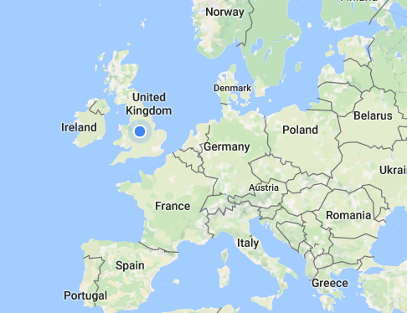
Exports explained
All countries trade with other countries, they send products abroad. This process is called exporting.
The UK exports:
Medical supplies
Cars
Gas turbines
And gold….

Slide 10
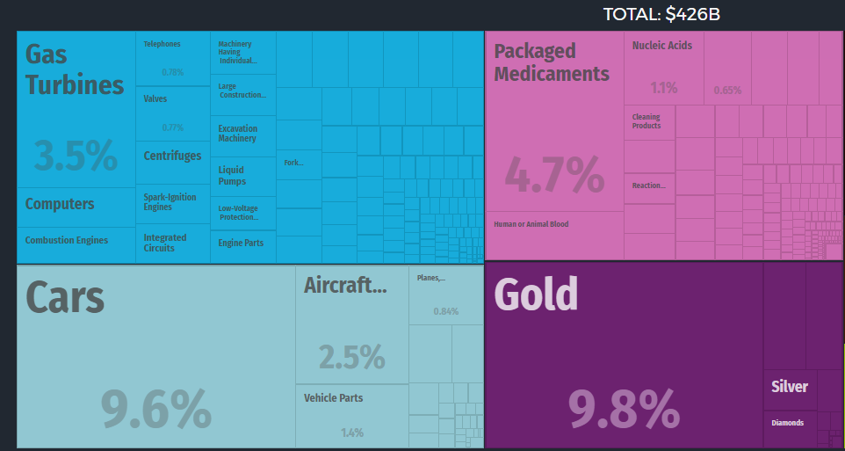
What does the UK export? Graphic HERE
In 2015 the United Kingdom exported $425B, making it the 9th largest exporter in the world.

Slide 11
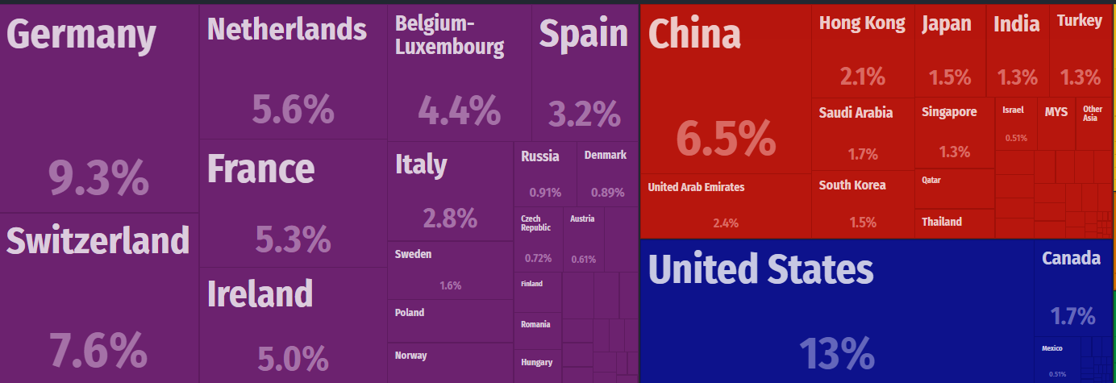
Where does the UK export to?
We export cars and aircraft parts to Germany
We export gold to Switzerland
We export petrol to the Netherlands

Slide 12
Specialisation and comparative advantage

Slide 13
Specialisation defined
Specialisation is the process of concentrating on and becoming expert in a particular subject or skill
In terms of countries it means that a country will have industries in which it leads the world. This may be due to; proximity of raw materials, low labour costs, historical ability or other factors e.g. Belgian chocolate, Scotch whiskey etc.

Slide 14
Specialisation and comparative advantage
A country may decide to specialise in a particular industry or sector
For example India specialises in IT due to a huge number of IT graduates from its universities
This means they can set up call centres for overseas companies staffed by English speaking graduates who are on a fraction of the wages required in the UK
This gives a country an advantage over others in that particular industry e.g. UK beer brewing, Indian garments etc.

Slide 15
Benefits to India of specialisation
Increased productivity and output, this means reduced average costs and economies of scale
As more resources are devoted to the industry rather than being spread out the scale of production can be increased to gain the EOS
This gives the Indian call service industry comparative advantage over the next best country
The increased productivity will lead to GDP growth and increasing sales will boost economic growth

Slide 16
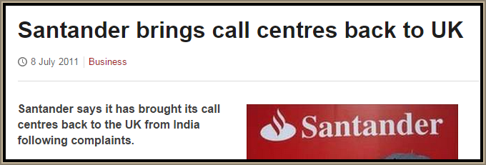
The downside of specialisation
A country may become over reliant on one industry (eggs in one basket) and this does not spread risk
Other countries may become cheaper in the same industry and it may be harder to compete
If the business grows too big it may suffer from DEOS through lack of communication and co-ordination

Slide 17
FDI

Slide 18
FDI defined
FDI is foreign direct investment – this means that a business from one country decides to establish themselves in another country.

Slide 19
FDI and business growth
FDI may decide to build factories or other business premises which will create jobs for the host nation e.g. Microsoft, Facebook and Amazon have all setup in India
Vodaphone bought an existing business in India and trained up the managers with the latest telecom ideas, so MNCs can bring skills and technology to emerging economies

Slide 20
Revision Video

Slide 21
Sample Edexcel A2 questions

Slide 22
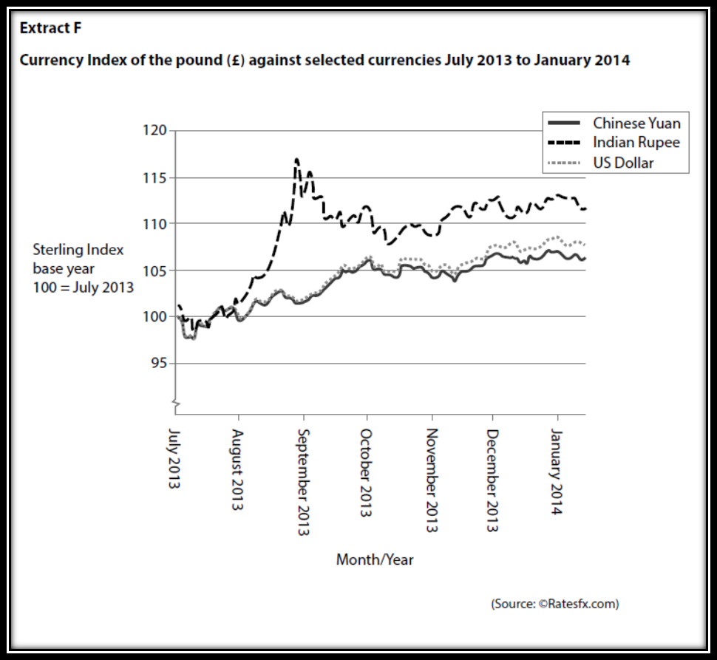
Case study for question 1

Slide 24
Sample question 1
Knowledge 4
Application 4
Analysis
6
Evaluation
6

Slide 25
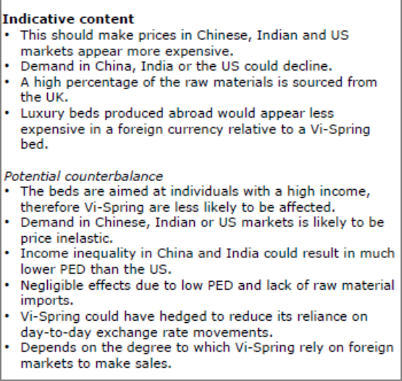
Answer sample question 1

Slide 26
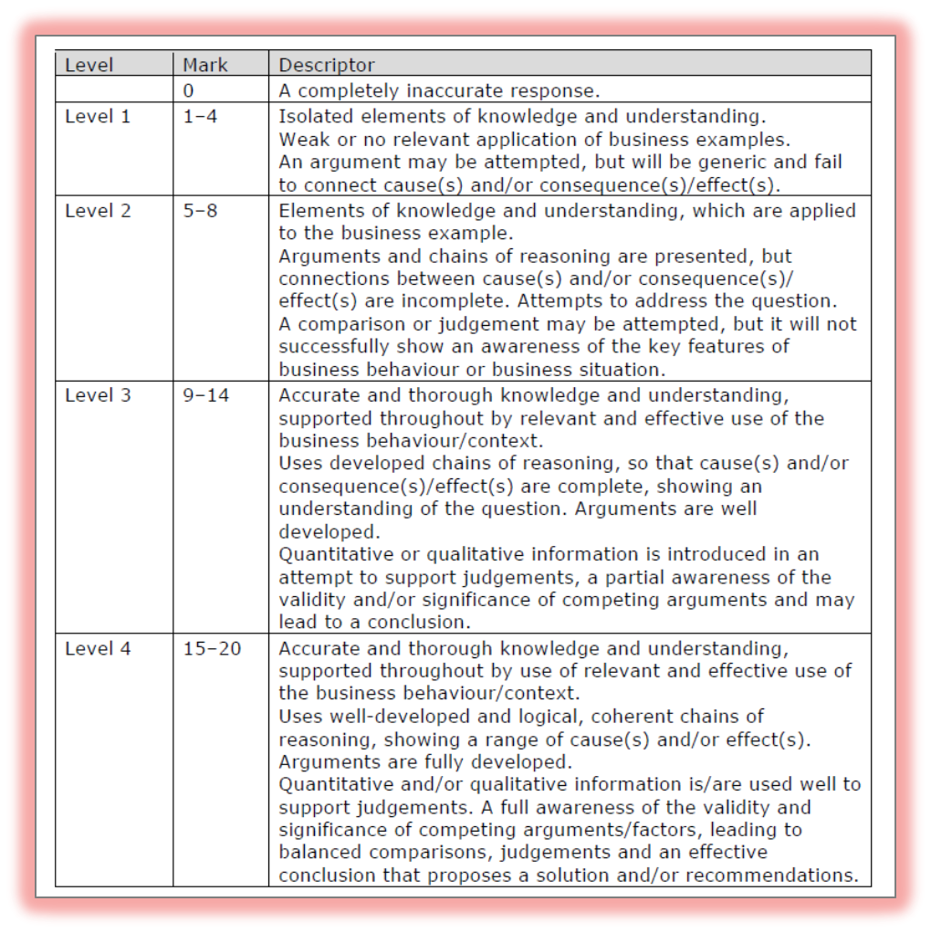
How to level sample question 1

Slide 27
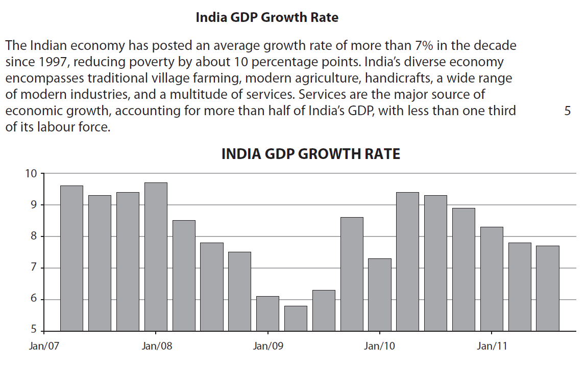
Case study for question 2

Slide 28
Sample question 2
[6]
Knowledge 2
Application 2
Analysis
2
Notes:
This is a legacy question which is why it is 6 marks

Slide 29
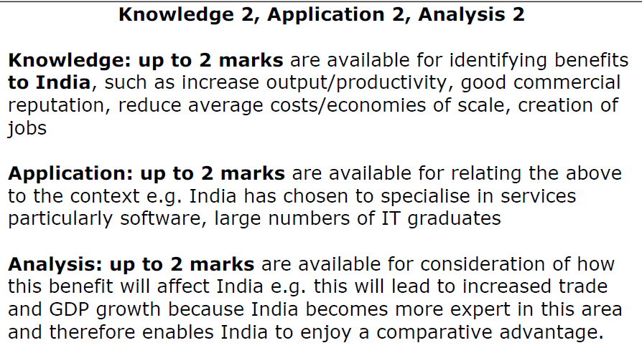
Answer sample question 2

Slide 30
Case study for question 3

Slide 31
Sample question 3
Knowledge 2
Application 2
Analysis
2
Evaluation
3
Notes:
Another legacy question which is why it is 9 marks

Slide 32
Answer sample question 3
e.g. a concentration of productive resources in a particular area of the economy based on comparative Advantage
e.g perhaps referring to the evidence and/or discussing the kind of specialisation that a developed economy like Australia might pursue such as mining and car engines
e.g. specialisation may lead to a competitive advantage as skills and experience lead to greater efficiency and a comparative advantage in production
e.g. specialisation can lead to economies of scale as more resources are devoted to specialisation rather than spread out over many areas, the scale of
production increases bringing both internal and external economies of scale into being
e.g. specialising in such a large new market can mean increased sales and economic growth
e.g. over-reliance can be a problem, if demand falls or if a new competitor emerges there is likely to be a significant impact on the country as risk is not sufficiently spread
e.g other countries in RCEP may choose to compete and may have a lower cost base than a developed economy such as Australia
e.g. if area of specialisation is not sufficiently advanced, low cost rivals may take market share
e.g. commodities may run out in the future or larger reserves are discovered elsewhere

Slide 33
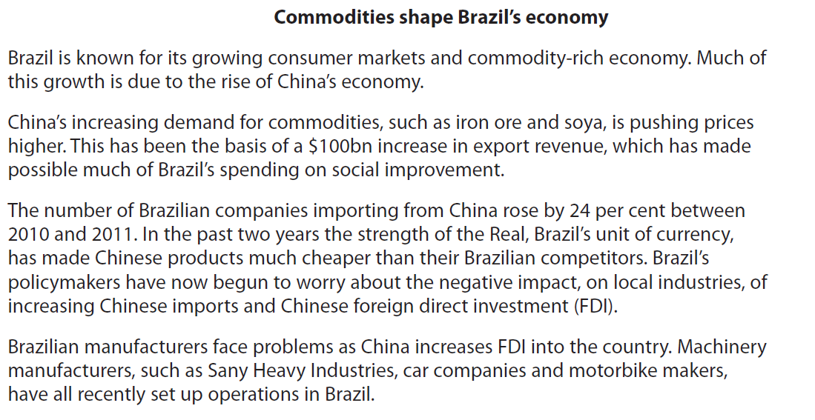
Case Study sample question 4

Slide 34
Sample question 4
[9]
Knowledge 2
Application 2
Analysis
2
Evaluation
3
Notes:
Another legacy question which is why it is 9 marks

Slide 35
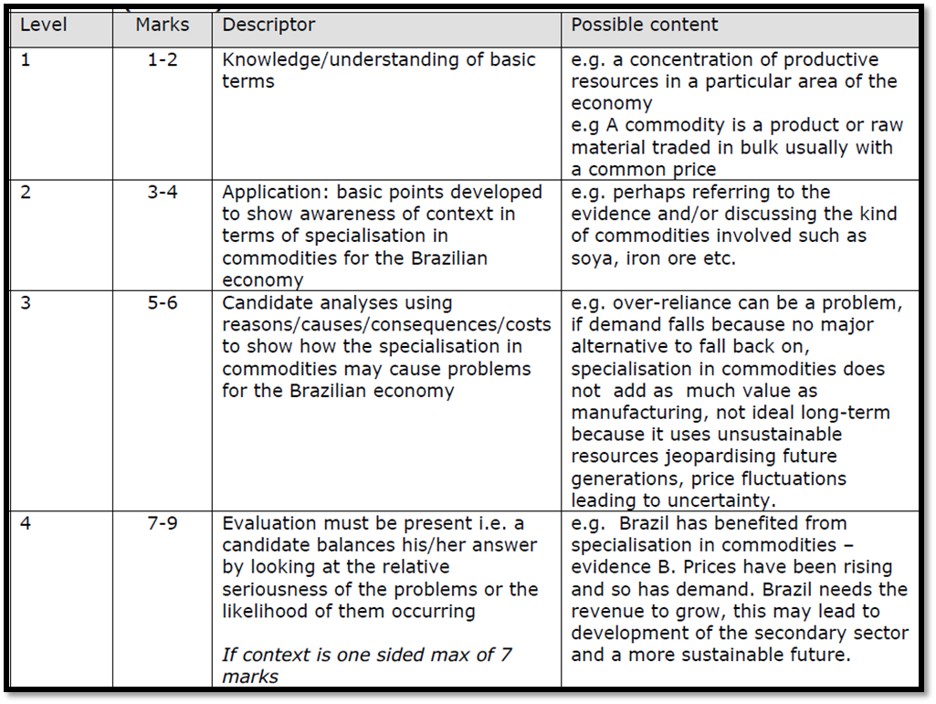
Answer sample question 4

Slide 36
Glossary
Commodities; A commodity is a product or raw material traded in bulk usually with a common price
Specialisation; A method of production where a business or area focuses on the production of a limited scope of products or services in order to gain greater degrees of productive efficiency within the entire system of businesses or areas. Many countries specialise in producing the goods and services that are native to their part of the world.
Comparative advantage; The ability of a firm or individual to produce goods and/or services at a lower opportunity cost than other firms or individuals.
Import; An import is a good brought across a national border, from an external source. The business bringing in the good is called an importer. An import in the receiving country is an export from the sending country.
Export; The term export means shipping the goods and services out of the port of a country. The seller of such goods and services is referred to as an "exporter" and is based in the country of export whereas the overseas based buyer is referred to as an "importer"

